Slide 1
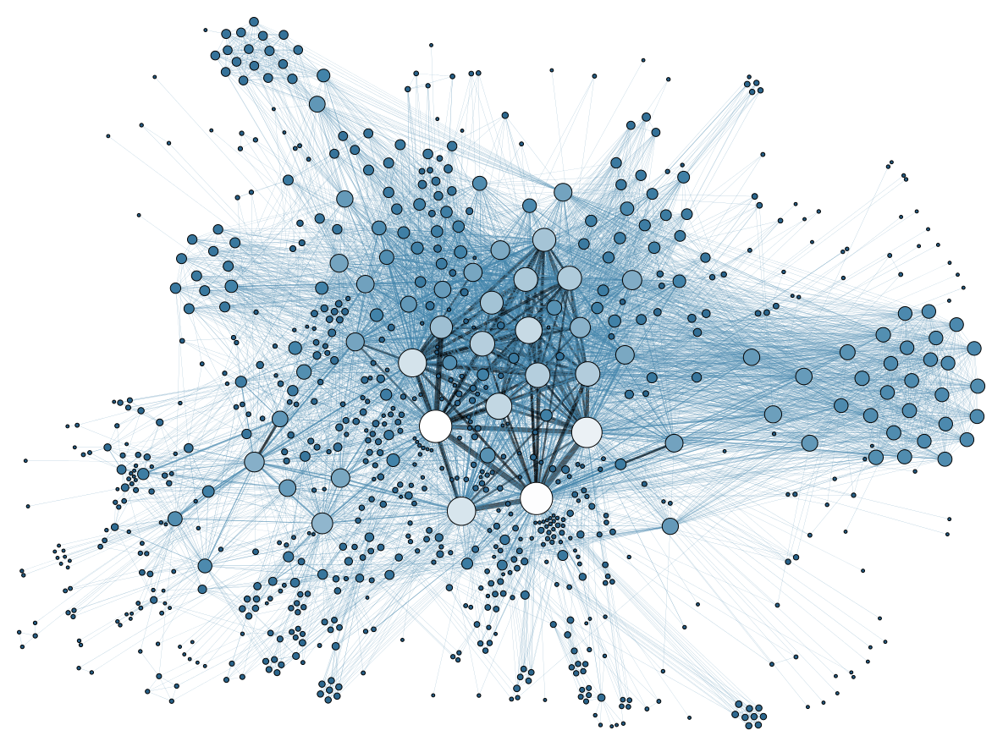
What is a network?
A set of entities
  Nodes, Vertices
Joined via a set of relations
  Links, Ties, Edges

Slide 2
What is a network?
A set of entities
  Nodes, Vertices
Joined via a set of relations
  Links, Ties, Edges
In a point and line plot
  Entities are some shape (e.g., circles)
  Relations are lines

Slide 3
What is a network?
Don’t confuse pictures of networks with the real thing!
In a point and line plot
  Entities are some shape (e.g., circles)
  Relations are lines

Slide 4
What is a network?
Networks
Lots of things in the world are networks
Social
Technological
Biological
The Internet
Schools
Airports
The Brain
Instagram
Workplaces
The WWW
Ecosystems

Slide 5
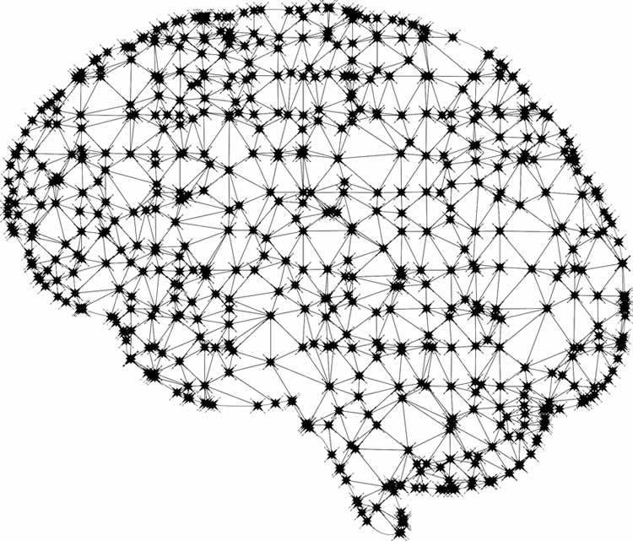
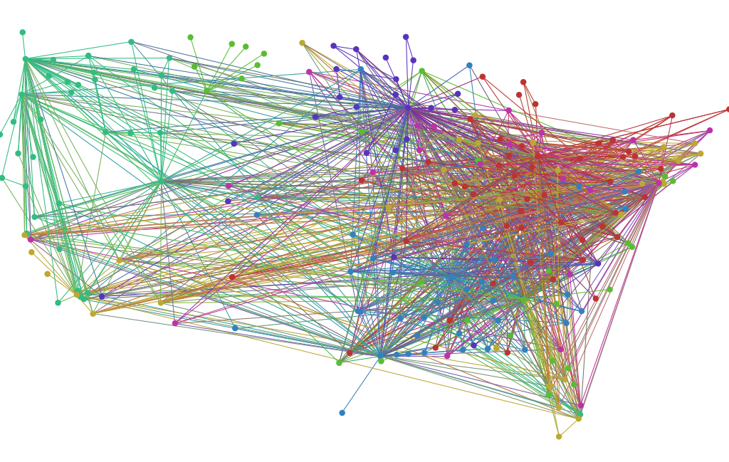
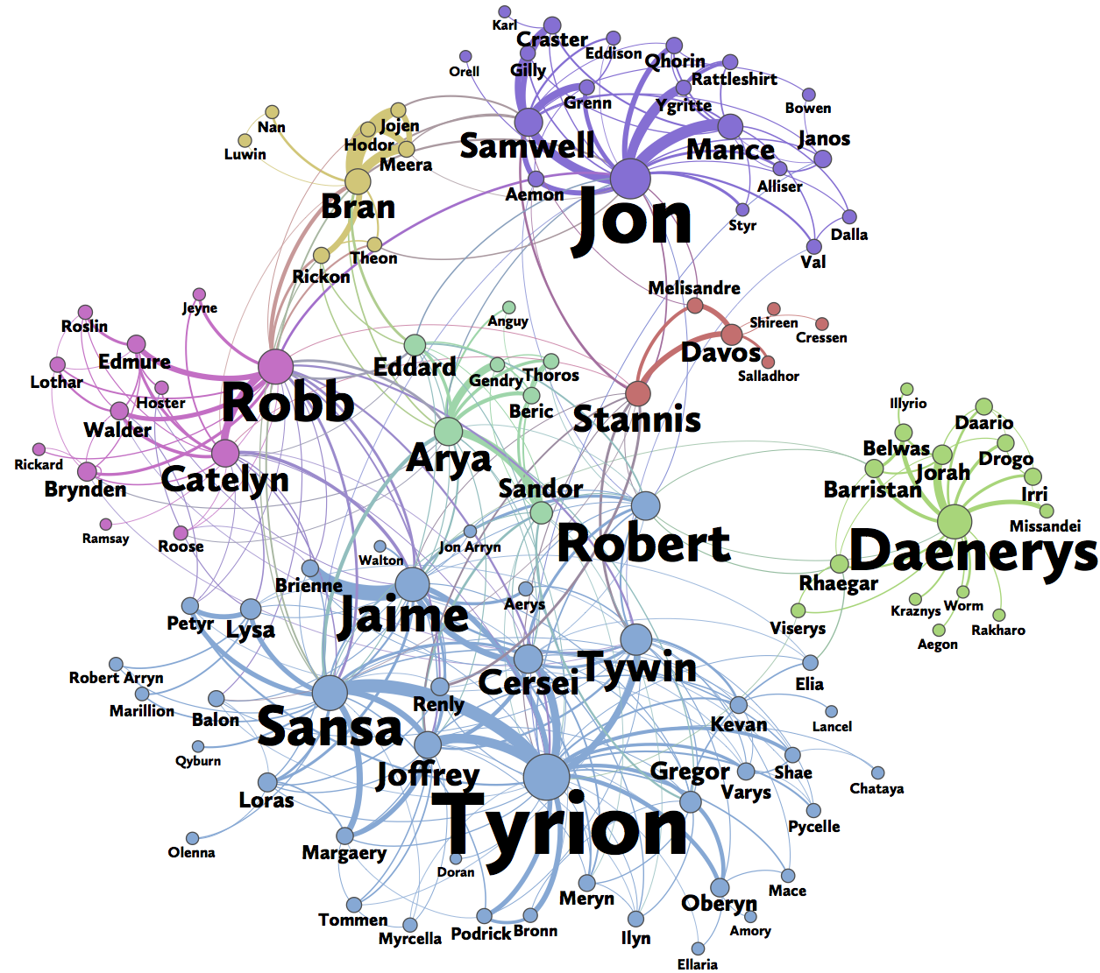
U.S. Airport Network
The Brain’s Neural Network
GoT’s Social Network

Slide 6
What is a social network?
Networks
Some networks are social networks
Social networks link people
Via social relations
Social
Schools
Airports
Instagram
Workplaces
The WWW

Slide 7
What is a social network?
Networks
Some networks are social networks
Social
Schools
Airports
Instagram
Workplaces
The WWW

Slide 8
What is a social network?
Networks
Some networks are both social and technological
Technological
Airports
Instagram
The WWW

Slide 9
What is a social network?
Networks
Some networks are social networks
Some networks are “purely” social
Social
Schools
Instagram
Workplaces

Slide 10
What is a social network?
Networks
Some networks are social networks
In this quarter we will learn about social network analysis (SNA)
Social
We will look mostly at “pure” social networks
Schools
Instagram
Workplaces

Slide 11
What is a social network analysis?
Social Network Analysis
SNA is an interdisciplinary field in social science in charge of studying social networks
Sociology
Anthropology
Psychology
Communication

Slide 12
What is network science?
Network Science
Psychological
Networks
Social Network
Analysis
Network Biology
SNA is part of the larger interdisciplinary field of Network Science
Data Science
Network
Neuroscience

Slide 13
Summary
Networks: Systems of entities linked by relations
  Different kinds: Social, biological, technological, etc.
Social Networks: Systems of people (or groups of people) linked by social relations
Network Science: Interdisciplinary field in charge of studying all types of networks
  Biology, mathematics, computer science, physics, etc.
Social Network Analysis: Interdisciplinary field in charge of studying social networks
  Sociology, psychology, anthropology, communication

Slide 14
Summary
This course is about these two things!
Networks: Systems of entities linked by relations
  Different kinds: Social, biological, technological, etc.
Social Networks: Systems of interactive people (or groups of people) linked by social relations
Network Science: Interdisciplinary field in charge of studying all types of networks
  Biology, mathematics, computer science, physics, etc.
Social Network Analysis: Interdisciplinary field in charge of studying social networks
  Sociology, psychology, anthropology, communication

Slide 15
Social Network Analysis
(SNA)
Social network theories are general statements about how people behave in networks
Social Network Theory
Social Network Measurement
Structural
Holes
Strength of Weak Ties
Degree
Centrality
Network
Density
The two faces of social network analysis

Slide 16
Social Network Analysis
(SNA)
Social network theories tell us what networks do, where they come from and what difference they make for people
Social Network Theory
Social Network Measurement
Structural
Holes
Strength of Weak Ties
Degree
Centrality
Network
Density
The two faces of social network analysis

Slide 17
Social Network Analysis
(SNA)
Social network measurement links concepts defined in social network theories to a mathematical representation
Social Network Theory
Social Network Measurement
Structural
Holes
Strength of Weak Ties
Degree
Centrality
Network
Density
The two faces of social network analysis

Slide 18
Social Network Analysis
(SNA)
Social network measurement helps make natural language concepts (e.g., “popularity”) more precise
Social Network Theory
Social Network Measurement
Structural
Holes
Strength of Weak Ties
Degree
Centrality
Network
Density
The two faces of social network analysis

Slide 19
Social Network Analysis
(SNA)
Social network measurement helps make natural language concepts (e.g., “popularity”) more precise
Social Network Theory
Social Network Measurement
Structural
Holes
Strength of Weak Ties
Degree
Centrality
Network
Density
The two faces of social network analysis

Slide 20


A “Graph”
Social Networks can be mathematically represented in two ways
We will learn how to go back and forth between the two
A “Matrix”
Two mathematical representations of networks

Slide 21
Levels of Analysis in social networks
Individual
1
Dyads
2
Triads
3
Cliques, Communities
4
Whole Network
5
We will be working through all these levels in the course!

Slide 22
Levels of Analysis in social networks
Individual
1
Dyads
2
Triads
3
Cliques, Communities
4
Whole Network
5
We will be working through all these levels in the course!
(But not in this order)

Slide 23
Ties in Social Networks

Slide 24
Levels of Analysis in social networks
Individual
1
Dyads
2
Triads
3
Cliques, Communities
4
Whole Network
5
The first part of the course follows this organization!

Slide 25
Levels of Analysis in social networks
Individual
Tie types and properties
1
Dyads
2
Triads
3
Cliques, Communities
4
Whole Network
5
The first part of the course follows this organization!

Slide 26
Dyads in Social Networks
In a network any two pair of nodes is called a dyad
Dyads can either be:
  Connected
    If there as an edge linking them
  Disconnected
    If there is no edge linking them
A
B
Connected Dyad
D
E
Disconnected Dyad

Slide 27
Dyads in Social Networks
This is a social tie!
In a network any two pair of nodes is called a dyad
Dyads can either be:
  Connected
    If there as an edge linking them
  Disconnected
    If there is no edge linking them
In social networks the link joining connected dyads is called a social tie
A
B
Connected Dyad
D
E
Disconnected Dyad

Slide 28
Dyads in Social Networks
This is a social tie!
Social ties are the fundamental units of social networks
  Like the atom is to physics
  Or the cell is to biology
There are different types of social ties
A
B
Connected Dyad
D
E
Disconnected Dyad

Slide 29
Dyads in Social Networks
This is a social tie!
Social ties are the fundamental units of social networks
  Like the atom is to physics
  Or the cell is to biology
There are different types of social ties
Social networks are built up from a concatenation of social ties
A
B
Connected Dyad
D
E
Disconnected Dyad

Slide 30
Dyads in Social Networks
This is a social tie!
Social ties are the fundamental units of social networks
  Like the atom is to physics
  Or the cell is to biology
There are different types of social ties
Social networks are built up from a concatenation of social ties
  But the absences (lack of ties) matter too!
A
B
Connected Dyad
D
E
Disconnected Dyad

Slide 31
Dyads in Social Networks
This is a social tie!
There are two ways to classify types of social ties in networks
We can either use:
  Sociological Criteria
  Graph Theory Criteria
We can also combine the two
  Sociology + Graph theory =
    Social Network Analysis
A
B
Connected Dyad
D
E
Disconnected Dyad

Slide 32

Types of social ties: Sociological Classification
In social networks there are four different types of social ties
  Similarities, Relations, Interactions, and flows
Borgatti, S. P., Mehra, A., Brass, D. J., & Labianca, G. (2009). Network analysis in the social sciences. Science, 323(5916), 892-895.

Slide 33
Types of social ties: Sociological Classification
In social networks there are four different types of social ties
  Similarities and relations are types of states (static situations)
  Interactions and flows are types of events (processes in time)
Borgatti, S. P., Mehra, A., Brass, D. J., & Labianca, G. (2009). Network analysis in the social sciences. Science, 323(5916), 892-895.

Slide 34





Social Tie Types
Asymmetric
Symmetric
Antisymmetric
Reciprocal
Nonreciprocal
Summary: Types of Social Ties

Slide 35
Social Ties: Sociological classification (Kitts)
Role relations
  Friends, kin, business partners
Interpersonal sentiments and cognitions
  Liking, trusting, acquaintanceship
Behavioral Social Interactions
  Calling, texting, citing, supporting, resource exchange
Opportunity structure for exchange
  Structural holes, brokerage, intermediation
    “Non-ties” matter here
Kitts, J. A. (2014). Beyond networks in structural theories of exchange: Promises from computational social science. In Advances in Group Processes (pp. 263-298). Emerald Group Publishing Limited.

Slide 36
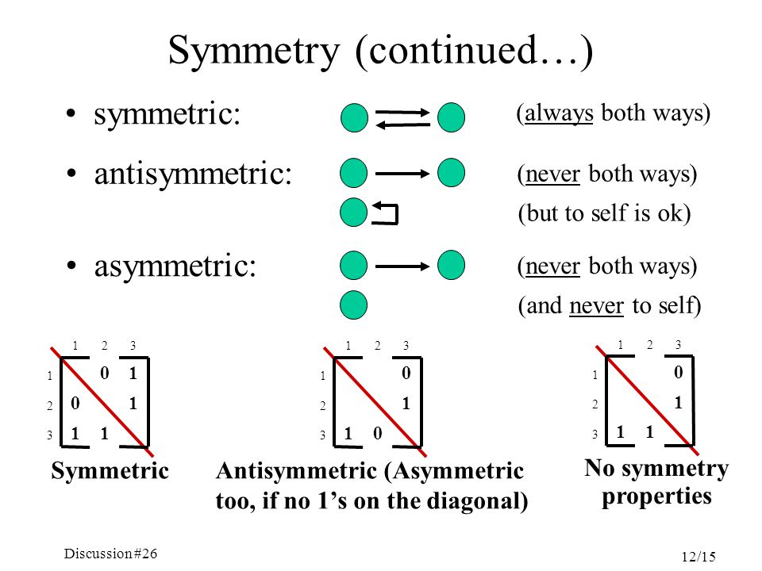
Dyad types: Graph theory classification
Symmetric
  If it exists, if a is linked to b, then b is necessarily linked to a
Asymmetric
  If it exists then if a is linked to b, then it is not a necessity that b is linked to a (but can happen)
Antisymmetric
  If it exists then is a is linked to b, then b cannot by necessity be linked to a

Slide 37
Symmetric kin (being a sibling of)
1st Generation
Antisymmetric kin (parent of, uncle of)
Second Generation
In Families:
  Same generation ties are symmetric
    Sibling/Cousin
  Cross-Generation ties antisymmetric
    Parent/Uncle/Parent’s parent
Third Generation
Social Ties: Linking sociological and graph theoretic types

Slide 38
Symmetric work (coworker, officemate)
Executives
Antisymmetric work (boss, supervisor)
Managers
In Hierarchies or Organizations:
  Same authority level ties are symmetric
  Cross-Authority level ties antisymmetric
Workers
Social Ties: Linking sociological and graph theoretic types

Slide 39
Symmetric work (coworker, officemate)
Executives
Antisymmetric work (boss, supervisor)
Asymmetric work (like, dislike)
Managers
People are usually linked by different types of ties at the same time
  This is called multiplexity
Example:
  People joined via a either symmetric or antisymmetric role relations (e.g., supervisor)
  Can also be linked via an asymmetric sentiment relation (liking, disliking)
Workers
=Multiplexity

Slide 40
Symmetric kin (being a sibling of)
Gma
1st Generation
Antisymmetric kin (parent of, uncle of)
Asymmetric kin (social support)
Mom
Unc
People are usually linked by different types of ties at the same time
  This is called multiplexity
Example:
  People joined via a either symmetric or antisymmetric role relations (e.g., kin ties)
  Can be linked via an asymmetric social support relation
Second Generation
You
Sis
Third Generation
Multiplexity

Slide 41
Properties of Social Ties
In Social Network Analysis social ties can have different properties
  A property of social ties is a characteristic that can be different for ties of the same type
For instance:
  Some ties are new and some ties are old
    New friends versus old friends
  Some ties are durable (hard to break) others are nondurable (easy to break)
    Durable relations (mother) versus non-durable relations (coworker)
  Some ties are frequently activated others are infrequently activated
    Friends you see all the time versus friends you see once in a while
  Some ties are intimate and other ties are not intimate
    Friends you confide in versus Friends that you do not confide in

Slide 42
Tie properties: Strength
In Social Network Analysis social ties can have different properties
  A property of social ties is a characteristic that differentiates ties of the same type
Out of all the properties tie strength is the most important one
  Some ties are strong and some ties are weak
“The strength of a tie is a...combination of the amount of time, the emotional intensity, the intimacy (mutual confiding) and the reciprocal services which characterize the tie” (Granovetter 1973: 1361).
A
B
A
B
Strong Tie
Weak Tie
Granovetter, M. S. (1973). The strength of weak ties. American journal of sociology, 78(6), 1360-1380.

Slide 43
Tie properties: Strength
According to Granovetter, tie strength is a combination of different tie properties
  So it is a “superordinate” property of social ties
Ties are strong if:
  Have lasted for a long time
  Are frequently activated
  Are emotionally intimate
  Feature exchanges of favors
Tie Strength
Duration
Time Spent Together
Emotional Intensity
Intimacy/Confiding
Interaction Freq.

Slide 44
Tie properties: Strength
According to Granovetter, tie strength is a combination of different tie properties
  So it is a “superordinate” property of social ties
Ties are weak if:
  Have recently started
  Are infrequently activated
  Lack emotional intimacy
  Don’t Feature exchanges of favors
Tie Strength
Duration
Time Spent Together
Emotional Intensity
Intimacy/Confiding
Interaction Freq.

Slide 45
Tie properties: Strength
Just having one property (e.g., frequent activation) is not sufficient for a tie to count as strong
  You can see a coworker you hate every weekday
  You can tell an acquaintance an intimate secret
Some ties of a particular type (e.g., kin ties, same race ties) are expected to be strong
  But the don’t have to be!
  You can be estranged from your parents or siblings
Tie Strength
Duration
Time Spent Together
Emotional Intensity
Intimacy/Confiding
Interaction Freq.

Slide 46
Tie properties: Strength
Just having one property (e.g., frequent activation) is not sufficient for a tie to count as strong
  You can see a coworker you hate every weekday
  You can tell an acquaintance an intimate secret
It is better to say that there is a positive correlation between a tie being of some type (e.g., similarity, kin, positive sentiment) and tie strength
    Similar-race ties are likely to be strong
    Kin-ties are likely to be strong
    Coworker ties are likely to be weak
    Positive sentiment ties are likely to be strong
    Same neighborhood ties are likely to be weak
    Acquaintanceship ties are likely to be weak

Slide 47
Tie properties: Strength
Just having one property (e.g., frequent activation) is not sufficient for a tie to count as strong
  You can see a coworker you hate every weekday
  You can tell an acquaintance an intimate secret
Strong ties sound great!
  Does that mean that weak ties are useless?
  No! We will see later one way in which they are pretty useful
Tie Strength
Duration
Time Spent Together
Emotional Intensity
Intimacy/Confiding
Interaction Freq.

Slide 48
Basic Concepts in Graph Theory

Slide 49
What is a graph?
A graph (G) is an abstract mathematical object (not a picture!) consisting of:
  A vertex set V V(G)
    {v₁, v₂, v₃, v₄, v₅, v₆, v₇, v₈}
    Vertices represent actors or entities in the social network
  An edge set, E(G)
    {v₂v₃, v₃v₁, v₃v₅, v₃v₄, v₄v₇, v₅v₂, v₇v₈}
    Edges represent links, ties, relations in the social network
  Such that G = (V, E)
    A graph is a set of two sets!
1
2
3
4
7
5
6
8

Slide 50
Adjacency Relations
Pairs of vertices are adjacent if there is a link joining them
Adjacent Vertices
1
2
3
4
7
5
6
8

Slide 51
Adjacency Relations
Nonadjacent Vertices
Pairs of vertices are adjacent if there is a link joining them
Pairs of vertices are nonadjacent if there is no link joining them
1
2
3
4
7
5
6
8

Slide 52
Adjacency Relations
Pairs of vertices are adjacent if there is a link joining them
Pairs of vertices are nonadjacent if there is no link joining them
Isolates are vertices with no incoming or outgoing links
1
2
3
4
7
5
6
8
Isolate Vertex

Slide 53
Neighborhoods
In a graph, each vertex has a neighborhood
  The neighborhood N(V) of each vertex is the set of all other vertices that are adjacent to it
1
2
3
4
7
5
6
8

Slide 54
Neighborhoods
In a graph, each vertex has a neighborhood
  The neighborhood N(V) of each vertex is the set of all other vertices that are adjacent to it
N(V₃) = {V₁, V₂, V₄, V₅}
1
2
3
4
7
These are the neighbors of vertex 3!
5
6
8

Slide 55
Neighborhoods
In a graph, each vertex has a neighborhood
  The neighborhood N(V) of each vertex is the set of all other vertices that are adjacent to it
Even lonely vertex 6 has a neighborhood
  It just happens to be the empty set!
    N(V₆) = {∅}
1
2
3
4
7
5
6
8
?

Slide 56
Graphs and Subgraphs
In a graph, a subgraph is any vertex or edge subset of the original graph
  In a set, a subset is just a portion of the larger set of members
1
2
3
4
7
5
6
8

Slide 57
Graphs and Subgraphs
In a graph, a subgraph is any vertex or edge subset of the original graph
  In a set, a subset is just a portion of the larger set of members
We can “induce” (create) subgraphs by picking either subsets of vertices or subsets of edges
1
2
3
4
7
5
6
8

Slide 58
Graphs and Subgraphs
In a graph, a subgraph is any vertex or edge subset of the original graph
  In a set, a subset is just a portion of the larger set of members
We can “induce” (create) subgraphs by picking either subsets of vertices or subsets of edges
  Let us make a subgraph by picking the following subset of vertices
    {V₁, V₃, V₆, V₈}
1
2
3
4
7
5
6
8

Slide 59
Graphs and Subgraphs
In a graph, a subgraph is any vertex or edge subset of the original graph
  In a set, a subset is just a portion of the larger set of members
We can “induce” (create) subgraphs by picking either subsets of vertices or subsets of edges
  Let us make a subgraph by picking the following subset of vertices
    {V₁, V₃, V₆, V₈}
  Voila!
1
3
6
8

Slide 60
Graphs and Subgraphs
In a graph, a subgraph is any vertex or edge subset of the original graph
  In a set, a subset is just a portion of the larger set of members
We can “induce” (create) subgraphs by picking either subsets of vertices or subsets of edges
1
2
3
4
7
5
6
8

Slide 61
Graphs and Subgraphs
In a graph, a subgraph is any vertex or edge subset of the original graph
  In a set, a subset is just a portion of the larger set of members
We can “induce” (create) subgraphs by picking either subsets of vertices or subsets of edges
  Let us make another subgraph by picking the following subset of vertices
    {V₃, V₄, V₅, V₇}
1
2
3
4
7
5
6
8

Slide 62
Graphs and Subgraphs
In a graph, a subgraph is any vertex or edge subset of the original graph
  In a set, a subset is just a portion of the larger set of members
We can “induce” (create) subgraphs by picking either subsets of vertices or subsets of edges
  Let us make another subgraph by picking the following subset of vertices
    {V₃, V₄, V₅, V₇}
  Neat!
3
4
7
5

Slide 63
Graphs and Subgraphs
In a graph, a subgraph is any vertex or edge subset of the original graph
  In a set, a subset is just a portion of the larger set of members
We can “induce” (create) subgraphs by picking either subsets of vertices or subsets of edges
1
2
3
4
7
5
6
8

Slide 64
Graphs and Subgraphs
In a graph, a subgraph is any vertex or edge subset of the original graph
  In a set, a subset is just a portion of the larger set of members
We can “induce” (create) subgraphs by picking either subsets of vertices or subsets of edges
  Let us make a subgraph by picking the following subset of edges
    {V₂V₃, V₁V₃, V₄V₇, V₇V₈}
1
2
3
4
7
5
6
8

Slide 65
Graphs and Subgraphs
In a graph, a subgraph is any vertex or edge subset of the original graph
  In a set, a subset is just a portion of the larger set of members
We can “induce” (create) subgraphs by picking either subsets of vertices or subsets of edges
  Let us make a subgraph by picking the following subset of edges
    {V₂V₃, V₁V₃, V₄V₇, V₇V₈}
  Awesome!
1
2
3
4
7
8

Slide 66
Graph Order and Size
The order of a graph is the cardinality of the vertex set (N)
1
2
3
4
7
5
6
8

Slide 67
Graph Order and Size
The order of a graph is the cardinality of the vertex set (N)
  This is the number of vertices:
    |V| = N = 8
1
2
3
4
7
5
6
8

Slide 68
Graph Order and Size
The order of a graph is the cardinality of the vertex set (N)
  This is the number of vertices:
    |V| = N = 8
1
2
3
4
7
The cardinality of a set is the number of elements inside of it!
5
6
8

Slide 69
Graph Order and Size
The order of a graph is the cardinality of the vertex set (N)
  This is the number of vertices:
    |V| = N = 8
The size of a graph is the cardinality of the edge set (M)
1
2
3
4
7
5
6
8

Slide 70
Graph Order and Size
The order of a graph is the cardinality of the vertex set (N)
  This is the number of vertices:
    |V| = N = 8
The size of a graph is the cardinality of the edge set (M)
  This is the number of edges
    |E| = M = 7
1
2
3
4
7
The cardinality of a set is the number of elements inside of it!
5
6
8

Slide 71
Graph Maximum Size
The maximum size of a graph of order N is the number of edges that would exist if graph was complete
1
2
3
4
7
5
6
8

Slide 72
Graph Maximum Size
The maximum size of a graph of order N is the number of edges that would exist if graph was complete
  How many total edges are there now?
1
2
3
4
7
This is a complete graph of order 8!
5
6
8

Slide 73
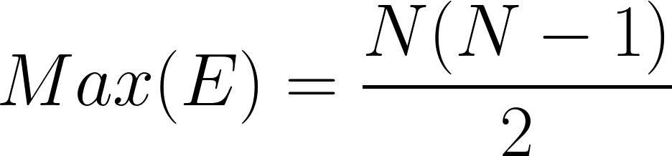
Graph Maximum Size
The maximum size of a graph of order N is the number of edges that would exist if graph was complete
  How many total edges are there now?
We can try to count and get a headache, or we can use math:
1
2
3
4
7
5
6
8

Slide 74
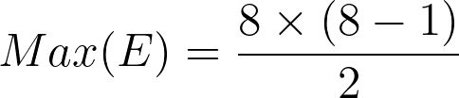
Graph Maximum Size
The maximum size of a graph of order N is the number of edges that would exist if graph was complete
  How many total edges are there now?
We can try to count and get a headache, or we can use math:
1
2
3
4
7
5
6
8

Slide 75
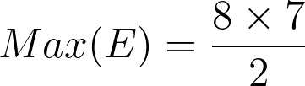
Graph Maximum Size
The maximum size of a graph of order N is the number of edges that would exist if graph was complete
  How many total edges are there now?
We can try to count and get a headache, or we can use math:
1
2
3
4
7
5
6
8

Slide 76
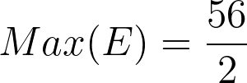
Graph Maximum Size
The maximum size of a graph of order N is the number of edges that would exist if graph was complete
  How many total edges are there now?
We can try to count and get a headache, or we can use math:
1
2
3
4
7
5
6
8

Slide 77

Graph Maximum Size
The maximum size of a graph of order N is the number of edges that would exist if graph was complete
  How many total edges are there now?
We can try to count and get a headache, or we can use math:
1
2
3
4
7
There are 28 edges in there!
5
6
8

Slide 78
Graph Density
We may be interested in how close (or far) a given graph is from its maximum
This called the density of the graph
1
2
3
4
7
5
6
8

Slide 79
Graph Density
We may be interested in how close (or far) a given graph is from its maximum
This called the density of the graph
  To find that out, we can compute the ratio between:
    The observed number of edges (M)
    And the maximum possible for a graph of that order (Max(E))
1
2
3
4
7
5
6
8

Slide 80
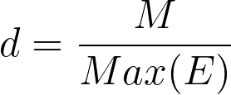
Graph Density
We may be interested in how close (or far) a given graph is from its maximum
This called the density of the graph
  To find that out, we can compute the ratio between:
    The observed number of edges (M)
    And the maximum possible for a graph of that order (Max(E))
1
2
3
4
7
5
6
8

Slide 81
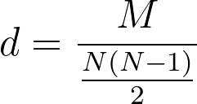
Graph Density
We may be interested in how close (or far) a given graph is from its maximum
This called the density of the graph
  To find that out, we can compute the ratio between:
    The observed number of edges (M)
    And the maximum possible for a graph of that order (Max(E))
1
2
3
4
7
5
6
8

Slide 82
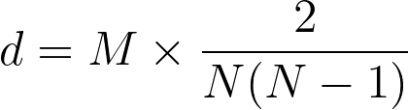
Graph Density
We may be interested in how close (or far) a given graph is from its maximum
This called the density of the graph
  To find that out, we can compute the ratio between:
    The observed number of edges (M)
    And the maximum possible for a graph of that order (Max(E))
1
2
3
4
7
5
6
8

Slide 83
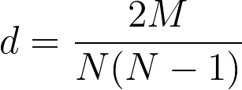
Graph Density
We may be interested in how close (or far) a given graph is from its maximum
This called the density of the graph
  To find that out, we can compute the ratio between:
    The observed number of edges (M)
    And the maximum possible for a graph of that order (Max(E))
1
2
3
4
7
5
6
8

Slide 84
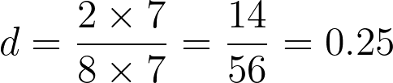
Graph Density
We may be interested in how close (or far) a given graph is from its maximum
This called the density of the graph
  To find that out, we can compute the ratio between:
    The observed number of edges (M)
    And the maximum possible for a graph of that order (Max(E))
1
2
3
4
7
5
6
8

Slide 85
Graph Density
We may be interested in how close (or far) a given graph is from its maximum
This called the density of the graph
  Density (d) is always number between 0 and 1
    The closer d is to zero the closer the observed graph is to the empty graph
    The closer d is to one the closer the observed graph is to the complete graph
1
2
3
4
7
5
6
8

Slide 86
Graph Density
We may also be interested in how close (or far) a given graph is from its maximum
This called the density of the graph
  Density (d) is always number between 0 and 1
    The closer d is to zero the closer the observed graph is to the empty graph
    The closer d is to one the closer the observed graph is to the complete graph
1
2
3
4
7
This graph has a density equal to one!
5
6
8

Slide 87
Graph Density
We may also be interested in how close (or far) a given graph is from its maximum
This called the density of the graph
  Density (d) is always number between 0 and 1
    The closer d is to zero the closer the observed graph is to the empty graph
    The closer d is to one the closer the observed graph is to the complete graph
1
2
3
4
7
This graph has a density equal to zero!
5
6
8

Slide 88
Graph Density
We may also be interested in how close (or far) a given graph is from its maximum
This called the density of the graph
  The graph density can be interpreted in two other ways
    As the percentage of possible edges that are actually present
    As the probability that if we pick two nodes at random from the graph there will be an edge linking them
1
2
3
4
7
5
6
8

Slide 89
Types of graphs

Slide 90
Types of graphs in social network analysis
So far we have considered simple graphs
C
B
E
A
D

Slide 91
Types of graphs in social network analysis
So far we have considered simple graphs
  A graph is a simple graph if:
    There is only one edge joining adjacent nodes
      No multiedges
    There are no self-edges
      No loops
    Edges lack directionality
      No “arrows”
    Edges don’t have any properties
      Weights, signs, etc.
C
B
E
A
D

Slide 92
Types of graphs in social network analysis
So far we have considered simple graphs
  A graph is a simple graph if:
    There is only one edge joining adjacent nodes
      No multiedges
    There are no self-edges
      No loops
    Edges lack directionality
      No “arrows”
    Edges don’t have any properties
      Weights, signs, etc.
C
B
E
A
This is a simple graph!
D

Slide 93
Undirected Graphs
Depending on the type of social tie we are studying we may need to consider other types of graphs
  For symmetric ties like
    Similarities
    Colocation
    Co-memberships
  A type of simple graph called an undirected graph is fine
C
B
E
A
This is an undirected graph!
D

Slide 94
Undirected Graphs
Depending on the type of social tie we are studying we may need to consider other types of graphs
  For symmetric ties like
    Similarities
    Colocation
    Co-memberships
  A type of simple graph called an undirected graph is fine
C
B
E
A
This graph can represent such ties as spending time together or being a member of the same club
D

Slide 95
Undirected Graphs
In an undirected graph there are two kinds of dyads
C
B
E
A
Reminder: A dyad is a subgraph of order 2!
D

Slide 96
Undirected Graphs
In an undirected graph there are two kinds of dyads
  Connected Dyads
    Like the B and E Dyad
C
B
E
A
Reminder: A dyad is a subgraph of order 2!
D

Slide 97
Undirected Graphs
In an undirected graph there are two kinds of dyads
  Connected Dyads
    Like the B and E Dyad
  Disconnected Dyads
    Like the B and D dyad
C
B
E
A
Reminder: A dyad is a subgraph of order 2!
D

Slide 98
Types of graphs in social network analysis
What if the relationship we are studying is asymmetric?
  Knowing someone
  Giving advice
  Providing support
C
B
E
A
D

Slide 99
Directed Graphs
What if the relationship we are studying is asymmetric?
  Knowing someone
  Giving advice
  Providing support
Then we need a graph that represents:
  Directionality
  Reciprocity
This is called a directed graph
C
B
E
A
D

Slide 100
Directed Graphs
What if the relationship we are studying is asymmetric?
  Knowing someone
  Giving advice
  Providing support
Then we need a graph that represents:
  Directionality
  Reciprocity
This is called a directed graph
  Directed graphs are also called digraphs
C
B
E
A
D

Slide 101
Directed Graphs
What if the relationship we are studying is asymmetric?
  Knowing someone
  Giving advice
  Providing support
Then we need a graph that represents:
  Directionality
  Reciprocity
This is called a directed graph
  Directed graphs are also called digraphs
C
B
E
A
This graph can represent an advice network!
D

Slide 102
Directed Graphs
In a directed graph each edge has:
  A source node
  A destination node
C
B
E
A
This graph can also represent an exchange network!
D

Slide 103
Directed Graphs
In a directed graph each edge has:
  A source node
  A destination node
In the edge BE
  B is the source node
  E is the destination
C
B
E
A
This graph can represent an advice network!
D

Slide 104
Directed Graphs
In a directed graph each edge has:
  A source node
  A destination node
In the edge BE
  B is the source node
  E is the destination
In the edge EB
  E is the source node
  B is the destination node
C
B
E
A
This graph can represent an advice network!
D

Slide 105
Directed Graphs
In a directed graph each edge has:
  A source node
  A destination node
In the edge BE
  B is the source node
  E is the destination
In the edge EB
  E is the source node
  B is the destination node
C
B
E
A
This graph can represent an advice network!
D

Slide 106
Directed Graphs
In a directed graph there are three kinds of dyads
C
B
E
A
D

Slide 107
Directed Graphs
In a directed graph there are three kinds of dyads
  Reciprocal dyads
    Both directed edges present like the B and E dyad
C
B
E
A
D

Slide 108
Directed Graphs
In a directed graph there are three kinds of dyads
  Reciprocal dyads
    Both directed edges present like the B and E dyad
  Nonreciprocal dyads
    Only one directed edge present like the C and E dyad
C
B
E
A
D

Slide 109
Directed Graphs
In a directed graph there are three kinds of dyads
  Reciprocal dyads
    Both directed edges present like the B and E dyad
  Nonreciprocal dyads
    Only one directed edge present like the C and E dyad
  Disconnected dyads
    Neither directed edge present
C
B
E
A
D

Slide 110
Directed Graphs
In a directed graph there are three kinds of dyads
  Reciprocal dyads (mutual)
    Both directed edges present like the B and E dyad
  Nonreciprocal dyads (asymmetric)
    Only one directed edge present like the C and E dyad
  Disconnected dyads (null)
    Neither directed edge present
C
B
E
A
D
Sometimes people use the terminology in parentheses to refer to the three types of dyads in directed graphs

Slide 111
Node neighborhoods in directed graphs
In undirected graphs nodes have a single set of neighbors
C
B
E
A
D

Slide 112
Node neighborhoods in directed graphs
In undirected graphs nodes have a single set of neighbors
  N(E) = {B, C, D}
C
B
E
A
D

Slide 113
Node neighborhoods in directed graphs
In directed graphs nodes have two separate set of neighbors:
  Out-neighbors
  In-neighbors
C
B
E
A
D

Slide 114
Node neighborhoods in directed graphs
In directed graphs nodes have two separate set of neighbors:
  Out-neighbors
  In-neighbors
Out-neighbors of E:
  Set of nodes incident to arcs that have E as the source node
    N_{out}(E) = {B, D}
C
B
E
A
D

Slide 115
Node neighborhoods in directed graphs
In directed graphs nodes have two separate set of neighbors:
  Out-neighbors
  In-neighbors
Out-neighbors of E:
  Set of nodes incident to arcs that have E as the source node
    N_{out}(E) = {B, D}
In-neighbors of E:
  Set of nodes incident to arcs that have E as the destination node
    N_{In}(E) = {B, D, C}
C
B
E
A
D

Slide 116
Tree Graphs
What if the relationship we are studying is antisymmetric?
  Giving orders to (in an army)
  Being the parent of
  Being someone’s supervisor
Then we need a graph that represents:
  Unidirectionality
  Nonreciprocity
This is called a tree graph
C
B
E
A
D

Slide 117
Tree Graphs
What if the relationship we are studying is antisymmetric?
  Giving orders to (in an army)
  Being the parent of
  Being someone’s supervisor
Then we need a graph that represents:
  Unidirectionality
  Nonreciprocity
This is called a tree graph
C
B
E
A
D

Slide 118
Tree Graphs
Tree graphs can always be redrawn to reveal the hierarchy of relations:
C
B
E
A
D

Slide 119
Tree Graphs
C
Tree graphs can always be redrawn to reveal the hierarchy of relations:
E
A
B
D

Slide 120
Tree Graphs
C
Tree graphs can always be redrawn to reveal the hierarchy of relations:
  Nodes that only send but do not receive ties are at the top
E
A
B
D

Slide 121
Tree Graphs
C
Tree graphs can always be redrawn to reveal the hierarchy of relations:
  Nodes that only send but do not receive ties are at the top
  Nodes that only receive but do not send ties are at the bottom
E
A
B
D

Slide 122
Tree Graphs
C
Tree graphs can always be redrawn to reveal the hierarchy of relations:
  Nodes that only send but do not receive ties are at the top
  Nodes that only receive but do not send ties are at the bottom
  Nodes that both send and receive ties are in the middle
E
A
B
D

Slide 123

Weighted graphs
Weighted graphs are a special type of graph featuring:
  Numerical values associated with each edge
  This is called the edge weight (w_{uv})
  G = {E, V, w}
We can go from weighted to simple binary graphs by using a cutoff:
  a_{ij} = 1 if w_{ij} > ϴ, else a_{ij} = 0
  Binary graphs can be thought of as a special (truncated) case of weighted graphs

Slide 124
Weighted graphs
Weighted graphs are a special type of graph featuring:
  Numerical values associated with each edge
  This is called the edge weight (w_{uv})
  G = {E, V, w}
We can go from weighted to simple binary graphs by using a cutoff:
  a_{ij} = 1 if w_{ij} > ϴ, else a_{ij} = 0
  Binary graphs can be thought of as a special (truncated) case of weighted graphs
Weighted graphs can be either directed or undirected
Directed Weighted Graph

Slide 125
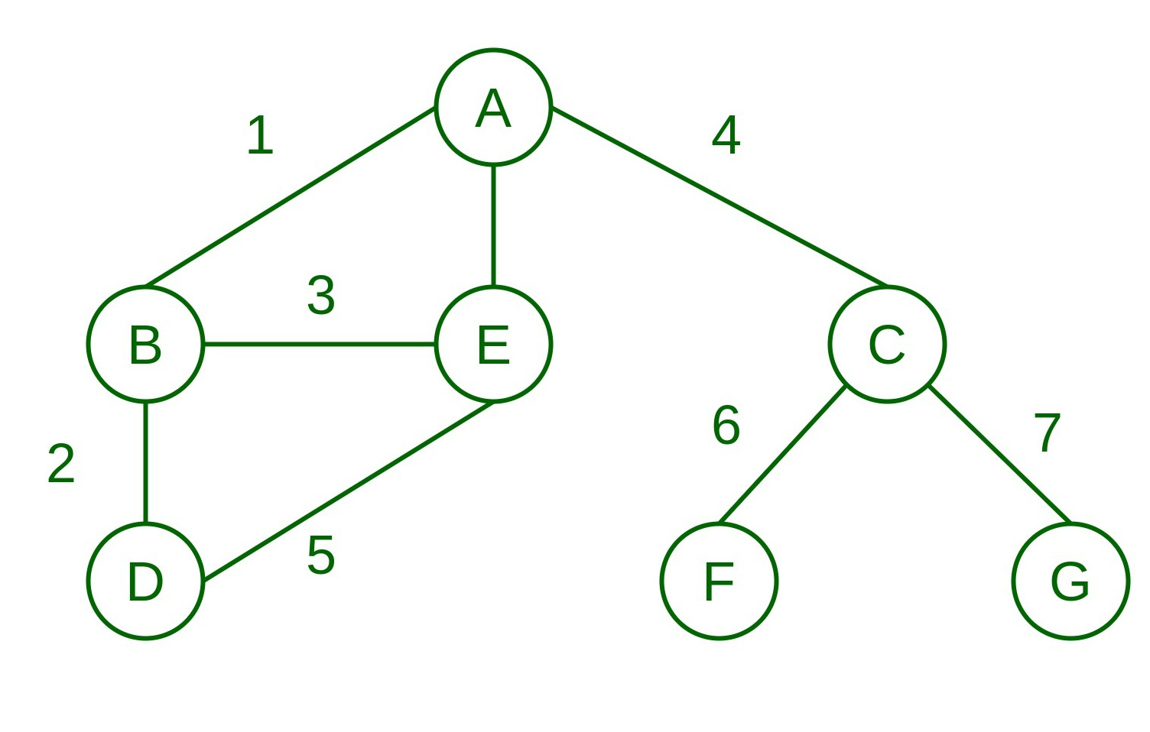
Weighted graphs
Weighted graphs are a special type of graph featuring:
  Numerical values associated with each edge
  This is called the edge weight (w_{uv})
  G = {E, V, w}
We can go from weighted to simple binary graphs by using a cutoff:
  a_{ij} = 1 if w_{ij} > ϴ, else a_{ij} = 0
  Binary graphs can be thought of as a special (truncated) case of weighted graphs
Weighted graphs can be either directed or undirected
Undirected Weighted Graph

Slide 126
Weighted graphs
Weighted graphs can be used to represent weighted networks
  In a weighted network we not only measure the presence/absence of a tie, but also the strength of the relationship:
    Proportion of time i and j spend together
    Number of texts from i to j
    Number of times i retweets j
    Number of times i goes to j for help or advice
Directed Weighted Graph

Slide 127
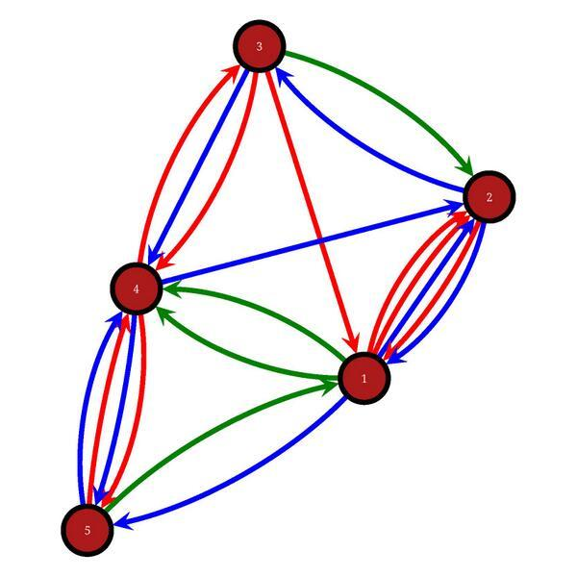
Multigraphs
Multigraphs are a special kind of graph featuring:
  A single vertex set
  More than one edge set
A multigraph is a set in which other graphs with unique edge sets are members
  G = {(V, E₁), (V, E₂), (V, E₃), … (V, E_{m})}
  A simple graph is a special (one layer) case of a multigraph!
3
2
4
1
5

Slide 128
Multigraphs
Multigraphs are a special kind of graph featuring:
  A single vertex set
  More than one edge set
A multigraph can be thought of as a set in which other graphs with unique edge sets are the members
  G = {(V, E₁), (V, E₂), (V, E₃), … (V, E_{m})}
  A simple graph can be thought of as a special (one layer) case of a multigraph!
Multigraphs can be directed or undirected
3
2
4
1
5
Directed Multigraph

Slide 129
Multiplex and multilayer networks
Multigraphs may be used to represent the social network concept of multiplex or multilayer networks
  Multiplexity exists when there is more than one basis of connectivity between pairs of people in a network
    E.g., a friend who is also an advisor who is also a member of your congregation
  Networks have different “layers” when we measure different types of ties on the same nodes:
    E.g., Advice, liking, hanging out, texting
3
2
4
1
Advice
5
Likes
Emotional Support

Slide 130
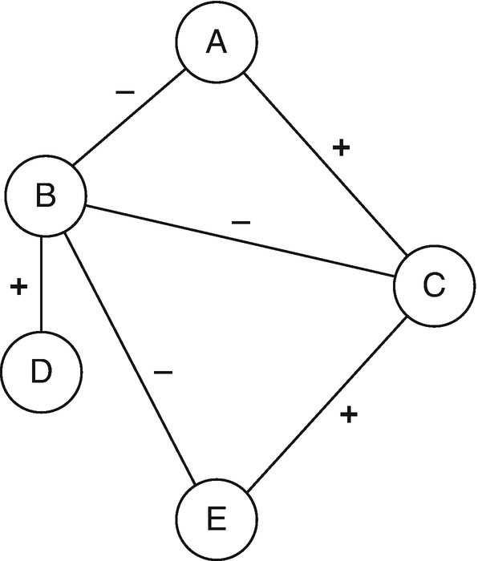
Signed graphs
Signed graphs are a special kind of (multi)graph featuring:
  One edge set (V)
  Two disjoint sets of edges:
    Positive links (E⁺)
    Negative links (E⁻)
      G= {V, E⁺, E⁻}

Slide 131
Signed graphs
Signed graphs are a special kind of (multi)graph featuring:
  One edge set (V)
  Two disjoint sets of edges:
    Positive links (E⁺)
    Negative links (E⁻)
      G= {V, E⁺, E⁻}
Two sets are disjoint when they don’t share any members! (Their intersection is the empty set)

Slide 132
Signed graphs
Signed graphs are a special kind of (multi)graph featuring:
  One edge set (V)
  Two disjoint sets of edges:
    Positive links (E⁺)
    Negative links (E⁻)
      G= {V, E⁺, E⁻}
Signed graphs can be either directed or undirected
Undirected Signed Graph

Slide 133
Signed graphs
Signed graphs are can be used to represent sentiment networks
  In a sentiment network edges have a bipolar emotional or cognitive value
    Likes and dislikes
    Alliances/Enmities
The network theory of structural balance deals with sentiment relations

Slide 134
Signed graphs
Signed graphs are can be used to represent sentiment networks
  In a sentiment network edges have a bipolar emotional or cognitive value
    Likes and dislikes
    Alliances/Enmities
The network theory of structural balance deals with sentiment relations
  Can we predict the sign of a new edge based on the sign of other edges?
?

Slide 135
Signed graphs
Signed graphs are can be used to represent sentiment networks
  In a sentiment network edges have a bipolar emotional or cognitive value
    Likes and dislikes
    Alliances/Enmities
The network theory of structural balance deals with sentiment relations
  Can we predict the sign of an edge based on the sign of other edges?
  Yes! (If people prefer balance)
⎼
This tie should be negative!

Slide 136
Ties and graphs summary
Tie Type | Graph Type
Symmetric | Undirected
Asymmetric | Directed
Anti-Symmetric | Tree
Tie Property | Graph Type
Multiplexity | Multigraph
Strength | Weighted
Valenced | Signed

Slide 137
Indirect Connections:Basic Concepts

Slide 138
Indirect relationships
Adjacency relations get at direct connections between vertices
C
B
E
A
D

Slide 139
Indirect relationships
E and C are Adjacent Vertices
Adjacency relations get at direct connections between vertices
C
B
E
A
D

Slide 140
Indirect relationships
Adjacency relations get at direct connections between vertices
But sometimes we are interested in indirect connections
  B and D are “connected” in the sense that they have a neighbor (E) in common
C
B
E
A
D
What’s the relation between B and D?

Slide 141
Indirect relationships
Adjacency relations get at direct connections between vertices
But sometimes we are interested in indirect connections
  B and D are “connected” in the sense that they have a neighbor (E) in common
  But they are not adjacent
  This is type of indirect connection between vertices in a graph
C
B
E
A
D
What’s the relation between B and D?

Slide 142
Indirect relationships
Adjacency relations get at direct connections between vertices
But sometimes we are interested in indirect connections
  In graph theory indirect connections are defined using the concepts of:
    Path
    Connectivity
    Reachability
C
B
E
A
D
What’s the relation between B and D?

Slide 143
Paths
In graph theory a path is a sequence of alternating nodes and edges that:
  Begins with an origin node
  Ends with a destination node
  Includes at least one more node beyond these two
  Does not repeat any nodes in the sequence
C
B
E
A
D

Slide 144
Paths
We usually write the path using the edge sequence
  B―D = {BE, ED}
We say that node B can reach node D via a path
C
B
E
A
D
Node B can reach node D via the {BE, ED} path!

Slide 145
Paths
In an undirected graph if a given path exists
  B―D = {BE, ED}
Then the reverse path also exists
  D―B = {DE, EB}
C
B
E
A
D
Node D can also reach node B via the {DE, EB} path!

Slide 146
Paths
The same two nodes may be connected via multiple paths
  B can reach A via:
    {BE, ED, DA}
C
B
E
A
D

Slide 147
Paths
In the B―D = {BE, ED} path:
  B is the origin node
  D is the destination node
  E is the inner node
Note that if the path was instead D―B
  Then D would be the origin and E the destination!
  Even in a undirected graph paths have a direction!
Origin node
C
B
E
A
D
Inner node
Destination node

Slide 148
Paths
In the B―D = {BE, ED} path:
  B is the origin node
  D is the destination node
  E is the inner node
The main characteristic of a path is its length
  The length of a path is the number of edges in it
    We refer to path length using the letter l
  For the B―D path:
    l = 2
C
B
E
A
D
A path of length two!

Slide 149
Paths
The same two nodes may be connected via multiple paths
  B can reach A via:
C
B
E
A
D

Slide 150
Paths
The same two nodes may be connected via multiple paths
  B can reach A via:
    {BE, ED, DA}
    {BE, EC, CA}
C
B
E
A
D

Slide 151
Paths
The same two nodes may be connected via multiple paths
  B can reach A via:
    {BE, ED, DA}
    {BE, EC, CA}
    {BE, ED, DC, CA}
C
B
E
A
D

Slide 152
Paths
The same two nodes may be connected via multiple paths
  B can reach A via:
    {BE, ED, DA}
    {BE, EC, CA}
    {BE, ED, DC, CA}
    {BE, EC, CD, DA}
C
B
E
A
D

Slide 153
Paths
The same two nodes may be connected via multiple paths
  B can reach A via:
    {BE, ED, DA}
    {BE, EC, CA}
    {BE, ED, DC, CA}
    {BE, EC, CD, DA}
  These paths are different lengths!
C
B
E
A
D

Slide 154
Paths
The same two nodes may be connected via multiple paths
  B can reach A via:
    {BE, ED, DA}
    {BE, EC, CA}
    {BE, ED, DC, CA}
    {BE, EC, CD, DA}
  These paths are different lengths!
  But the shortest path(s) connecting B and A is:
    l = 3
C
B
E
A
D

Slide 155
Cycles
A special case:
  What happens when a path begins and ends with the same node?
This is called a cycle
C
B
E
A
D

Slide 156
Cycles
A special case:
  What happens when a path begins and ends with the same node?
This is called a cycle
  The path {ED, DA, AC, CE} defines a cycle of length 4
C
B
E
A
D

Slide 157
Cycles
A special case:
  What happens when a path begins and ends with the same node?
This is called a cycle
  The path {ED, DA, AC, CE} defines a cycle of length 4
  The path {ED, DC, CE} defines a cycle of length 3
    This is the smallest length a cycle can be!
C
B
E
A
D

Slide 158
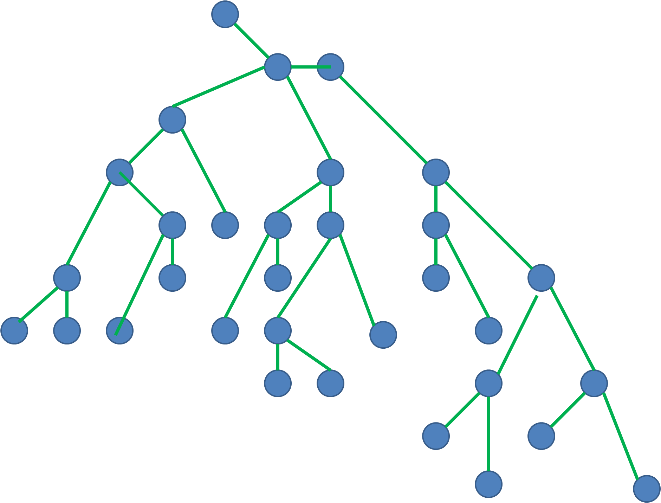
Cycles
A special case:
  What happens when a path begins and ends with the same node?
This is called a cycle
Tree graphs can’t have cycles
  That’s why they are sometimes called acyclic graphs
Makes sense for antisymmetric links!

Slide 159
Directed Paths
How do paths work in directed graphs?
  Same as before except that you need to respect direction!
C
B
E
A
D

Slide 160
Directed Paths
How do paths work in directed graphs?
  Same as before except that you need to respect direction!
There are two directed paths of length 3 from A to B:
  {AD, DE, EB}
C
B
E
A
D

Slide 161
Directed Paths
How do paths work in directed graphs
  Same as before except that you need to respect direction!
There are two directed paths of length 3 from A to B:
  {AD, DE, EB}
  {AC, CE, EB}
C
B
E
A
D

Slide 162
Directed Paths
How do paths work in directed graphs
  Same as before except that you need to respect direction!
There are also two directed paths of length 4 from A to B:
  {AC, CD, DE, EB}
C
B
E
A
D

Slide 163
Directed Paths
How do paths work in directed graphs
  Same as before except that you need to respect direction!
There are also two directed paths of length 4 from A to B:
  {AC, CD, DE, EB}
  {AD, DC, CE, EB}
C
B
E
A
D

Slide 164
Directed Paths
How do paths work in directed graphs
  Same as before except that you need to respect direction!
But there is no directed path connecting B to A!
C
B
E
A
?
D

Slide 165
Directed Paths
How do paths work in directed graphs
  Same as before except that you need to respect direction!
But there is no directed path connecting B to A!
  That means that while A can reach B
  B cannot reach A
C
B
E
A
D
In directed graphs the reachability relation is asymmetric!

Slide 166
Directed Paths
How do paths work in directed graphs
  Same as before except that you need to respect direction!
But there is no directed path connecting B to A!
  That means that while A can reach B
  B cannot reach A
In a directed graph:
  Nonadjacent nodes may be mutually reachable
C
B
E
A
D
B and D are mutually reachable: B can reach D (blue directed path) and D can reach B (red directed path)

Slide 167
Directed Paths
How do paths work in directed graphs
  Same as before except that you need to respect direction!
But there is no directed path connecting B to A!
  That means that while A can reach B
  B cannot reach A
In a directed graph:
  Nonadjacent nodes may be mutually reachable
C
B
E
A
D
A and B are NOT mutually reachable: A can reach B (red directed path) but B cannot reach A

Slide 168
From Graph to Matrix

Slide 169
What is a matrix?
Rectangular array of numbers arranged in rows and columns
  The objects in the rows is the row dimension (i)
  The objects in the columns is the column dimension (j)
 | Mon | Tues | Wed | Thurs | Fri
Pears
Grapes
Oranges
Bananas

Slide 170
What is a matrix?
Rectangular array of numbers arranged in rows and columns
  The objects in the rows is the row dimension (i)
  The objects in the columns is the column dimension (j)
In this example
  Row dimension is:
    Fruits
  Column dimension is:
    Weekdays
 | Mon | Tues | Wed | Thurs | Fri
Pears
Grapes
Oranges
Bananas

Slide 171
What is a matrix?
The number of objects in each dimension define the dimensions of the matrix
  Matrix dimensions are written R X C (pronounced “R by C”)
    R is the number of row objects and C is the number of column objects
In this example
  Row dimension is:
    Fruits
  Column dimension is:
    Weekdays
 | Mon | Tues | Wed | Thurs | Fri
Pears
Grapes
Oranges
Bananas

Slide 172
What is a matrix?
The number of objects in each dimension define the dimensions of the matrix
  Matrix dimensions are written R X C (pronounced “R by C”)
    R is the number of row objects and C is the number of column objects
In this example
  Row dimension is:
    Fruits
  Column dimension is:
    Weekdays
 | Mon | Tues | Wed | Thurs | Fri
Pears
Grapes
Oranges
Bananas
This matrix is 4 X 5!

Slide 173
What is a matrix?
The number of objects in each dimension define the dimensions of the matrix
  Matrix dimensions are written R X C (pronounced “R by C”)
    R is the number of row objects and C is the number of column objects
Cells record:
  Number of times you ate the row fruit in the column day
 | Mon | Tues | Wed | Thurs | Fri
Pears | 2 | 0 | 4 | 2 | 1
Grapes | 0 | 4 | 0 | 3 | 1
Oranges | 2 | 1 | 3 | 5 | 0
Bananas | 2 | 0 | 5 | 2 | 3

Slide 174
What is a matrix?
The number of objects in each dimension define the dimensions of the matrix
  Matrix dimensions are written R X C (pronounced “R by C”)
    R is the number of row objects and C is the number of column objects
If we call this matrix A then:
  A_{Grapes, Wed} = 0
  A_{Bananas, Thurs}= 2
  A_{Pears, Fri} = 1
 | Mon | Tues | Wed | Thurs | Fri
Pears | 2 | 0 | 4 | 2 | 1
Grapes | 0 | 4 | 0 | 3 | 1
Oranges | 2 | 1 | 3 | 5 | 0
Bananas | 2 | 0 | 5 | 2 | 3

Slide 175

The Adjacency Matrix
Adjacency relations between vertices in a graph can be represented using a matrix
Undirected Graph

Slide 176
The Adjacency Matrix
Adjacency relations between vertices in a graph can be represented using a matrix
Undirected Graph
 | a | b | c | d | e
a | --
b |  | --
c |  |  | --
d |  |  |  | --
e |  |  |  |  | --

Slide 177
The Adjacency Matrix
Adjacency relations between vertices in a graph can be represented using a matrix
This is called the adjacency matrix
Undirected Graph
 | a | b | c | d | e
a | --
b |  | --
c |  |  | --
d |  |  |  | --
e |  |  |  |  | --

Slide 178
The Adjacency Matrix
Adjacency relations between vertices in a graph can be represented using a matrix
This is called the adjacency matrix
  In this matrix:
    The row objects are the vertices in the graph
    And so are the column objects!
Undirected Graph
 | a | b | c | d | e
a | --
b |  | --
c |  |  | --
d |  |  |  | --
e |  |  |  |  | --

Slide 179
The Adjacency Matrix
Adjacency relations between vertices in a graph can be represented using a matrix
This is called the adjacency matrix
  The adjacency matrix is square because the number of rows is the same as the number of columns
    R = C = 5
Undirected Graph
 | a | b | c | d | e
a | --
b |  | --
c |  |  | --
d |  |  |  | --
e |  |  |  |  | --
This matrix is 5 X 5!

Slide 180
The Adjacency Matrix
It is conventional to:
  Refer to the whole matrix by its name usually a capital letter like A
  Refer to any row object with the letter i
  Refer to any column object with the letter j
  Refer to any cell in the matrix by the matrix name followed by a row subscript and a column subscript:
Undirected Graph
 | a | b | c | d | e
a | --
b |  | --
c |  |  | --
d |  |  |  | --
e |  |  |  |  | --

Slide 181
The Adjacency Matrix
It is conventional to:
  Refer to the whole matrix by its name usually a capital letter like A
  Refer to any row object with the letter i
  Refer to any column object with the letter j
  Refer to any cell in the matrix by the matrix name followed by a row subscript and a column subscript:
    A_{ij} is the cell corresponding to row i and column j of matrix A
Undirected Graph
 | a | b | c | d | e
a | --
b |  | --
c |  |  | --
d |  |  |  | --
e |  |  |  |  | --

Slide 182
The Adjacency Matrix
It is conventional to:
  Refer to the whole matrix by its name usually a capital letter like A
  Refer to any row object with the letter i
  Refer to any column object with the letter j
  Refer to any cell in the matrix by the matrix name followed by a row subscript and a column subscript:
    A_{ij} is the cell corresponding to row i and column j of matrix A
  The cells in which i = j is called the matrix diagonal
Undirected Graph
 | a | b | c | d | e
a | --
b |  | --
c |  |  | --
d |  |  |  | --
e |  |  |  |  | --

Slide 183
The Adjacency Matrix
We can refer to particular cells in the adjacency matrix in two ways:
Undirected Graph
 | a | b | c | d | e
a | --
b |  | --
c |  |  | --
d |  |  |  | --
e |  |  |  |  | --

Slide 184
The Adjacency Matrix
We can refer to particular cells in the adjacency matrix in two ways:
  By typing the matrix name followed by the names of the row object and the column object:
    A_{c,d}
Undirected Graph
 | a | b | c | d | e
a | --
b |  | --
c |  |  | --
d |  |  |  | --
e |  |  |  |  | --

Slide 185
The Adjacency Matrix
We can refer to particular cells in the adjacency matrix in two ways:
  By typing the matrix name followed by the names of the row object and the column object:
    A_{c,d}
  By typing the matrix name followed by the row number and the column number
    A_{4,5}
Undirected Graph
 | a | b | c | d | e
a | --
b |  | --
c |  |  | --
d |  |  |  | --
e |  |  |  |  | --

Slide 186
The Adjacency Matrix
We can refer to particular cells in the adjacency matrix in two ways:
  By typing the matrix name followed by the names of the row object and the column object:
    A_{c,d}
  By typing the matrix name followed by the row number and the column number
    A_{4,5}
Undirected Graph
 | a | b | c | d | e
a | --
b |  | --
c |  |  | --
d |  |  |  | --
e |  |  |  |  | --
We will typically use this approach!

Slide 187
The Adjacency Matrix
We can refer to particular cells in the adjacency matrix in two ways:
  By typing the matrix name followed by the names of the row object and the column object:
    A_{c,d}
  By typing the matrix name followed by the row number and the column number
    A_{4,5}
  Note that:
    A_{4,5} = A_{d,e}
Undirected Graph
 | a | b | c | d | e
a | --
b |  | --
c |  |  | --
d |  |  |  | --
e |  |  |  |  | --

Slide 188
The Adjacency Matrix
Filling in the cells of the adjacency matrix
  If an edge exists between vertex i and vertex j (e.g., vertices i and j are adjacent in graph G):
    We put a “1” in the ij^{th} cell of matrix A
  Otherwise,
    We put a “0” in the ij^{th} cell
More formally,
  A_{ij} = 1, if {v_{i}v_{j}} can be found in E
  A_{ij} = 0 if {v_{i}v_{j}} cannot be found in E
Undirected Graph
 | a | b | c | d | e
a | --
b |  | --
c |  |  | --
d |  |  |  | --
e |  |  |  |  | --

Slide 189
The Adjacency Matrix
Translating from a graph to matrix:
  If an edge exists between vertex i and vertex j:
    We put a “1” in the ij^{th} cell of matrix A
  Otherwise,
    We put a “0” in the ij^{th} cell
More formally,
  A_{ij} = 1, if {v_{i}v_{j}} can be found in E
  A_{ij} = 0 if {v_{i}v_{j}} cannot be found in E
Undirected Graph
 | a | b | c | d | e
a | --
b |  | --
c |  |  | --
d |  |  |  | --
e |  |  |  |  | --

Slide 190
The Adjacency Matrix
Translating from a graph to matrix:
  If an edge exists between vertex i and vertex j:
    We put a “1” in the ij^{th} cell of matrix A
  Otherwise,
    We put a “0” in the ij^{th} cell
More formally,
  A_{ij} = 1, if {v_{i}v_{j}} can be found in E
  A_{ij} = 0 if {v_{i}v_{j}} cannot be found in E
We begin with the first row object and ask:
  Is it adjacent to each of the column objects?
Undirected Graph
 | a | b | c | d | e
a | --
b |  | --
c |  |  | --
d |  |  |  | --
e |  |  |  |  | --

Slide 191
The Adjacency Matrix
Translating from a graph to matrix:
  If an edge exists between vertex i and vertex j:
    We put a “1” in the ij^{th} cell of matrix A
  Otherwise,
    We put a “0” in the ij^{th} cell
More formally,
  A_{ij} = 1, if {v_{i}v_{j}} can be found in E
  A_{ij} = 0 if {v_{i}v_{j}} cannot be found in E
We begin with the first row object and ask:
  Is it adjacent to each of the column objects?
Undirected Graph
 | a | b | c | d | e
a | -- | 1 | 0 | 0 | 0
b |  | --
c |  |  | --
d |  |  |  | --
e |  |  |  |  | --

Slide 192
The Adjacency Matrix
Translating from a graph to matrix:
  If an edge exists between vertex i and vertex j:
    We put a “1” in the ij^{th} cell of matrix A
  Otherwise,
    We put a “0” in the ij^{th} cell
More formally,
  A_{ij} = 1, if {v_{i}v_{j}} can be found in E
  A_{ij} = 0 if {v_{i}v_{j}} cannot be found in E
And the same for each row object until every cell has a value {0, 1}
Undirected Graph
 | a | b | c | d | e
a | -- | 1 | 0 | 0 | 0
b | 1 | -- | 1 | 0 | 0
c | 0 | 1 | -- | 1 | 1
d | 0 | 0 | 1 | -- | 1
e | 0 | 0 | 1 | 1 | --

Slide 193
The Adjacency Matrix
Matrices can be used to represent either undirected graphs or directed graphs:
  Undirected graphs result in symmetric adjacency matrices
  Directed graphs result in asymmetric adjacency matrices
Undirected Graph
 | a | b | c | d | e
a | --
b |  | --
c |  |  | --
d |  |  |  | --
e |  |  |  |  | --

Slide 194
The Adjacency Matrix
Matrices can be used to represent either undirected graphs or directed graphs:
  Undirected graphs result in symmetric adjacency matrices
  Directed graphs result in asymmetric adjacency matrices
Directed Graph
 | a | b | c | d | e
a | --
b |  | --
c |  |  | --
d |  |  |  | --
e |  |  |  |  | --

Slide 195
The Adjacency Matrix
Undirected Graph
Directed Graph
 | a | b | c | d | e
a | -- | 1 | 0 | 0 | 0
b | 1 | -- | 1 | 0 | 0
c | 0 | 1 | -- | 1 | 1
d | 0 | 0 | 1 | -- | 1
e | 0 | 0 | 1 | 1 | --
How do we know if an adjacency matrix is symmetric or asymmetric?
 | a | b | c | d | e
a | -- | 1 | 0 | 0 | 0
b | 1 | -- | 0 | 0 | 0
c | 0 | 1 | -- | 1 | 1
d | 0 | 0 | 0 | -- | 0
e | 0 | 0 | 1 | 1 | --
Symmetric Adjacency Matrix
Asymmetric Adjacency Matrix

Slide 196
The Adjacency Matrix
Undirected Graph
Directed Graph
 | a | b | c | d | e
a | -- | 1 | 0 | 0 | 0
b | 1 | -- | 1 | 0 | 0
c | 0 | 1 | -- | 1 | 1
d | 0 | 0 | 1 | -- | 1
e | 0 | 0 | 1 | 1 | --
In an symmetric matrix the upper and lower “triangles” (off-diagonal entries) are mirror images
  A_{ij}= A_{ji}
In a asymmetric matrix they can be different
  A_{ij} ≠ A_{ji}
 | a | b | c | d | e
a | -- | 1 | 0 | 0 | 0
b | 1 | -- | 0 | 0 | 0
c | 0 | 1 | -- | 1 | 1
d | 0 | 0 | 0 | -- | 0
e | 0 | 0 | 1 | 1 | --
Symmetric Adjacency Matrix
Asymmetric Adjacency Matrix

Slide 197
 | a | b | c | d | e
a | -- | 1 | 0 | 0 | 0
b | 1 | -- | 1 | 0 | 0
c | 0 | 1 | -- | 1 | 1
d | 0 | 0 | 1 | -- | 1
e | 0 | 0 | 1 | 1 | --
Undirected Graph
Symmetric
Adjacency Matrix
Adjacent vertices: Edge exists
Non-adjacent vertices: Edge does not exist
 | a | b | c | d | e
a | -- | 1 | 0 | 0 | 0
b | 1 | -- | 0 | 0 | 0
c | 0 | 1 | -- | 1 | 1
d | 0 | 0 | 0 | -- | 0
e | 0 | 0 | 1 | 1 | --
Directed Graph
Summary: Graphs, matrices
Asymmetric
Adjacency Matrix

Slide 198
Weighted graphs: Matrix Representation
 | a | b | c | d | e | f
a | --
b |  | --
c |  |  | --
d |  |  |  | --
e |  |  |  |  | --
f
Weighted Directed Graph

Slide 199
Weighted graphs: Matrix Representation
 | a | b | c | d | e | f
a | --
b |  | --
c |  |  | --
d |  |  |  | --
e |  |  |  |  | --
f
Weighted Directed Graph

Slide 200
Weighted graphs: Matrix Representation
 | a | b | c | d | e | f
a | --
b | 0.3 | --
c |  |  | --
d |  |  |  | --
e |  |  |  |  | --
f
Weighted Directed Graph

Slide 201
Weighted graphs: Matrix Representation
 | a | b | c | d | e | f
a | --
b | 0.3 | -- | 0.3
c |  |  | --
d |  |  |  | --
e |  |  |  |  | --
f
Weighted Directed Graph

Slide 202
Weighted graphs: Matrix Representation
 | a | b | c | d | e | f
a | --
b | 0.3 | -- | 0.3 | 0.4 | 0 | 0
c |  |  | --
d |  |  |  | --
e |  |  |  |  | --
f
Weighted Directed Graph

Slide 203
Weighted graphs: Matrix Representation
 | a | b | c | d | e | f
a | -- | 0 | 0 | 0 | 0.1 | 0.9
b | 0.3 | -- | 0.3 | 0.4 | 0 | 0
c | 0 | 0 | -- | 0.6 | 0.4 | 0
d | 0 | 0 | 0 | -- | 1.0 | 0
e | 0.55 | 0 | 0 | 0 | -- | 0.45
f | 0 | 0 | 0 | 1.0 | 0 | --
Weighted Directed Graph

Slide 204
The Reachability Matrix
The reachability matrix of a directed graph has a one in each cell if the corresponding pair of nodes are connected via a path of some length
Reachability matrix
C
 | A | B | C | D | E
A | --
B |  | --
C |  |  | --
D |  |  |  | --
E |  |  |  |  | --
B
E
A
D

Slide 205
The Reachability Matrix
To fill it out we put a “1” in the ij^{th} cell if node i can reach node j via a directed path of any length
  And a zero otherwise
Reachability matrix
C
 | A | B | C | D | E
A | --
B |  | --
C |  |  | --
D |  |  |  | --
E |  |  |  |  | --
B
E
A
D

Slide 206
The Reachability Matrix
We begin with the first row node and ask:
  Can A reach B?
Reachability matrix
C
 | A | B | C | D | E
A | --
B |  | --
C |  |  | --
D |  |  |  | --
E |  |  |  |  | --
B
E
A
D

Slide 207
The Reachability Matrix
We begin with the first row node and ask:
  Can A reach B?
    Yes! (A₁₂ = 1) because path {AC, CE, EB} exists
Reachability matrix
C
 | A | B | C | D | E
A | -- | 1
B |  | --
C |  |  | --
D |  |  |  | --
E |  |  |  |  | --
B
E
A
D

Slide 208
The Reachability Matrix
And so on for each of the other nodes that A could potentially reach
Reachability matrix
C
 | A | B | C | D | E
A | -- | 1 | 1 | 1 | 1
B |  | --
C |  |  | --
D |  |  |  | --
E |  |  |  |  | --
B
E
A
D

Slide 209
The Reachability Matrix
And so on for each of the other nodes that A could potentially reach
And so for each row object
Reachability matrix
C
 | A | B | C | D | E
A | -- | 1 | 1 | 1 | 1
B | 0 | -- | 1 | 1 | 1
C | 0 | 1 | -- | 1 | 1
D | 0 | 1 | 1 | -- | 1
E | 0 | 1 | 1 | 1 | --
B
E
A
D

Slide 210
Ego Networks: Theory

Slide 211
Levels of Analysis in social networks
Individual
1
Dyads
2
Triads
3
Cliques, Communities
4
Whole Network
5
The first part of the course follows this organization!

Slide 212
Levels of Analysis in social networks
Ego Networks
Individual
1
Dyads
2
Triads
3
Cliques, Communities
4
Whole Network
5
The first part of the course follows this organization!

Slide 213
Ego networks
Ego: Central node
Alters: Nodes around ego
  Obligatory links from ego to every alter
  Optional links from alter to alter
b
a
c
Ego
h
d
g
e
f

Slide 214
Ego Networks: Dunbar Circles
Ego-networks are organized by “layers”
  “Closer” more intimate layers
  “Farther” less intimate ones
  Closer layers are smaller
  Farther layers are larger
Active Network(120-150)
Affinity Group (45-50
Ego
Sympathy Group (12-15)
Support Clique (4-5)
Ego
Closeness

Slide 215
Ego Networks: Dunbar Circles
Ego-networks are organized by “layers”
  “Closer” more intimate layers
  “Farther” less intimate ones
  Closer layers are smaller
  Farther layers are larger
Different relationships entails different “maintenance costs”
  Cognitive/Emotional
  Time/Energy
    Costs determine the number of persons in each layer
Active Network(120-150)
Affinity Group (45-50
Ego
Sympathy Group (12-15)
Support Clique (4-5)
Ego
Closeness

Slide 216
Ego Networks: Dunbar Circles
Support clique (~ 4 - 5)
  Your most intimate kin and best friends you can rely on them for crises and emergencies
Support Clique (4-5)
Ego
Closeness

Slide 217
Ego Networks: Dunbar Circles
Support clique (~ 4 - 5)
  Your most intimate kin and best friends you can rely on them for crises and emergencies
Sympathy group (~12 - 15)
  Kin and good friends that can provide some services and that you interact with often
Sympathy Group (12-15)
Support Clique (4-5)
Ego
Closeness

Slide 218
Ego Networks: Dunbar Circles
Support clique (~ 4 - 5)
  Your most intimate kin and best friends you can rely on them for crises and emergencies
Sympathy group (~12 - 15)
  Kin and good friends that can provide some services and that you interact with often
Affinity group (~ 45 - 50)
  More casual but still close friends, extended family
Affinity Group (45-50
Ego
Sympathy Group (12-15)
Support Clique (4-5)
Ego
Closeness

Slide 219
Ego Networks: Dunbar Circles
Support clique (~ 4 - 5)
  Your most intimate kin and best friends you can rely on them for crises and emergencies
Sympathy group (~12 - 15)
  Kin and good friends that can provide some services and that you interact with often
Affinity group (~ 45 - 50)
  More casual but still close friends, extended family
Active Network (~120 - 150)
  Total number people that you know by face/name and interact with at least once a year
Active Network(120-150)
Affinity Group (45-50
Ego
Sympathy Group (12-15)
Support Clique (4-5)
Ego
Closeness

Slide 220
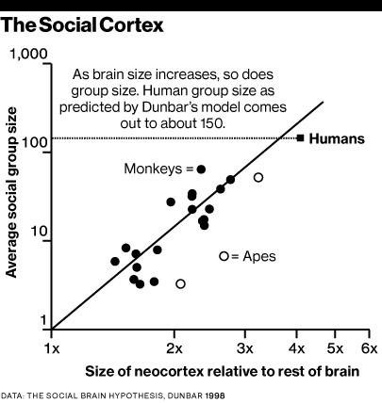
Ego networks: Social brain hypothesis
Why is your (human) head so big?
  In comparison to our closest primate ancestors
Because humans are very social animals!
  Finding:
    Neocortex size scales with average group size for all primates
  Explanation:
    The brain is for keeping track of other people (among other things)
Dunbar, R. I. M. (2003). Evolution of the social brain. Science, 302, 1160 –1161.

Slide 221
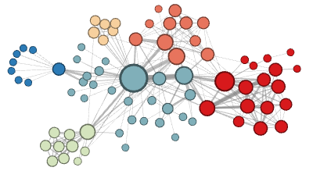
Why do your ego networks look they way they do?
The composition of your ego network is likely biased
  How are your ego networks biased?
    Some kinds of people are over-represented in your ego-network
    Some kinds of people are under-represented in your ego network
    The people who are over-represented are more likely to be similar to you
    The people who are under-represented are more likely to be dissimilar to you
      These last two things are the basis of homophily*
*McPherson, M., Smith-Lovin, L., & Cook, J. M. (2001). Birds of a feather: Homophily in social networks. Annual Review of Sociology, 27(1), 415-444.

Slide 222
Why do your ego networks look they way they do?
In what ways are your networks biased toward homophily?
  According to pretty much any social distinction we can think of
    Gender
    Race/Ethnicity
    Education
    Age
    Occupation/Income
  These are what Peter Blau called dimensions of association
    Some of these are categorical (no inherent ordering)
      Like race , gender or occupation
    Some are continuous (inherent ordering)
      Like age, education or income

Slide 223

Why do your ego networks look they way they do?
Why are your ego networks biased toward homophily?
  One obvious source of bias is what has been called* choice homophily
    You like to hang out with people who are similar to you (regardless)
  One non-obvious source of bias is what has been called* induced homophily
    The social context (nation, state, organization) where you reside determines the people who are available for you to hang out with
*McPherson, J. M., & Smith-Lovin, L. (1987). Homophily in voluntary organizations: Status distance and the composition of face-to-face groups. American Sociological Review, 370-379.
Peter Blau (1918 - 2002)

Slide 224


Why do your ego networks look they way they do?
The World
Your ego network
Peter Blau (1918 - 2002)
Unbiased
Biased

Slide 225
Why do your ego networks look they way they do?
The World
Your ego network
Peter Blau (1918 - 2002)
Unbiased
Biased

Slide 226
Why do your ego networks look they way they do?
The World
Your ego network
Peter Blau (1918 - 2002)
Unbiased
Biased

Slide 227
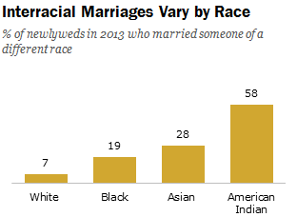
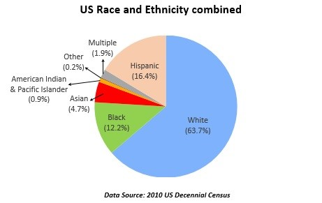
Blau’s rules: Group size effects
If a categorical dimension divides the population into two or more groups:
  Rule 1: Members of numerically smaller groups will be more likely to have relations with outgroup members
  Rule 2: Members of numerically larger groups will be more likely to have relations with ingroup members
These are called group size effects

Slide 228
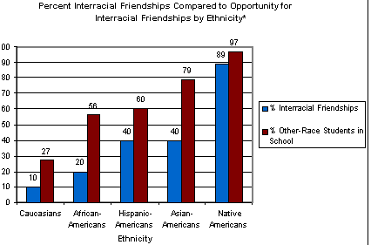
Blau’s rules: Group size effects
If a categorical dimension divides the population into two or more groups:
  Rule 1: Members of numerically smaller groups will be more likely to have relations with outgroup members
  Rule 2: Members of numerically larger groups will be more likely to have relations with ingroup members
These are called group size effects
Source: Joyner, K. & Kao, G. (2000). School racial composition and adolescent racial homophily. Social Science Quarterly, 81, 810-825.

Slide 229

Blau’s rules: Multiform heterogeneity effects
Rule 3:
Example:
  In the U.S. there are systematic correlations between religion and race
Multiform Heterogeneity Effect:
  Network biased by race will also be biased by religion
  Even if people don’t have preferences religion of alter (or vice versa)

Slide 230
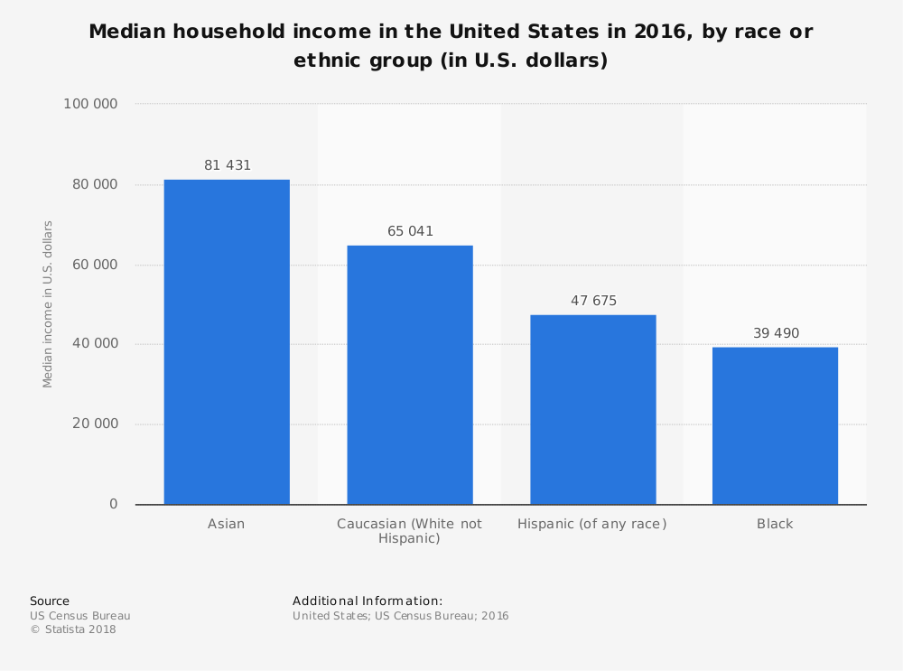
Blau’s rules: Multiform heterogeneity effects
This applies to any correlation between dimensions of association
  Categorical-Categorical (e.g., Race and Religion)
    Networks biased by religion will be biased by race
  Categorical-Continuous (e.g., Race and Income)
    Networks biased by race will be biased by income
  Continuous-Continuous (e.g., Age and Income)
    Neworks biased by age will be biased by income

Slide 231

Focused organizations of social ties
One observation:
  Often social relations are organized around “circles,” or “common activities”
  These “foci” may themselves be a primary driver of which relations show up in people’s networks
What is a “focus”?
  “ a social, psychological, legal, or physical entity around which joint activities are organized (e.g., workplaces, voluntary organizations, hangouts, families, etc.” (Feld 1981: 1016)

Slide 232

Why do your ego networks look they way they do?
Church
Family
School
You
Scott Feld
Unbiased!

Slide 233
Why do your ego networks look they way they do?
Church
Family
School
You
Scott Feld
Unbiased!

Slide 234
Why do your ego networks look they way they do?
The typical settings within which you interact as reference for bias:
  Feld Rule: If the settings within which you interact are biased towards a particular categorical or continuous dimension of association your ego-network will reflect that bias
    Feld referred to these settings as social foci
    Therefore, this is the called the focus effect
      Foci make homophily happen via segregation
    Conversely,
      Desegregated foci reduce homophily
Scott Feld

Slide 235

Focused organizations of social ties
This suggests two new mechanisms for where ties come from:
b
a
c
Ego
h
d
From circle to relation
g
e
f
From common activity to relation

Slide 236
Focused organizations of social ties
Foci vary around several dimensions
  Constraint
    Time and energy that they require
  Size
Foci emerge from pre-existing relations
  Friends form clubs, participate in common activities
Multiple intersecting foci
  “Cross-cutting” circles
  Clustering at the ego-network level may be the result of constraining overlapping foci
b
a
c
Ego
h
d
g
e
f

Slide 237

Why do your ego networks look they way they do?
The World
Your ego network
Small
Large
Peter Marsden
More biased
Less Biased

Slide 238
Why do your ego networks look they way they do?
Overall, larger ego networks should be more diverse
  Regardless of preferences for choice homophily
    At some point you run out of ingroup alters!
But this effect should depend group size effects
  In general, minorities should get more “bang from their buck” (in terms of diversity) from network size
    Can you tell why?
Peter V. Marsden

Slide 239
Why do your ego networks look they way they do?
Overall, larger ego networks should be more diverse
  Regardless of preferences for choice homophily
    At some point you run out of ingroup alters!
But this effect should depend group size effects
  In general, minorities should get more “bang from their buck” (in terms of diversity) from network size
    Can you tell why?
A
B

Slide 240

Why do your ego networks look they way they do?
A
B

Slide 241
Ego network properties
Size
  Number of ego-alter ties
Composition
  Prop. of certain types of alter ties
Diversity
  Variation in alter attributes
Homophily/Heterophily
  Ties to alter same/different from ego
Clustering
  Density of alter-alter network
b
a
c
Ego
h
d
g
e
f

Slide 242
Ego network properties
Measure | Ego-alter ties | Alter-Alter Ties | Attributes
Size | ✅
Diversity |  |  | ✅
Homophily | ✅ |  | ✅
Composition |  |  | ✅
Clustering |  | ✅

Slide 243
Ego network properties: Size
Size
  Number of ego-alter ties (blue links)
b
b
b
b
a
a
a
c
c
c
c
h
Ego
d
h
Ego
d
h
Ego
d
Ego
d
g
e
g
f

Slide 244
Ego network properties: Size
Size
  Number of ego-alter ties (blue links)
Size = 8
Size = 6
Size = 5
Size = 3
b
b
b
b
a
a
a
a
c
c
c
c
Ego
Ego
Ego
Ego
h
d
h
d
h
d
g
e
g
f

Slide 245
Ego networks: Composition
White
Hispanic
Black
Asian
Size = 4
Size = 4
Size = 4
Size = 4
a
b
a
b
a
b
a
b
Ego
Ego
Ego
Ego
c
d
c
d
c
d
c
d

Slide 246
Ego networks: Composition
White
Hispanic
Black
Asian
Size = 4
Size = 4
Size = 4
Size = 4
Proportion White: 1.0
Proportion Hispanic: 0
Proportion Black: 0
Proportion Asian: 0
Proportion White: 0.75
Proportion Hispanic: 0
Proportion Black: 0.25
Proportion Asian: 0
Proportion White: 0.5
Proportion Hispanic: 0.25
Proportion Black: 0.25
Proportion Asian 0
Proportion White: 0.25
Proportion Hispanic: 0.25
Proportion Black: 0.25
Proportion Asian: 0.25
a
b
a
b
a
b
a
b
Ego
Ego
Ego
Ego
c
d
c
d
c
d
c
d

Slide 247
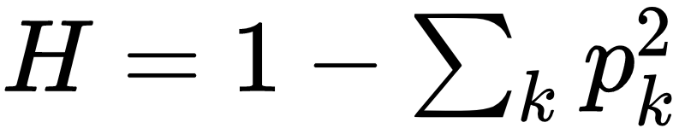
Ego networks: Blau’s Index of Heterogeneity (H)
White
One minus the sum of squared proportions of alters from each group
Hispanic
Black
Asian
a
b
a
b
a
b
a
b
Ego
Ego
Ego
Ego
c
d
c
d
c
d
c
d
H = 1 - (4/4)²
H = 1 - 1²
H = 1 - 1
H = 0
H = 1 - [(¼)² + (¾)²]
H = 1 -(0.25² + 0.75²)
H = 1 - (0.06 + 0.56)
H = 0.38
H = 1 - [(¼)² + (¼)² + (½)²]
H = 1 -(0.25² + 0.25² + 0.5²)
H = 1 - (0.06 + 0.06 + 0.25)
H = 0.63
H = 1 - [(¼)² + (¼)² + (¼)² + (¼)²]
H = 1 -(0.25² + 0.25² + 0.25² + 0.25²)
H = 1 - (0.06 + 0.06 + 0.06 + 0.06)
H = 0.76

Slide 248
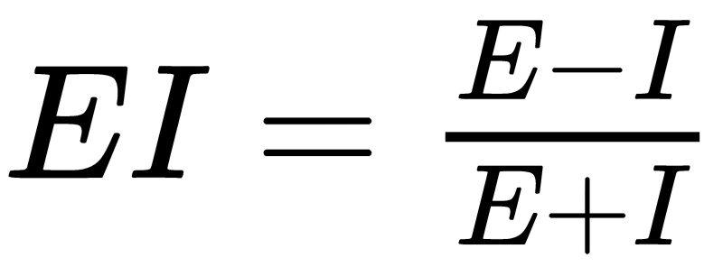
Ego networks: EI Homophily Index
Difference in number of External Ties (E) to Internal Ties (I) Divided by their Sum
Different Race Tie
Same Race Tie
a
b
a
b
a
b
Ego
Ego
Ego
c
d
c
d
c
d
EI_{ego}= (4-0) ÷ (4+0) = 1
EI_{ego}= (2-2) ÷ (2+ 2) = 0
EI_{ego}= (0 -4) ÷ (0 + 4) = -1
Four external ties, no internal ties
Two external ties, and two internal ties
No external ties, and four internal ties

Slide 249
Ego networks: Clustering Coefficient
b
a
 | a | b | c | d | e | f | g | h
a | --
b |  | --
c |  |  | --
d |  |  |  | --
e |  |  |  |  | --
f |  |  |  |  |  | --
g |  |  |  |  |  |  | --
h |  |  |  |  |  |  |  | --
c
Ego
d
h
g
e
f

Slide 250
Ego networks: Clustering Coefficient
b
a
 | a | b | c | d | e | f | g | h
a | --
b |  | --
c |  |  | --
d |  |  |  | --
e |  |  |  |  | --
f |  |  |  |  |  | --
g |  |  |  |  |  |  | --
h |  |  |  |  |  |  |  | --
c
d
h
g
e
f
Forget about Ego!
We only care about alter-alter edges

Slide 251
Ego networks: Clustering Coefficient
b
a
 | a | b | c | d | e | f | g | h
a | -- | 1 | 0 | 0 | 0 | 0 | 1 | 1
b | 1 | -- | 0 | 0 | 0 | 0 | 1 | 1
c | 0 | 0 | -- | 0 | 0 | 0 | 0 | 0
d | 0 | 0 | 0 | -- | 1 | 1 | 1 | 0
e | 0 | 0 | 0 | 1 | -- | 1 | 0 | 0
f | 0 | 0 | 0 | 1 | 1 | -- | 1 | 0
g | 1 | 1 | 0 | 1 | 0 | 1 | -- | 1
h | 1 | 1 | 0 | 0 | 0 | 0 | 1 | --
c
d
h
g
e
f
Forget about Ego!
We only care about alter-alter edges

Slide 252
Ego networks: Clustering Coefficient
b
a
 | a | b | c | d | e | f | g | h
a | -- | 1 | 0 | 0 | 0 | 0 | 1 | 1
b | 1 | -- | 0 | 0 | 0 | 0 | 1 | 1
c | 0 | 0 | -- | 0 | 0 | 0 | 0 | 0
d | 0 | 0 | 0 | -- | 1 | 1 | 1 | 0
e | 0 | 0 | 0 | 1 | -- | 1 | 0 | 0
f | 0 | 0 | 0 | 1 | 1 | -- | 1 | 0
g | 1 | 1 | 0 | 1 | 0 | 1 | -- | 1
h | 1 | 1 | 0 | 0 | 0 | 0 | 1 | --
c
d
h
g
e
f
How many nodes? N = 8
How many total links? E = 22/2 = 11
We only care about half!

Slide 253
Ego networks: Clustering Coefficient
b
a
 | a | b | c | d | e | f | g | h
a | -- | 1 | 0 | 0 | 0 | 0 | 1 | 1
b | 1 | -- | 0 | 0 | 0 | 0 | 1 | 1
c | 0 | 0 | -- | 0 | 0 | 0 | 0 | 0
d | 0 | 0 | 0 | -- | 1 | 1 | 1 | 0
e | 0 | 0 | 0 | 1 | -- | 1 | 0 | 0
f | 0 | 0 | 0 | 1 | 1 | -- | 1 | 0
g | 1 | 1 | 0 | 1 | 0 | 1 | -- | 1
h | 1 | 1 | 0 | 0 | 0 | 0 | 1 | --
c
d
h
g
e
f
How many nodes? N = 8
How many total links? E = 22/2 = 11
How many possible number of links? (N*(N - 1)/2 = (8*7)/2 = 28

Slide 254
Ego networks: Clustering Coefficient
b
CC_{ego}= E/(N*(N - 1)/2)
CC_{ego} = 11/28
CC_{ego}= 0.39
a
 | a | b | c | d | e | f | g | h
a | -- | 1 | 0 | 0 | 0 | 0 | 1 | 1
b | 1 | -- | 0 | 0 | 0 | 0 | 1 | 1
c | 0 | 0 | -- | 0 | 0 | 0 | 0 | 0
d | 0 | 0 | 0 | -- | 1 | 1 | 1 | 0
e | 0 | 0 | 0 | 1 | -- | 1 | 0 | 0
f | 0 | 0 | 0 | 1 | 1 | -- | 1 | 0
g | 1 | 1 | 0 | 1 | 0 | 1 | -- | 1
h | 1 | 1 | 0 | 0 | 0 | 0 | 1 | --
c
Ego
d
h
g
e
f
How many nodes? N = 8
How many total links? E = 22/2 = 11
How many possible number of links? (N*(N - 1)/2 = (8*7)/2 = 28

Slide 255
Ego networks: Clustering Coefficient
a
b
a
b
a
b
Ego
Ego
Ego
c
d
c
d
c
d
 | a | b | c | d
a | -- | 0 | 0 | 0
b | 0 | -- | 0 | 0
c | 0 | 0 | -- | 0
d | 0 | 0 | 0 | --
 | a | b | c | d
a | -- | 1 | 1 | 0
b | 1 | -- | 0 | 0
c | 1 | 0 | -- | 1
d | 0 | 0 | 1 | --
 | a | b | c | d
a | -- | 1 | 1 | 1
b | 1 | -- | 1 | 1
c | 1 | 1 | -- | 1
d | 1 | 1 | 1 | --
CC_{ego}= 0
CC_{ego}= 0.5
CC_{ego}= 1.0
Unclustered
Clustered

Slide 256
Individual Level in Networks II
Centrality and Social Position

Slide 257
Levels of Analysis in social networks
Individual
1
Dyads
2
Triads
3
Cliques, Communities
4
Whole Network
5
The first part of the course follows this organization!

Slide 258
Levels of Analysis in social networks
Centrality
Individual
1
Dyads
2
Triads
3
Cliques, Communities
4
Whole Network
5
The first part of the course follows this organization!

Slide 259
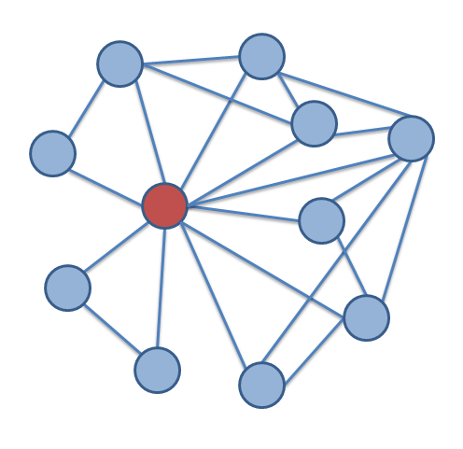
Centrality: What is it?
A measure of the importance or strategic location of a node in the network:
  Autonomy
  Control
  Risk
  Exposure
  Influence
  Belongingness
  Brokerage
  Independence
  Power

Slide 260
Centrality: What is it?
A centrality metric is a summary index of the centrality of a node
  Based on sums or averages of one of three things:

Slide 261
Centrality: What is it?
A centrality metric is a summary index of the centrality of a node
  Based on sums or averages of one of three things:
    Number of edges that are directly incident upon that node.
    The length of the shortest paths (smaller is better) having that node as one of their ends
    The proportion of the shortest paths that have that node as one their inner nodes

Slide 262
Centrality: What is it?
A centrality metric is a summary index of the centrality of a node
  Based on sums or averages of one of three things:
    Number of edges that are directly incident upon that node.
    The length of the shortest paths (smaller is better) having that node as one of their ends
    The proportion of the shortest paths that have that node as one their inner nodes
More/more principle:
  The more a node has of any of these things the more central it is

Slide 263
Centrality: What is it?
A centrality metric is a summary index of the centrality of a node
  Based on sums or averages of one of three things:
    Number of edges that are directly incident upon that node.
    The length of the shortest paths (smaller is better) having that node as one of their ends
    The proportion of the shortest paths that have that node as one their inner nodes
Result is a ranking of all nodes in graph
  From most central (top) to least central (bottom)

Slide 264
Degree C_{d}(v_{i})
Simplest (local) centrality measure to compute
Graph theory definition:
  Number of edges incident to a node
  Cardinality of the set of neighbors of a node
In undirected graphs:
  Given by either row or column sum vector of corresponding adjacency matrix
Undirected Graph
 | a | b | c | d | e
a | -- | 1 | 0 | 0 | 0
b | 1 | -- | 1 | 0 | 0
c | 0 | 1 | -- | 1 | 1
d | 0 | 0 | 1 | -- | 1
e | 0 | 0 | 1 | 1 | --

Slide 265
Degree C_{d}(v_{i})
Simplest (local) centrality measure to compute
Graph theory definition:
  Number of edges incident to a node
  Cardinality of the set of neighbors of a node
In undirected graphs:
  Given by either row or column sum vector of corresponding adjacency matrix
Undirected Graph
 | a | b | c | d | e
a | -- | 1 | 0 | 0 | 0
b | 1 | -- | 1 | 0 | 0
c | 0 | 1 | -- | 1 | 1
d | 0 | 0 | 1 | -- | 1
e | 0 | 0 | 1 | 1 | --
1
2
3
2
2

Slide 266
Degree C_{d}(v_{i}): Undirected
Simplest (local) centrality measure to compute
Graph theory definition:
  Number of edges incident to a node
  Cardinality of the set of neighbors of a node
In undirected graphs:
  Given by either row or column sum vector of corresponding adjacency matrix
Undirected Graph
 | a | b | c | d | e
a | -- | 1 | 0 | 0 | 0
b | 1 | -- | 1 | 0 | 0
c | 0 | 1 | -- | 1 | 1
d | 0 | 0 | 1 | -- | 1
e | 0 | 0 | 1 | 1 | --
1
2
3
2
2
1 | 2 | 3 | 2 | 2

Slide 267
Degree C_{d}(v_{i}): Undirected
Simplest (local) centrality measure to compute
Graph theory definition:
  Number of edges incident to a node
  Cardinality of the set of neighbors of a node
In undirected graphs:
  Given by either row or column sum vector of corresponding adjacency matrix
Undirected Graph
 | a | b | c | d | e
a | -- | 1 | 0 | 0 | 0
b | 1 | -- | 1 | 0 | 0
c | 0 | 1 | -- | 1 | 1
d | 0 | 0 | 1 | -- | 1
e | 0 | 0 | 1 | 1 | --
1
2
3
2
2
1 | 2 | 3 | 2 | 2

Slide 268
Degree C_{d}(v_{i}): Undirected
Simplest (local) centrality measure to compute
Graph theory definition:
  Number of edges incident to a node
  Cardinality of the set of neighbors of a node
In undirected graphs:
  Given by either row or column sum vector of corresponding adjacency matrix
Undirected Graph
 | a | b | c | d | e
a | -- | 1 | 0 | 0 | 0
b | 1 | -- | 1 | 0 | 0
c | 0 | 1 | -- | 1 | 1
d | 0 | 0 | 1 | -- | 1
e | 0 | 0 | 1 | 1 | --
1
2
3
2
2
1 | 2 | 3 | 2 | 2

Slide 269

Degree C_{deg}(v): Directed
In directed graphs nodes have two separate types of degree centrality:
  Outdegree centrality
  Indegree centrality
Graph theory definition:
  Outdegree:
    Cardinality of the set of out-neighbors
  Indegree:
    Cardinality of the set of in-neighbors
Directed Graph
 | a | b | c | d | e
a | -- | 1 | 0 | 0 | 0
b | 1 | -- | 0 | 0 | 0
c | 0 | 1 | -- | 1 | 1
d | 0 | 0 | 0 | -- | 0
e | 0 | 0 | 1 | 1 | --

Slide 270
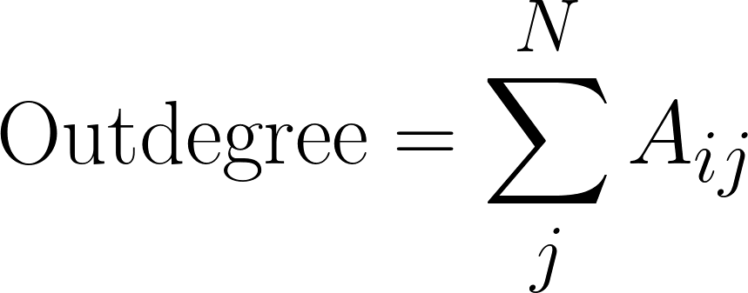
Degree C_{deg}(v): Directed
In directed graphs nodes have two separate types of degree centrality:
  Outdegree centrality
  Indegree centrality
Graph theory definition:
  Outdegree:
    Cardinality of the set of out-neighbors
  Indegree:
    Cardinality of the set of in-neighbors
Outdegree calculated by summing the rows of the asymmetric adjacency matrix
Directed Graph
 | a | b | c | d | e
a | -- | 1 | 0 | 0 | 0
b | 1 | -- | 0 | 0 | 0
c | 0 | 1 | -- | 1 | 1
d | 0 | 0 | 0 | -- | 0
e | 0 | 0 | 1 | 1 | --

Slide 271
Degree C_{deg}(v): Directed
In directed graphs nodes have two separate types of degree centrality:
  Outdegree centrality
  Indegree centrality
Graph theory definition:
  Outdegree:
    Cardinality of the set of out-neighbors
  Indegree:
    Cardinality of the set of in-neighbors
Outdegree calculated by summing the rows of the asymmetric adjacency matrix
Directed Graph
 | a | b | c | d | e
a | -- | 1 | 0 | 0 | 0
b | 1 | -- | 0 | 0 | 0
c | 0 | 1 | -- | 1 | 1
d | 0 | 0 | 0 | -- | 0
e | 0 | 0 | 1 | 1 | --
1
1
3
0
2

Slide 272
Degree C_{deg}(v): Directed
In directed graphs nodes have two separate types of degree centrality:
  Outdegree centrality
  Indegree centrality
Graph theory definition:
  Outdegree:
    Cardinality of the set of out-neighbors
  Indegree:
    Cardinality of the set of in-neighbors
Outdegree calculated by summing the rows of the asymmetric adjacency matrix
Directed Graph
 | a | b | c | d | e
a | -- | 1 | 0 | 0 | 0
b | 1 | -- | 0 | 0 | 0
c | 0 | 1 | -- | 1 | 1
d | 0 | 0 | 0 | -- | 0
e | 0 | 0 | 1 | 1 | --
1
1
3
0
2

Slide 273
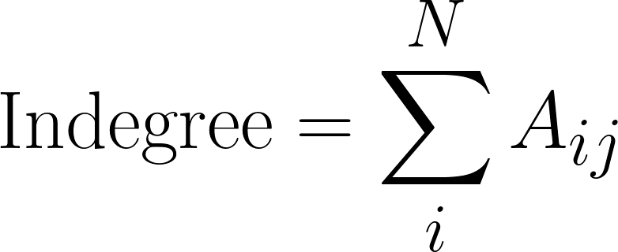
Degree C_{deg}(v): Directed
In directed graphs nodes have two separate types of degree centrality:
  Outdegree centrality
  Indegree centrality
Graph theory definition:
  Outdegree:
    Cardinality of the set of out-neighbors
  Indegree:
    Cardinality of the set of in-neighbors
Indegree calculated by summing the columns of the asymmetric adjacency matrix
Directed Graph
 | a | b | c | d | e
a | -- | 1 | 0 | 0 | 0
b | 1 | -- | 0 | 0 | 0
c | 0 | 1 | -- | 1 | 1
d | 0 | 0 | 0 | -- | 0
e | 0 | 0 | 1 | 1 | --

Slide 274
Degree C_{deg}(v): Directed
In directed graphs nodes have two separate types of degree centrality:
  Outdegree centrality
  Indegree centrality
Graph theory definition:
  Outdegree:
    Cardinality of the set of out-neighbors
  Indegree:
    Cardinality of the set of in-neighbors
Indegree calculated by summing the columns of the asymmetric adjacency matrix
Directed Graph
 | a | b | c | d | e
a | -- | 1 | 0 | 0 | 0
b | 1 | -- | 0 | 0 | 0
c | 0 | 1 | -- | 1 | 1
d | 0 | 0 | 0 | -- | 0
e | 0 | 0 | 1 | 1 | --
1 | 2 | 1 | 2 | 1

Slide 275
Degree C_{deg}(v)
In directed graphs nodes have two separate types of degree centrality:
  Outdegree centrality
  Indegree centrality
Graph theory definition:
  Outdegree:
    Cardinality of the set of out-neighbors
  Indegree:
    Cardinality of the set of in-neighbors
Indegree calculated by summing the columns of the asymmetric adjacency matrix
Directed Graph
 | a | b | c | d | e
a | -- | 1 | 0 | 0 | 0
b | 1 | -- | 0 | 0 | 0
c | 0 | 1 | -- | 1 | 1
d | 0 | 0 | 0 | -- | 0
e | 0 | 0 | 1 | 1 | --
1 | 2 | 1 | 2 | 1

Slide 276
Centrality Beyond Degree
s
e
q
b
g
p
m
d
l
a
h
i
j
f
k
n
o
c
r

Slide 277
Centrality Beyond Degree
In this graph this node has the largest degree centrality!
s
e
q
b
g
p
m
d
l
a
h
i
j
f
k
n
o
c
r

Slide 278
Centrality Beyond Degree
s
e
q
b
g
p
m
d
l
a
h
i
j
f
k
n
C_{Deg}(j) = 7
o
c
r

Slide 279
Centrality Beyond Degree: Closeness (C_{Clos})
s
e
q
b
g
p
m
d
l
a
h
i
j
f
k
n
o
c
r

Slide 280
Centrality Beyond Degree: Closeness (C_{Clos})
A node that can reach all the other nodes in the graph via the shortest paths (on average) has the largest closeness centrality!
s
e
q
b
g
p
m
d
l
a
h
i
j
f
k
n
o
c
r

Slide 281
Centrality Beyond Degree: Closeness (C_{Clos})
In this graph this node has the largest closeness centrality!
s
e
q
b
g
p
m
d
l
a
h
i
j
f
k
n
o
c
r

Slide 282
Centrality Beyond Degree: Closeness (C_{Clos})
SP(p--a) =
SP(p--b) =
SP(p--c) =
SP(p--d) =
SP(p--e) =
SP(p--f) =
SP(p--g) =
SP(p--h) =
SP(p--i) =
SP(p--j) =
SP(p--k) =
SP(p--l) =
SP(p--m) =
SP(p--n) =
SP(p--o) =
SP(p--q) =
SP(p--r) =
SP(p--s) =
s
e
q
b
g
p
m
d
l
a
h
i
j
f
k
n
o
c
r

Slide 283
Centrality Beyond Degree: Closeness (C_{Clos})
SP(p--a) = 5
SP(p--b) =
SP(p--c) =
SP(p--d) =
SP(p--e) =
SP(p--f) =
SP(p--g) =
SP(p--h) =
SP(p--i) =
SP(p--j) =
SP(p--k) =
SP(p--l) =
SP(p--m) =
SP(p--n) =
SP(p--o) =
SP(p--q) =
SP(p--r) =
SP(p--s) =
s
e
q
b
g
p
m
d
l
a
h
i
j
f
k
n
o
c
r

Slide 284
Centrality Beyond Degree: Closeness (C_{Clos})
SP(p--a) = 5
SP(p--b) = 4
SP(p--c) =
SP(p--d) =
SP(p--e) =
SP(p--f) =
SP(p--g) =
SP(p--h) =
SP(p--i) =
SP(p--j) =
SP(p--k) =
SP(p--l) =
SP(p--m) =
SP(p--n) =
SP(p--o) =
SP(p--q) =
SP(p--r) =
SP(p--s) =
s
e
q
b
g
p
m
d
l
a
h
i
j
f
k
n
o
c
r

Slide 285
Centrality Beyond Degree: Closeness (C_{Clos})
SP(p--a) = 5
SP(p--b) = 4
SP(p--c) = 3
SP(p--d) = 4
SP(p--e) = 4
SP(p--f) = 4
SP(p--g) = 3
SP(p--h) = 2
SP(p--i) = 1
SP(p--j) = 1
SP(p--k) = 1
SP(p--l) = 2
SP(p--m) = 2
SP(p--n) = 2
SP(p--o) = 2
SP(p--q) = 3
SP(p--r) = 3
SP(p--s) = 4
s
e
q
b
g
p
m
d
l
a
h
i
j
f
k
n
o
c
r

Slide 286
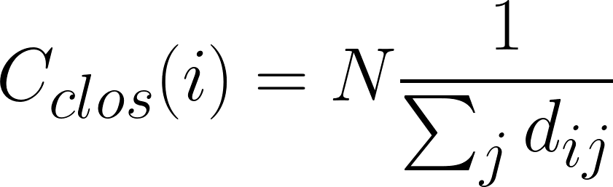
Centrality Beyond Degree: Closeness (C_{Clos})
s
e
q
b
g
p
m
d
l
a
h
i
j
f
k
n
o
c
r

Slide 287
Centrality Beyond Degree: Betweenness (C_{Bet})
A node that is in the middle of the largest number of shortest paths indirectly connecting the other pairs of nodes in the graph has the largest betweenness centrality!
s
e
q
b
g
p
m
d
l
a
h
i
j
f
k
n
o
c
r

Slide 288
Centrality Beyond Degree: Betweenness (C_{Bet})
In this graph this node has the largest betweenness centrality!
s
e
q
b
g
p
m
d
l
a
h
i
j
f
k
n
o
c
r

Slide 289
Centrality Beyond Degree: Betweenness (C_{Bet})
This is the shortest path between g and i: and h is in the middle of it!
s
e
q
b
g
p
m
d
l
a
h
i
j
f
k
n
o
c
r

Slide 290
Centrality Beyond Degree: Betweenness (C_{Bet})
This is the shortest path between p and c: and h is in the middle of it!
s
e
q
b
g
p
m
d
l
a
h
i
j
f
k
n
o
c
r

Slide 291
Centrality Beyond Degree: Betweenness (C_{Bet})
This is the shortest path between k and r: and h is in the middle of it!
s
e
q
b
g
p
m
d
l
a
h
i
j
f
k
n
o
c
r

Slide 292
Centrality Beyond Degree: Betweenness (C_{Bet})
You can see that h has to be high betweenness because they stand on the shortest paths indirectly connecting the nodes on the left with the nodes on the right
s
e
q
b
g
p
m
d
l
a
h
i
j
f
k
n
o
c
r

Slide 293
Centrality Beyond Degree: Betweenness (C_{Bet})
You can see that h has to be high betweenness because they stand on the shortest paths indirectly connecting the nodes on the right with the nodes on the left
s
e
q
b
g
p
m
d
l
a
h
i
j
f
k
n
o
c
r

Slide 294
Centrality Beyond Degree: Betweenness (C_{Bet})
You can see that h has to be high betweenness because they stand on the shortest paths indirectly connecting the nodes on the right with the nodes on the left
s
e
q
b
g
p
m
d
l
a
h
i
j
f
k
n
o
c
r

Slide 295
Centrality Beyond Degree: Betweenness (C_{Bet})
This node is probably also high-betweenness but not as high as h!
s
e
q
b
g
p
m
d
l
a
h
i
j
f
k
n
o
c
r

Slide 296
The star graph
In the star graph three centralities are maximized for the central node
Node a has the highest:
c
b
d
i
a
e
h
f
g

Slide 297
The star graph
In the star graph three centralities are maximized for the central node
Node a has the highest:
  Degree centrality
    Every other node has C_{deg} = 1 but the central node has C_{deg} = N - 1!
c
b
d
i
a
e
h
f
g

Slide 298
The star graph
In the star graph three centralities are maximized for the central node
Node a has the highest:
  Degree centrality
    Every other node has C_{deg} = 1 but the central node has C_{deg} = N - 1!
  Closeness centrality
    Can reach all nodes via paths of length 1!
c
b
d
i
a
e
h
f
g

Slide 299
The star graph
In the star graph three centralities are maximized for the central node
Node a has the highest:
  Degree centrality
    Every other node has C_{deg} = 1 but the central node has C_{deg} = N - 1!
  Closeness centrality
    Can reach all nodes via paths of length 1!
  Betweenness centrality
    The central node stands in every one of the shortest paths linking all the other pairs of nodes (length = 2)!
c
b
d
i
a
e
h
f
g

Slide 300
Centrality Beyond Degree: Eigenvector (C_{Eig})
A node that is directly and indirectly connected to other nodes of high degree has the highest eigenvector centrality!
s
e
q
b
g
p
m
d
l
a
h
i
j
f
k
n
o
c
r

Slide 301
Centrality Beyond Degree: Eigenvector (C_{Eig})
In this graph this node has the highest eigenvector centrality!
s
e
q
b
g
p
m
d
l
a
h
i
j
f
k
n
o
c
r

Slide 302
Centrality Beyond Degree: Eigenvector (C_{Eig})
C_{deg}(e) = 3
Node d is directly connected to other nodes that have high degree of centrality (for this graph)
s
C_{deg}(b) = 4
e
q
b
g
C_{deg}(g) = 5
p
m
d
l
a
h
i
j
f
k
C_{deg}(a) = 3
C_{deg}(f) = 4
n
o
c
r

Slide 303
Centrality Beyond Degree: Eigenvector (C_{Eig})
Node d is indirectly connected to other high-degree nodes
s
e
q
b
g
p
C_{deg}(j) = 7
m
d
l
a
h
i
j
f
k
n
o
c
r

Slide 304
Centrality Beyond Degree: Eigenvector (C_{Eig})
It is called “eigenvector” because it is calculated using a matrix algebra called eigenvalue decomposition to rank each node according to whether they are connected to well-connected others.
s
e
q
b
g
p
C_{deg}(j) = 7
m
d
l
a
h
i
j
f
k
n
o
c
r

Slide 305
Centrality Beyond Degree: Eigenvector (C_{Eig})
Eigenvector centrality was discovered by a Professor of sociology at UCLA! (Bonacich 1978)
s
e
q
b
g
p
C_{deg}(j) = 7
m
d
l
a
h
i
j
f
k
n
o
c
r

Slide 306
Types of centrality measures and interpretations
How well is a node directly connected to others?
  Degree, indegree, outdegree: Based on the number of one-step connections from that node to all others
How well is a node indirectly connected to others?
  Closeness: Based on the number shortest paths that begin with that node and reach the others
How well can a node serve as an intermediary between other nodes?
  Betweenness: Based on the proportion of shortest paths between all other pairs of nodes including that node
How well is node connected to highly connected others?
  Eigenvector: Based on the direct and indirect connections of that node to other central nodes

Slide 307
Sub-Groups, Cliques, Communities

Slide 308
Levels of Analysis in social networks
Individual
1
Dyads
2
Triads
3
Cliques, Communities
4
Whole Network
5
The first part of the course follows this organization!

Slide 309
Levels of Analysis in social networks
Individual
1
Dyads
2
Triads
3
Cliques, Communities
4
Whole Network
5
The first part of the course follows this organization!

Slide 310
Cohesion, connectivity, subgroups
Group level in networks:
  In between the micro:
    Dyads, triads
  And the macro:
    “Whole network”
Why groups?
  Important functional units in organizations
    Workplaces
    Creative industries
    Science
  Important units for solidarity and interaction in social systems
    Social foci
    Primary groups (family, support cliques)

Slide 311
Cohesion, connectivity, subgroups
Group level in networks:
  In between the micro:
    Dyads, triads
  And the macro:
    “Whole network”
Why groups?
  Important sources of:
    Ideational homogeneity
    Conformity
    Influence
    Information transmission

Slide 312
Cohesion, connectivity, subgroups
Group level in networks:
  In between the micro:
    Dyads, triads
  And the macro:
    “Whole network”
Questions:
  How can we translate the concept of a group into network terms?
  What are the most important group properties from a network perspective?
    Cohesion
    Polarization
    Fragmentation

Slide 313
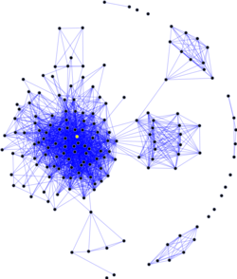
What are “groups” or “communities”?
“Group,” is a fuzzy social science concept, with many overlapping but sometimes contradictory verbal definitions
  As always graph theory to the rescue!
The graph theoretic concept of group/community is:
  A relatively dense subgraph featuring more links among the subset of vertices that belong to the subgraph than links to vertices in the rest of the graph

Slide 314
Graphs and subgraphs
A subgraph G' = (V', E') of a graph G = (V, E) exists when:
  V' is a subset of V and E' is a subset of E
A lot of network methods are designed to split a graph into subgraphs
  Subgraphs can be used to represent the social network concepts of groups, cliques, or communities

Slide 315
Graphs and subgraphs
A subgraph G' = (V', E') of a graph G = (V, E) exists when:
  V' is a subset of V and E' is a subset of E
A lot of network methods are designed to split a graph into subgraphs
  Subgraphs can be used to represent the social network concepts of groups, cliques, or communities
This is a subgraph

Slide 316
Graphs and subgraphs
A subgraph G' = (V', E') of a graph G = (V, E) exists when:
  V' is a subset of V and E' is a subset of E
A lot of network methods are designed to split a graph into subgraphs
  Subgraphs can be used to represent the social network concepts of groups, cliques, or communities
This is another subgraph

Slide 317
Connected Subgraphs
A subgraph G' = (V', E') of a graph G = (V, E) exists when:
  V' is a subset of V and E' is a subset of E
A subgraph is connected if every node within it can reach every other one via a path of some length
This subgraph is connected :)

Slide 318
Disconnected Subgraphs
A subgraph G' = (V', E') of a graph G = (V, E) exists when:
  V' is a subset of V and E' is a subset of E
A subgraph is connected if every node within it can reach every other one via a path of some length
A subgraph is disconnected if there are nodes that cannot reach other nodes via a path of any length
This subgraph is disconnected :(

Slide 319
Cliques
A subgraph G' = (V', E') of a graph G = (V, E) exists when:
  V' is a subset of V and E' is a subset of E
A clique is a complete subgraph (density = 1.0)
  The size of a clique is the number of nodes in it:
    Clique of size 2, clique of size 3, clique of size 4, etc.
This is a clique of size 4

Slide 320
Cliques
This is a clique of size 5
A subgraph G' = (V', E') of a graph G = (V, E) exists when:
  V' is a subset of V and E' is a subset of E
A clique is a complete subgraph (density = 1.0)
  The size of a clique is the number of nodes in it:
    Clique of size 2, clique of size 3, clique of size 4, etc.

Slide 321
Cliques
A subgraph G' = (V', E') of a graph G = (V, E) exists when:
  V' is a subset of V and E' is a subset of E
A clique is a complete subgraph (density = 1.0)
  The size of a clique is the number of nodes in it:
    Clique of size 2, clique of size 3, clique of size 4, etc.
This triad is a clique of size 3!

Slide 322
Cliques
A subgraph G' = (V', E') of a graph G = (V, E) exists when:
  V' is a subset of V and E' is a subset of E
A clique is a complete subgraph (density = 1.0)
  The size of a clique is the number of nodes in it:
    Clique of size 2, clique of size 3, clique of size 4, etc.
The same actor can belong to multiple cliques!

Slide 323
N-Cliques
Some subgraphs are not complete graphs (cliques) but they are almost there
  They are quasi-groups
  We can relax the definition to accommodate!
An n-clique is a subgraph where each node is at least n steps away from each other node
    2-clique, 3-clique, 4-clique, 5-clique...k-clique

Slide 324
N-Cliques
Some subgraphs are not complete graphs (cliques) but they are almost there
  They are quasi-groups
  We can relax the definition to accommodate!
An n-clique is a subgraph where each node is at least n steps away from each other node
    2-clique, 3-clique, 4-clique, 5-clique...k-clique
This is a 2-clique!

Slide 325
N-Cliques
Some subgraphs are not complete graphs (cliques) but they are almost there
  They are quasi-groups
  We can relax the definition to accommodate!
An n-clique is a subgraph where each node is at least n steps away from each other node
    2-clique, 3-clique, 4-clique, 5-clique...k-clique
This is a 3-clique!

Slide 326
N-Cliques
Some subgraphs are not complete graphs (cliques) but they are almost there
  They are quasi-groups
  We can relax the definition to accommodate!
An n-clique is a subgraph where each node is at least n steps away from each other node
    2-clique, 3-clique, 4-clique, 5-clique...k-clique
This is a 4-clique!

Slide 327
Graph connectivity
A graph is connected if there exists a (finite) path between each pair of nodes
This is a connected graph! :)

Slide 328
Graph connectivity
A graph is connected if there exists a (finite) path between each pair of nodes
A graph is disconnected if there does not exist a path connecting every pair of nodes
This graph is disconnected :(

Slide 329
Graph connectivity: Components
A graph is connected if there exists a (finite) path between each pair of nodes
A graph is disconnected if there does not exist a path connecting every pair of nodes
A connected subgraph is called a component
These are two different components

Slide 330
Graph connectivity: Components
A graph is connected if there exists a (finite) path between each pair of nodes
A graph is disconnected if there does not exist a path connecting every pair of nodes
A connected subgraph is called a component
  If a graph has more than one component it is by definition disconnected
These are two different components

Slide 331
Graph connectivity: Components
A graph is connected if there exists a (finite) path between each pair of nodes
A graph is disconnected if there does not exist a path connecting every pair of nodes
A connected subgraph is called a component
  If a graph has more than one component it is by definition disconnected
These are three different components

Slide 332
Graph connectivity: Components
A graph is connected if there exists a (finite) path between each pair of nodes
A graph is disconnected if there does not exist a path connecting every pair of nodes
A connected subgraph is called a component
  The connected subgraph containing the largest number of vertices in a graph is called the giant component

Slide 333
Graph connectivity: Components
A graph is connected if there exists a (finite) path between each pair of nodes
A graph is disconnected if there does not exist a path connecting every pair of nodes
A connected subgraph is called a component
  The connected subgraph containing the largest number of vertices in a graph is called the giant component
This is the giant component!

Slide 334
Graph connectivity: Components
A graph is connected if there exists a (finite) path between each pair of nodes
A graph is disconnected if there does not exist a path connecting every pair of nodes
A connected subgraph is called a component
  A component is k-connected if every node in the component can reach any other one via a path of length k or less
This component is 2-connected!

Slide 335
Graph connectivity
We can disconnect a graph by removing edges

Slide 336
Graph connectivity
Oops! Disconnected!
We can disconnect a graph by removing edges

Slide 337
Graph connectivity
We can disconnect a graph by removing edges

Slide 338
Graph connectivity
We removed some edges
We can disconnect a graph by removing edges
Is this graph disconnected?

Slide 339
Graph connectivity
We can disconnect a graph by removing edges
Now it is!

Slide 340
Graph connectivity
This is a bridge
We can disconnect a graph by removing edges
In some graphs removing just one edge leads to disconnection
Edges with the property of being able to disconnect the graph upon removal are called bridges

Slide 341
Graph connectivity
We can also disconnect a graph by removing nodes

Slide 342
Graph connectivity
Oops! Disconnected!
We can also disconnect a graph by removing nodes

Slide 343
Graph connectivity
Oops! Disconnected!
We can also disconnect a graph by removing nodes
It can be easier to disconnect a graph this way because nodes take their links with them!

Slide 344
Graph connectivity
We can also disconnect a graph by removing nodes
Some nodes are more “important” for because they serve as the connectors
Can you guess what kind of centrality “connector” nodes are more likely to have?
VIP Node
Not VIP

Slide 345
Graph connectivity
We can also disconnect a graph by removing nodes
  Some nodes are more “important” because they serve as the connectors
A graph is k-connected if it takes removing k nodes to disconnect it
This graph is 1-connected

Slide 346
Graph connectivity
We can also disconnect a graph by removing nodes
Some nodes are more “important” because they serve as the connectors
A graph is k-connected if it takes removing k nodes to disconnect it
This graph is 1-connected

Slide 347
Graph connectivity
We can also disconnect a graph by removing nodes
Some nodes are more “important” because they serve as the connectors
A graph is k-connected if it takes removing k nodes to disconnect it
This graph is 2-connected

Slide 348
Graph connectivity
We can also disconnect a graph by removing nodes
Some nodes are more “important” because they serve as the connectors
A graph is k-connected if it takes removing k nodes to disconnect it
This graph is 2-connected

Slide 349
Graph connectivity
We can also disconnect a graph by removing nodes
Some nodes are more “important” because they serve as the connectors
A graph is k-connected if it takes removing k nodes to disconnect it
This graph is 3-connected

Slide 350
Graph connectivity
We can also disconnect a graph by removing nodes
Some nodes are more “important” because they serve as the connectors
A graph is k-connected if it takes removing k nodes to disconnect it
This graph is 3-connected

Slide 351
Graph connectivity
We can also disconnect a graph by removing nodes
Some nodes are more “important” because they serve as the connectors
A graph is k-connected if it takes removing k nodes to disconnect it
This graph is 3-connected

Slide 352
Graph connectivity: Cutsets
Some graphs are easy to disconnect
  Only require the removal of a few links or nodes
Others are hard to disconnect
  Requires the removal of a lot of links or nodes
The edge-cutset is the minimum number of edges required to disconnect a graph
  What’s the edge-cutset of the graph on the right?

Slide 353
Graph connectivity: Cutsets
Some graphs are easy to disconnect
  Only require the removal of a few links or nodes
Others are hard to disconnect
  Requires the removal of a lot of links or nodes
The edge-cutset is the minimum number of edges required to disconnect a graph
  What’s the edge-cutset of the graph on the right?
|Edge-cutset| = 2

Slide 354
Graph connectivity: Cutsets
Disconnected!
Some graphs are easy to disconnect
  Only require the removal of a few links or nodes
Others are hard to disconnect
  Requires the removal of a lot of links or nodes
The edge-cutset is the minimum number of edges required to disconnect a graph
  What’s the edge-cutset of the graph on the right?
|Edge-cutset| = 2

Slide 355
Graph connectivity: Cutsets
Some graphs are easy to disconnect
  Only require the removal of a few links or nodes
Others are hard to disconnect
  Requires the removal of a lot of links or nodes
The node-cutset is the minimum number of nodes required to disconnect a graph
  What’s the node-cutset of the graph on the right?

Slide 356
Graph connectivity: Cutsets
Some graphs are easy to disconnect
  Only require the removal of a few links or nodes
Others are hard to disconnect
  Requires the removal of a lot of links or nodes
The node-cutset is the minimum number of nodes required to disconnect a graph
  What’s the node-cutset of the graph on the right?
|node-cutset| = 1

Slide 357
Graph connectivity: Cutsets
Disconnected!
Some graphs are easy to disconnect
  Only require the removal of a few links or nodes
Others are hard to disconnect
  Requires the removal of a lot of links or nodes
The node-cutset is the minimum number of nodes required to disconnect a graph
  What’s the node-cutset of the graph on the right?
|node-cutset| = 1

Slide 358
Graph connectivity: Cutsets (for node pairs)
For any pair of non-adjacent nodes, u and v:
  The UV node cutset is the number of nodes that would have to be removed for them to be disconnected
U
V
K = 1
U
V
K = 2
U
V
K = 3

Slide 359
Graph connectivity: Menger’s Theorem
Menger’s theorem states that:
The graph on the right is three-connected!
(removing the three red nodes disconnects the graph)

Slide 360
Graph connectivity: Menger’s Theorem
Menger’s theorem states that:
  If a graph is k-connected there are at least k paths that don’t share other nodes connecting each non-adjacent pair of nodes
The graph on the right is three-connected!
(removing the three red nodes disconnects the graph)

Slide 361
Graph connectivity: Menger’s Theorem
Menger’s theorem states that:
  If a graph is k-connected there are at least k paths that don’t share other nodes connecting each non-adjacent pair of nodes
This means the two non-adjacent green nodes are indirectly connected in three separate (node-independent) ways!

Slide 362
Graph connectivity: Menger’s Theorem
Menger’s theorem states that:
  If a graph is k-connected there are at least k paths that don’t share other nodes connecting each non-adjacent pair of nodes
1
This means the two non-adjacent green nodes are indirectly connected in three separate (node-independent) ways!

Slide 363
Graph connectivity: Menger’s Theorem
Menger’s theorem states that:
  If a graph is k-connected there are at least k paths that don’t share other nodes connecting each non-adjacent pair of nodes
2
This means the two non-adjacent green nodes are indirectly connected in three separate (node-independent) ways!

Slide 364
Graph connectivity: Menger’s Theorem
Menger’s theorem states that:
  If a graph is k-connected there are at least k paths that don’t share other nodes connecting each non-adjacent pair of nodes
3
This means the two non-adjacent green nodes are indirectly connected in three separate (node-independent) ways!

Slide 365
Graph connectivity: Menger’s Theorem
Menger’s theorem states that:
  If a graph is k-connected there are at least k paths that don’t share other nodes connecting each non-adjacent pair of nodes
This is an important result in graph theory!

Slide 366
Graph connectivity: Cutsets
K-connectivity (graph theory) can represent concept of social cohesion (network theory):
  The larger the (edge, node) cutset the more cohesive (integrated) groups are with one another
  The smaller the (edge, node) cutset the less cohesive and more potentially fragmented the group structure is

Slide 367
Graph connectivity: Cutsets
K-connectivity (graph theory) can represent concept of social cohesion (network theory):
  The more k-connectivity the more cohesive (integrated) the group
    More people would have to be removed to disrupt the group
  Any graph can be split into subgraphs with any given level of k-connectivity

Slide 368
Graph connectivity: Cutsets
1
1
1
1
2
4
2
4
2
4
2
4
3
3
3
3
8
8
8
5
8
5
5
5
6
9
6
9
6
9
6
9
7
7
7
7
11
12
12
12
11
12
10
10
11
10
11
10
13
13
13
13
14
14
14
14

Slide 369
Graph connectivity: Cutsets
1
1
1
1
2
4
2
4
2
4
2
4
3
3
3
3
8
8
8
5
8
5
5
5
6
9
6
9
6
9
6
9
7
7
7
7
Already disconnected!
11
12
12
12
11
12
10
10
11
10
11
10
13
13
13
13
14
14
14
14
K = 0

Slide 370
Graph connectivity: Cutsets
1
1
1
1
2
4
2
4
2
4
2
4
3
3
3
3
8
8
8
5
8
5
5
5
6
9
6
9
6
9
6
9
7
7
7
7
Already disconnected!
11
12
12
12
11
12
10
10
11
10
11
10
13
13
13
13
14
14
14
14
K = 0

Slide 371
Graph connectivity: Cutsets
1
1
1
1
2
4
2
4
2
4
2
4
3
3
3
3
8
8
8
5
8
5
5
5
6
9
6
9
6
9
6
9
7
7
7
disconnected!
11
12
12
12
11
12
10
10
11
10
11
10
13
13
13
13
14
14
14
14
K = 0
K = 1

Slide 372
Graph connectivity: Cutsets
1
1
1
1
2
4
2
4
2
4
2
4
3
3
3
3
8
8
8
5
8
5
5
5
6
9
6
9
6
9
6
9
7
7
7
disconnected!
11
12
12
12
11
12
10
10
11
10
11
10
13
13
13
13
14
14
14
14
K = 0
K = 1

Slide 373
Graph connectivity: Cutsets
1
1
1
1
2
4
2
4
2
4
2
4
3
3
3
3
8
8
8
5
8
5
5
5
6
9
6
9
9
6
9
7
7
disconnected!
disconnected!
11
12
12
12
11
12
10
10
11
10
11
10
13
13
13
13
14
14
14
14
K = 0
K = 1
K = 2

Slide 374
Graph connectivity: Cutsets
1
1
1
1
2
4
2
4
2
4
2
4
3
3
3
3
8
8
8
5
8
5
5
5
6
9
6
9
9
9
7
disconnected!
disconnected!
Not yet!
11
12
12
12
11
12
10
10
11
10
11
10
13
13
13
13
14
14
14
14
K = 0
K = 1
K = 2

Slide 375
Graph connectivity: Cutsets
1
1
1
1
2
4
2
4
2
4
2
4
3
3
3
3
8
8
8
5
8
5
5
5
6
9
6
9
9
7
disconnected!
disconnected!
disconnected!
11
12
12
12
11
12
10
10
11
10
11
10
13
13
13
13
14
14
14
14
K = 0
K = 1
K = 2
K = 3

Slide 376

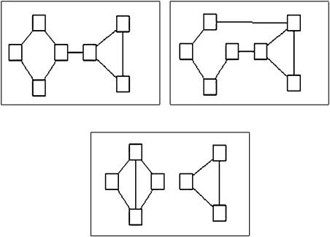
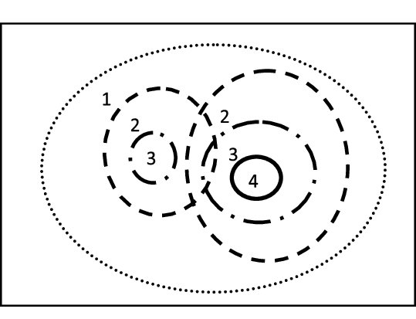
Cohesive Blocking
The idea of cutsets leads to the Cohesive Blocking approach for the identification of nested cohesive subgroups (Moody and White 2003):
  Identify the k-connectivity of the input graph
  Remove the k-cutset (vertices)
  Do the same on the resulting subgraphs until no more subdivisions can be obtained

Slide 377
Cohesive Blocking
Identify the k-connectivity of the input graph (G)
Remove the k-cutset (vertices)
Do the same on the resulting subgraphs until no more subdivisions can be obtained
2
1
3
9
10
4
8
G
5
7
13
11
12
6
14
15
17
16
18
19
20
21
22
23

Slide 378
Cohesive Blocking
Identify the k-connectivity of the input graph (G)
Remove the k-cutset (vertices)
Do the same on the resulting subgraphs until no more subdivisions can be obtained
2
1
3
9
10
4
8
G
5
7
13
11
12
6
14
15
17
16
18
19
This graph is 1-connected! Can you tell which node we need to remove?
20
21
22
23

Slide 379
Cohesive Blocking
Identify the k-connectivity of the input graph (G)
Remove the k-cutset (vertices)
Do the same on the resulting subgraphs until no more subdivisions can be obtained
2
1
3
9
10
4
8
G
5
7
13
11
12
6
14
15
17
16
18
19
This graph is 1-connected! Can you tell which node we need to remove?
20
21
22
23

Slide 380
Cohesive Blocking
Identify the k-connectivity of the input graph (G)
Remove the k-cutset (vertices)
Do the same on the resulting subgraphs until no more subdivisions can be obtained
2
1
3
9
10
4
8
G
5
13
11
12
6
14
15
17
16
1, 2, 3, 4, 5, 6, 7, 17, 18, 19, 20, 21, 22, 23
7, 8, 9, 10, 11, 12, 13, 14, 15, 16
18
19
20
21
22
23

Slide 381
Cohesive Blocking
Identify the k-connectivity of the input graph (G)
Remove the k-cutset (vertices)
Do the same on the resulting subgraphs until no more subdivisions can be obtained
2
1
3
9
10
4
8
G
5
13
11
12
6
14
15
17
16
1, 2, 3, 4, 5, 6, 7, 17, 18, 19, 20, 21, 22, 23
7, 8, 9, 10, 11, 12, 13, 14, 15, 16
18
19
Who’s next?
20
21
22
23

Slide 382
Cohesive Blocking
Identify the k-connectivity of the input graph (G)
Remove the k-cutset (vertices)
Do the same on the resulting subgraphs until no more subdivisions can be obtained
2
1
3
9
10
4
8
G
5
13
11
12
6
14
15
17
16
1, 2, 3, 4, 5, 6, 7, 17, 18, 19, 20, 21, 22, 23
7, 8, 9, 10, 11, 12, 13, 14, 15, 16
18
19
That’s right!
20
21
22
23

Slide 383
Cohesive Blocking
Identify the k-connectivity of the input graph (G)
Remove the k-cutset (vertices)
Do the same on the resulting subgraphs until no more subdivisions can be obtained
2
1
3
9
10
4
8
G
11
12
13
6
14
15
17
16
1, 2, 3, 4, 5, 6, 7, 17, 18, 19, 20, 21, 22, 23
7, 8, 9, 10, 11, 12, 13, 14, 15, 16
18
19
20
21
22
23
1, 2, 3, 4, 5, 6
17, 18, 19, 20, 21, 22, 23

Slide 384
Summary of key terms
Subgraph: A subset (G’) of the node and the edge set of a graph (G)
Connected subgraph: All nodes in the subgraph can reach other nodes in the subgraph via some path within the subset of edges
Maximal subgraph: A subgraph is maximal with respect to property p (e.d., completeness, connectivity) when no more nodes or edges can be added to the subgraph without losing that property
  Maximally connected subgraph, maximally complete subgraph, etc.
Clique: Maximally complete subgraph
Clique Size: Number of nodes in a clique
n-Clique: A subgraph in which every node can reach every other node inside the subgraph via a path of minimum length n

Slide 385
Summary of key terms
Connected graph: All nodes in the graph can reach every other node via a path regardless of length (l < ∞)
Disconnected graph: Some nodes in the graph cannot reach other nodes via any path (e.g., for at least one pair of nodes l _{uv}= ∞)
Components: Maximally connected subgraphs inside a disconnected graph
Giant Component: The maximally connected subgraph in a disconnected graph with the largest number of nodes
k-Connected component: A component in which every node can reach every other node inside the component via a path of minimum length k

Slide 386
Summary of key terms
Bridges: An edge that if it were removed would disconnect the graph
Edge cutset: Minimum number of edges whose removal would disconnect the graph
Node cutset: Minimum number of nodes whose removal would disconnect the graph
uv-cutset: Number of nodes whose removal would disconnect a pair of nodes (uv)
Menger’s Theorem: Important result in graph theory!
Cohesive Blocking: A way to find densely connected subgroups in a graph by removing nodes in the node cutset

Slide 387
Triads in Social Networks

Slide 388
Levels of Analysis in social networks
Individual
1
Dyads
2
Triads
3
Cliques, Communities
4
Whole Network
5
The first part of the course follows this organization!

Slide 389
Levels of Analysis in social networks
Individual
1
Dyads
2
Triads
3
Cliques, Communities
4
Whole Network
5
The first part of the course follows this organization!

Slide 390
Triads in Social Networks
What is a triad?
  Any subgraph of order three!
C
B
E
A
F
D

Slide 391
Triads in Social Networks
What is a triad?
  Any subgraph of order three!
C
B
E
A
F
D

Slide 392
Triads in Social Networks
What is a triad?
  Any subgraph of order three!
This is a triad
C
B
E
A
F
D

Slide 393
Triads in Social Networks
What is a triad?
  Any subgraph of order three!
This is another triad
C
B
E
A
F
D

Slide 394
Triads in Social Networks
What is a triad?
  Any subgraph of order three!
C
B
E
A
Triads don’t have to be connected!
F
D

Slide 395
Triads in Social Networks
What is a triad?
  Any subgraph of order three!
C
B
E
A
Triads could be empty subgraphs!
F
D

Slide 396
How many types of triads are there?
In an undirected graph there can be four types of triads:
    Closed triad
    Open triad
    Connected pair + unconnected third party
    Null (empty) triad
C
B
E
A
C
E
A
B
B
E
F
D
E
D
F
D
F
D
Closed
Open
Connected Pair
Null

Slide 397
How many types of triads are there?
In an undirected graph there can be four types of triads:
    Closed triad
    Open triad
    Connected pair + unconnected third party
    Null (empty) triad
C
B
E
A
F
D
Closed
Open
Connected Pair
Null

Slide 398
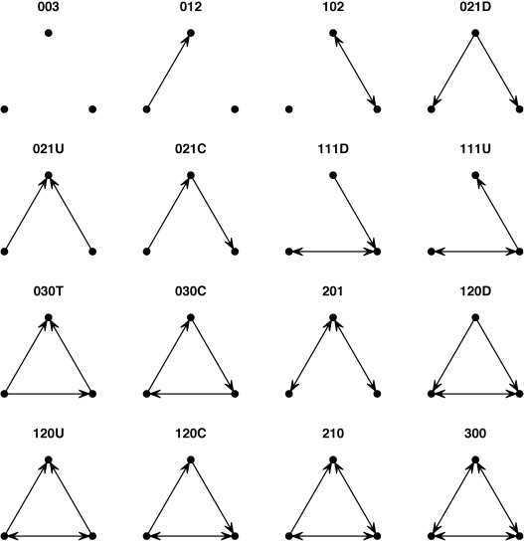
How many types of triads are there?
In a directed graph:
  There can be sixteen (16) possible triads!
C
B
E
A
F
D

Slide 399
Balance theory
Balance theory is a social psychological theory designed to explain expected triadic configurations in sentiment networks
  Sentiment networks are built from valenced ties (e.g., positive or negative)

Slide 400
Balance theory
Balance theory is a social psychological theory designed to explain expected triadic configurations in sentiment networks
  Sentiment networks are built from valenced ties (e.g., positive or negative)
There are four building blocks in balance theory
  (1) A person (P)
    We “look” at the triad from this person’s point of view
P

Slide 401
Balance theory
Balance theory is a social psychological theory designed to explain expected triadic configurations in sentiment networks
  Sentiment networks are built from valenced ties (e.g., positive or negative)
There are four building blocks in balance theory
  (2) An object (O) towards which the focal person has some kind of sentiment
    The sentiment can be positive or negative
P
O

Slide 402
Balance theory
Balance theory is a social psychological theory designed to explain expected triadic configurations in sentiment networks
  Sentiment networks are built from valenced ties (e.g., positive or negative)
There are four building blocks in balance theory
  (3) A third party (Q) towards which both the person and the other also have some kind of sentiment
Q
P
O

Slide 403
Balance theory
Balance theory is a social psychological theory designed to explain expected triadic configurations in sentiment networks
  Sentiment networks are built from valenced ties (e.g., positive or negative)
There are four building blocks in balance theory
  (4) A set of directed signed edges that indicate positive (solid) or negative (dashed) sentiments that P and O have toward the third party Q and P towards O
Q
P
O

Slide 404
Balance theory
Balance theory is a social psychological theory designed to explain expected triadic configurations in sentiment networks
  Sentiment networks are built from valenced ties (e.g., positive or negative)
There are four building blocks in balance theory
  (4) A set of directed signed edges that indicate positive (solid) or negative (dashed) sentiments that P and O have toward the third party Q and P towards O
Q
This reads:
Person (P) likes other (O)
Other (O) likes the third party (Q)
But person (P) dislikes the third party
P
O

Slide 405
Balance theory
Balance theory is a social psychological theory designed to explain expected triadic configurations in sentiment networks
  Sentiment networks are built from valenced ties (e.g., positive or negative)
There are four building blocks in balance theory
  (4) A set of directed signed edges that indicate positive (solid) or negative (dashed) sentiments that P and O have toward the third party Q and P towards O
Q
Example: You (P) have a friend (O) whom you like and they like another classmate (Q) who you dislike
Sounds dicey!
P
O

Slide 406
Balance theory
Balance theory is a social psychological theory designed to explain expected triadic configurations in sentiment networks
  Sentiment networks are built from valenced ties (e.g., positive or negative)
There are four building blocks in balance theory
  (4) A set of directed signed edges that indicate positive (solid) or negative (dashed) sentiments that P and O have toward the third party Q and P towards O
Q
In this example, you (P) have a friend (O) who you like and they like another classmate (Q) whom you also like.
Everything’s fine!
P
O

Slide 407
Balance theory
Balance theory is a social psychological theory designed to explain expected triadic configurations in sentiment networks
  Sentiment networks are built from valenced ties (e.g., positive or negative)
There are four building blocks in balance theory
  (4) A set of directed signed edges that indicate positive (solid) or negative (dashed) sentiments that P and O have toward the third party Q and P towards O
Q
In this example, you (P) have an enemy (O) who likes another classmate (Q) who you dislike
Seems fine?
P
O

Slide 408
Balance theory
Balance theory is a social psychological theory designed to explain expected triadic configurations in sentiment networks
  Sentiment networks are built from valenced ties (e.g., positive or negative)
There are four building blocks in balance theory
  Q does not have to be a real person!
    It could be any object
Q
In this example, you (P) love Marvel movies (Q) but your long time partner O (who you like duh!) hates them
Trouble in paradise!
P
O

Slide 409
Balance theory
There are eight (8) configurations featuring one-way directed links from:
  Person (P) to Other (O)
  Person (P) to Third Party (Q)
  Other (O) to Third Party (Q)

Slide 410
Balance theory
There are eight (8) configurations featuring one-way directed links from:
  Person (P) to Other (O)
  Person (P) to Third Party (Q)
  Other (O) to Third Party (Q)
Everything’s fine here!
Q
Q
P
P
O
O
Q
Q
P
P
O
O
Balanced Configurations

Slide 411
Balance theory
There are eight (8) configurations featuring one-way directed links from:
  Person (P) to Other (O)
  Person (P) to Third Party (Q)
  Other (O) to Third Party (Q)
Everything’s fine here!
Q
Q
P
P
O
O
Q
Q
P
P
O
O
Balanced Configurations

Slide 412
Balance theory
There are eight (8) configurations featuring one-way directed links from:
  Person (P) to Other (O)
  Person (P) to Third Party (Q)
  Other (O) to Third Party (Q)
Trouble in paradise!
Q
Q
Q
Q
P
P
P
P
O
O
O
O
Q
Q
Q
Q
P
P
P
P
O
O
O
O
Unbalanced Configurations
Balanced Configurations

Slide 413
Balance theory
Basic idea is that unbalanced configurations will tend to transition to balanced configurations
  Unbalanced configurations produce tension in P leading them to change their sentiments toward O or Q so as to generate balance
Q
Q
Q
Q
P
P
P
P
O
O
O
O
Q
Q
Q
Q
P
P
P
P
O
O
O
O
Unbalanced Configurations
Balanced Configurations

Slide 414
Balance theory
Basic idea is that unbalanced configurations will tend to transition to balanced configurations
  Unbalanced configurations produce tension in P leading them to change their sentiments toward O or Q so as to generate balance
Q
Q
Q
Q
P
P
P
P
O
O
O
O
Q
Q
Q
Q
P
P
P
P
O
O
O
O
Unbalanced Configurations
Balanced Configurations

Slide 415
Balance theory
Basic idea is that unbalanced configurations will tend to transition to balanced configurations
  Unbalanced configurations produce tension in P leading them to change their sentiments toward O or Q so as to generate balance
Q
Q
Q
Q
P
P
P
P
O
O
O
O
Q
Q
Q
Q
P
P
P
P
O
O
O
O
Unbalanced Configurations
Balanced Configurations

Slide 416
The Mathematics of Balance Theory
Remember the rules of sign multiplication from basic algebra?
  +1 * +1 = +1
  +1 * -1 = -1
  -1 * -1 = +1
Q
Q
Q
Q
P
P
P
P
O
O
O
O
Q
Q
Q
Q
P
P
P
P
O
O
O
O
Unbalanced Configurations
Balanced Configurations

Slide 417
The Mathematics of Balance Theory
Remember the rules of sign multiplication from basic algebra?
  +1 * +1 = +1
  +1 * -1 = -1
  -1 * -1 = +1
They apply to balance theory!
Q
Q
Q
Q
P
P
P
P
O
O
O
O
Q
Q
Q
Q
P
P
P
P
O
O
O
O
Unbalanced Configurations
Balanced Configurations

Slide 418
The Mathematics of Balance Theory
Turns out that if you multiply the signs of the edges of each of the unbalanced triads you get a negative number
  Try it!
Q
Q
Q
Q
P
P
P
P
O
O
O
O
Q
Q
Q
Q
P
P
P
P
O
O
O
O
Unbalanced Configurations
Balanced Configurations

Slide 419
The Mathematics of Balance Theory
Turns out that if you multiply the signs of the edges of each of the unbalanced triads you get a negative number
  +1_{PO} * +1_{OQ} * -1_{PQ} = -1_{POQ}
Q
Q
Q
Q
P
P
P
P
O
O
O
O
Q
Q
Q
Q
P
P
P
P
O
O
O
O
Unbalanced Configurations
Balanced Configurations

Slide 420
The Mathematics of Balance Theory
Turns out that if you multiply the signs of the edges of each of the unbalanced triads you get a negative number
  +1_{PO} * -1_{OQ} * +1_{PQ} = -1_{POQ}
Q
Q
Q
Q
P
P
P
P
O
O
O
O
Q
Q
Q
Q
P
P
P
P
O
O
O
O
Unbalanced Configurations
Balanced Configurations

Slide 421
The Mathematics of Balance Theory
Conversely, if you multiply the sign of the edges of the balanced triads you get a positive number:
  -1_{PO} * +1_{OQ} * -1_{PQ} = +1_{POQ}
Q
Q
Q
Q
P
P
P
P
O
O
O
O
Q
Q
Q
Q
P
P
P
P
O
O
O
O
Unbalanced Configurations
Balanced Configurations

Slide 422
The Mathematics of Balance Theory
Conversely, if you multiply the sign of the edges of the balanced triads you get a positive number:
  +1_{PO} * -1_{OQ} * -1_{PQ} = +1_{POQ}
Q
Q
Q
Q
P
P
P
P
O
O
O
O
Q
Q
Q
Q
P
P
P
P
O
O
O
O
Unbalanced Configurations
Balanced Configurations

Slide 423
The Mathematics of Balance Theory
A link between mathematics and the logic of social relations!
  “A friend of a friend is a friend”
  +1_{PO} * +1_{OQ} * +1_{PQ} = +1_{POQ}
Q
Q
Q
Q
P
P
P
P
O
O
O
O
Q
Q
Q
Q
P
P
P
P
O
O
O
O
Unbalanced Configurations
Balanced Configurations

Slide 424
The Mathematics of Balance Theory
A link between mathematics and the logic of social relations!
  “A friend of an enemy is an enemy”
  -1_{PO} * +1_{OQ} * -1_{PQ} = +1_{POQ}
Q
Q
Q
Q
P
P
P
P
O
O
O
O
Q
Q
Q
Q
P
P
P
P
O
O
O
O
Unbalanced Configurations
Balanced Configurations

Slide 425
The Mathematics of Balance Theory
A link between mathematics and the logic of social relations!
  “An enemy of a friend is an enemy”
  +1_{PO} * -1_{OQ} * -1_{PQ} = +1_{POQ}
Q
Q
Q
Q
P
P
P
P
O
O
O
O
Q
Q
Q
Q
P
P
P
P
O
O
O
O
Unbalanced Configurations
Balanced Configurations

Slide 426
The Mathematics of Balance Theory
A link between mathematics and the logic of social relations!
  “An enemy of an enemy is a friend”
  -1_{PO} * -1_{OQ} * +1_{PQ} = +1_{POQ}
Q
Q
Q
Q
P
P
P
P
O
O
O
O
Q
Q
Q
Q
P
P
P
P
O
O
O
O
Unbalanced Configurations
Balanced Configurations

Slide 427
Why are triads so special?
Simmelian Tie Theory:
  There are two types of connected dyads in networks:

Slide 428
Why are triads so special?
Simmelian Tie Theory:
  There are two types of connected dyads in networks:
    Simmelian ties*
      Dyads embedded in triads
*Named after the German sociologist Georg Simmel

Slide 429
Why are triads so special?
Simmelian Tie Theory:
  There are two types of connected dyads in networks:
    Simmelian ties*
      Dyads embedded in triads
    “Regular” (non-Simmelian) ties
      Stand alone dyads
*Named after the German sociologist Georg Simmel

Slide 430
Why are triads so special?
Simmelian Tie Theory:
  There are two types of connected dyads in networks:
    Simmelian ties*
      Dyads embedded in triads
    “Regular” (non-Simmelian) ties
      Stand alone dyads
Contrast between a two-person and a three-person “group”
*Named after the German sociologist Georg Simmel

Slide 431
Why are triads so special?
Simmelian Tie Theory:
  In a two-person group (standalone dyad):
    Have more individuality
    More potential for unresolved differences

Slide 432
Why are triads so special?
Simmelian Tie Theory:
  In a two-person group (standalone dyad):
    People have more individuality
    More potential for unresolved differences
      Ties are more “Breakable”
    Have more individuality
    More potential for unresolved differences

Slide 433
Why are triads so special?
Simmelian Tie Theory:
  In a two-person group (standalone dyad):
    People have more individuality
    More potential for unresolved differences
      Ties are more “Breakable”
  In a three-person group (Simmelian dyads):

Slide 434
Why are triads so special?
Simmelian Tie Theory:
  In a two-person group (standalone dyad):
    People have more individuality
    More potential for unresolved differences
      Ties are more “Breakable”
  In a three-person group (Simmelian dyads):
    There is more pressure to conform to the views of others
      Any one member can be “outvoted” by the other two

Slide 435
Why are triads so special?
Simmelian Tie Theory:
  In a two-person group (standalone dyad):
    People have more individuality
    More potential for unresolved differences
      Ties are more “Breakable”
  In a three-person group (Simmelian dyads):
    There is more pressure to conform to the views of others
      Any one member can be “outvoted” by the other two
    There is more potential for conflict resolution
      A fight between two members can be mediated by the third

Slide 436
Why are triads so special?
Simmelian Tie Theory:
  Predictions:
    Simmelian ties are stronger
    Simmelian ties last longer
    Simmelian ties are harder to break
  In a three-person group (Simmelian dyads):
    There is more pressure to conform to the views of others
      Any one member can be “outvoted” by the other two
    There is more potential for conflict resolution
      A fight between two members can be mediated by the third

Slide 437
Why are triads so special?
Simmelian tie theory:
  Explains why conflict is more difficult to settle in standalone dyads
  Explains why sometimes only conflict resolution recourse is to turn the standalone dyad into a “temporary” Simmelian dyad:
    Arbitration
    Mediation
  Research shows that third parties are useful in alleviating dyadic conflicts

Slide 438
Why are triads so special?
Simmel’s Model:
  Triads are qualitatively different from dyads
  Dyads embedded in reciprocally strong triads are not the same as standalone dyads
    People are “power-symmetric” in a standalone dyad:
      If either withdraws relationship dissolves
    Any one ego is experiences “power-asymmetry” (dependence) in an a triad:
      S/he can withdraw but the other two people still have a relationship
      S/he loses the benefits of two relationships
        Each other ego only loses one

Slide 439
Social Networks and Status Attainmnent

Slide 440
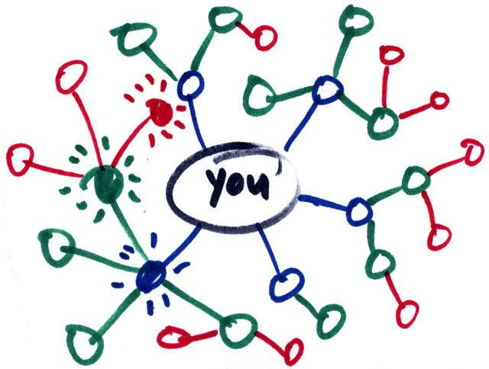
What is social capital?
Social capital:
  Benefits accrued as the result of your connections
    People who are better connected do better
What can you get from your connections?
  Some benefits comes from strong, dense networks:
    Social and emotional support
      Trusting somebody with an intimate secret
    Companionship
      Having somebody to hang out with
    Material support
      knowing where to go in a time of need

Slide 441
What is social capital?
Social capital:
  Benefits accrued as the result of your connections
    People who are better connected do better
What can you get from your connections?
  Some benefits come weakly connected, diverse networks:
    Novel information
      Finding out about things that your close contacts might not know
    New or cutting edge ideas
      Combining different ideas into a new idea
    New people
      Being introduced to people who can help

Slide 442
What is social capital?
What you get from your connections depends on how you are connected to others
  Two arguments:
    Social capital as closure (Coleman 1990)
      Having a core group of intimate friends who also know one another
    Social capital as brokerage (Burt 2005: 4)
      “Advantage created by a person’s location in a structure of relations”
  Which one is the better form of capital?
    Depends on what you want!
Here we will focus on the second:
  Social capital from being a connector (or being connected to people who connect) between different worlds

Slide 443
Granovetter’s strength of weak ties theory
Concept:
  Granovetter-transitivity (g-transitivity)
    Rule 1: if two people are strongly connected they are likely to have a lot of other friends in common
A
B
Strong Tie

Slide 444
Granovetter’s strength of weak ties theory
Concept:
  Granovetter-transitivity (g-transitivity)
    Rule 1: if two people are strongly connected they are likely to have a lot of other friends in common
    Rule 2: if A and B have a strong tie and B and C have a strong tie there should be at least a weak tie between A and C
Good probability of
existing tie!
C
Strong Tie
A
B
Strong Tie

Slide 445
Granovetter’s strength of weak ties theory
Concept:
  Granovetter-transitivity (g-transitivity)
    Rule 1: if two people are strongly connected they are likely to have a lot of other friends in common
    Rule 2: if A and B have a strong tie and B and C have a strong tie there should be at least a weak tie between A and C
  Reasons for g-transitivity:
    Demographic similarity (homophily)
    Shared foci
    Propinquity
Good probability of
existing tie!
C
Strong Tie
A
B
Strong Tie

Slide 446
Granovetter’s strength of weak ties theory
Concept:
  Granovetter’s weak tie principle:
    Weak ties allow for a violation of g-transitivity
    You don’t have to be connected to the people who are connected to the people whom you only have a weak tie connection to
Good probability of
no tie!
C
Strong Tie
A
B
Weak Tie

Slide 447
Strength of weak ties theory
Application of the g-transitivity principle to ego-network layers:
  G-transitivity more likely to apply to strong ties in your support clique and sympathy group
Implication:
  Weak ties in you active network less likely to be connected to one another
G-transitive ties
G-transitivity violations

Slide 448
Strength of weak ties theory
Application of the g-transitivity principle to ego-network layers:
  Weak ties can function as bridges to parts of social structure to which you wouldn’t have access
Implication:
  Absent weak ties:
    You will not have access to distant parts of the social system
    Information will tend to be local
    Will put you at a disadvantage when novel information is valuable

Slide 449
Strength of weak ties theory
People who may know something your close friends don’t know
Application of the g-transitivity principle to ego-network layers:
  Weak ties can function as bridges to parts of social structure to which you wouldn’t have access
Implication:
  Absent weak ties:
    You will not have access to distant parts of the social system
    Information will tend to be local
    Will put you at a disadvantage when novel information is valuable
Broker
Bridging tie

Slide 450
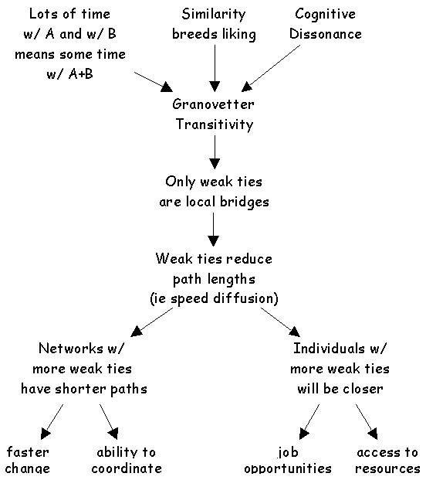
Application: Getting a job
If social mobility (e.g. finding new job opportunities) depends on (new) information access:
  Then having weak ties will be correlated with mobility and other forms of success
  Contacts with whom you are weakly connected will be more likely to know something you don’t know
  Weak ties help you insofar as they connect you to others with access to both information and resources

Slide 451
Structural holes theory
People who may know something your close friends don’t know
Strength of weak ties theory is a theory about how you can connect to brokers by developing bridging ties
  It is a theory of social capital as information access
But note that here the powerful person is the broker not you
  They control the information
What if you want to be the broker in control?
Broker
Bridging tie

Slide 452
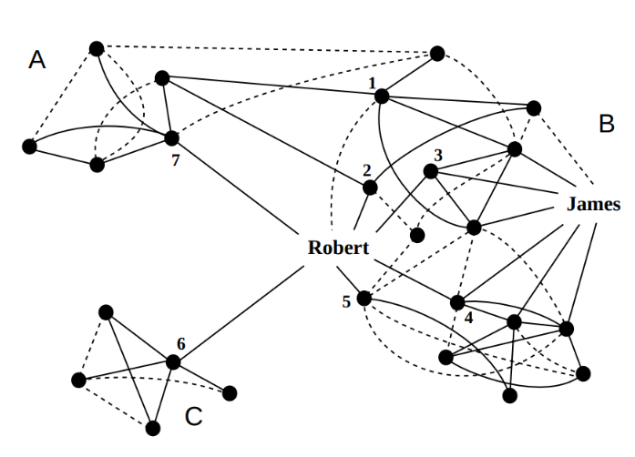
Structural holes theory
Structural holes theory is a theory about how to configure your network so that you control the information:
  Others depend on you for access
  You maximize social capital when you occupy a position “in between” others:
    Violations of g-transitivity create “holes” in social structure
  Who has the most social capital?
    James or Robert?

Slide 453
Structural holes theory
Structural holes in networks provide two kinds of benefits:
  Passive exposure effect:
    You get to know what other people know (a la Granovetter)
  Active control effect (Burt 1995):
    You decide whether some people know some things or not
    You shape the way other people perceive others
    You can play people against one another

Slide 454
Structural holes theory
Structural holes in networks provide two kinds of benefits:
  Passive exposure effect:
    You get to know what other people know (a la Granovetter)
  Active control effect (Burt 1995):
    You are less bound by the norms and expectations of any one group
    You are free to move across the social structure
      Be different things to different people

Slide 455
Structural holes theory
The opposite of having structural holes is what Burt calls Network Constraint
  In a high constraint network:
    Your contacts are connected to one another
    You are subject to the strong expectations of a single group
    You depend on others for information access

Slide 456
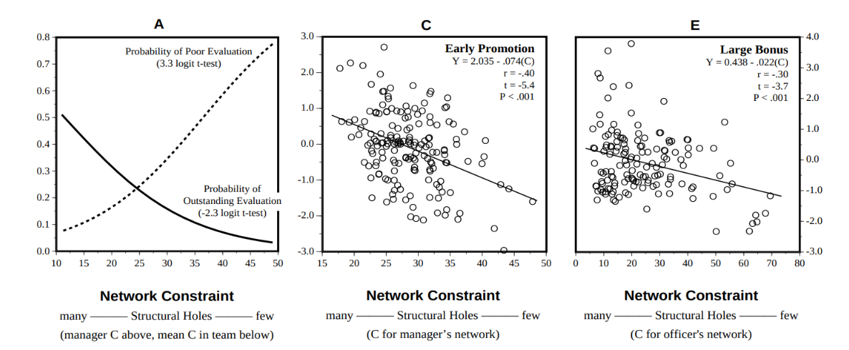
Structural holes theory
Evidence for structural holes argument (Burt 2005):
  In corporate settings people who have networks rich in structural holes (low constraint):
    Receive higher salaries
    Get promoted faster
    Receive better performance evaluations

Slide 457
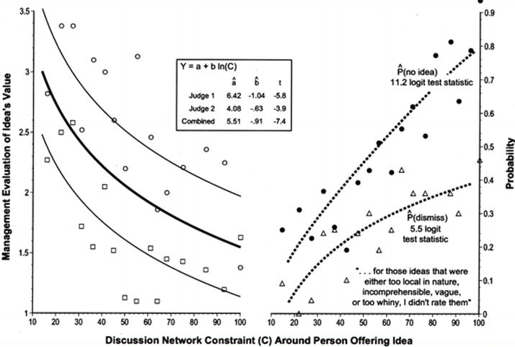
Structural holes theory
Why do people located in between structural holes do better?
  They have better ideas (Burt 2005)
Why do they have better ideas?
  They can combine elements from different sources to create novel combinations

Slide 458
Ego networks: Clustering Coefficient
a
b
a
b
a
b
Ego
Ego
Ego
c
d
c
d
c
d
 | a | b | c | d
a | -- | 0 | 0 | 0
b | 0 | -- | 0 | 0
c | 0 | 0 | -- | 0
d | 0 | 0 | 0 | --
 | a | b | c | d
a | -- | 1 | 1 | 0
b | 1 | -- | 0 | 0
c | 1 | 0 | -- | 1
d | 0 | 0 | 1 | --
 | a | b | c | d
a | -- | 1 | 1 | 1
b | 1 | -- | 1 | 1
c | 1 | 1 | -- | 1
d | 1 | 1 | 1 | --
CC_{ego}= 0
CC_{ego}= 0.5
CC_{ego}= 1.0
Unclustered
Clustered

Slide 459

Transitivity
Refers to the tendency in human social networks for open triads to transition into closed triads
  Akin to Mathematical transitivity
  Relation R is transitive iff:
    aRb, and bRc jointly imply aRc
    Equality, Less than, Greater than, etc.
      If 4 > 3 & 3 > 2 then 4 > 2
  Same reasoning can apply to social relationships:
    If A is friends with B and B is friends with C then A is friends with C

Slide 460
Theories of transitivity
Balance Theory
  Open triad
  Ego feels psychological pressure
  Ego relieves pressure by closing (e.g., introducing unconnected alters)
    Mechanism: Ego-driven link formation
Psychological Pressure

Slide 461
Theories of transitivity
Theory of Social Foci
  Empty triad
  Actors participates in common focus/joint activity
  Closed triad (3-clique)
    Mechanism: Context-driven link formation
Social
Foci

Slide 462
Theories of transitivity
Strength of Weak Ties Theory
  Open triad with strong links
  Depending on strength
  Triad will either close or remain open
    Mechanism: Strength-driven link formation
Strength Effect

Slide 463
Theories of transitivity
Strength of Weak Ties Theory
  Open triad with weak links
  Depending on strength
  Triad will either close or remain open
    Mechanism: Open triads stay that way if the links are weak
Weak Tie Effect

Slide 464
Theories of transitivity
Structural Holes Theory
  Unbalanced triad
  Ego gains control benefits from it
  Ego works to keep it from closing
    Mechanism: Ego-driven brokerage
Ego works to keep open

Slide 465
Theories of transitivity
Simmelian Tie Theory:
  Closed triad
  Simmelian tie effect
  Triad stays closed
    Mechanism: Triads have “top-down” effects on the dyads that compose them
All actors work together to keep ties from dissolving

Slide 466
Diversity-bandwidth tradeoff
Original Granovetter argument conceives of the properties of ties (e.g. strength) in static terms
  Yet information transmission/access are events that happen in time
In original SWT argument:
  Weak ties: Novel information
  Strong ties: Old/redundant information

Slide 467
High
Network Clustering
Low
Clustered Network of Strong, High-Bandwidth Ties
Unclustered Network of Weak, Low-Bandwidth Ties
Channel Bandwidth
High
Low

Slide 468
Diversity-bandwidth tradeoff
When taking into account temporal flow:
  “Weak” ties: Information transmission at slower rates (less frequency)
  “Strong” ties: Information transmission at higher rates (more frequency)
When seeking information via social networks
  There is a tradeoff between novelty/diversity of information and tie “bandwidth”

Slide 469
Diversity-bandwidth tradeoff
What about information complexity?
  Low bandwidth ties: Novel but “simple” information
    Who’s hiring? What’s the best messaging app?
  But what about novel but complex information?
    How to do network analysis in R
  In that case higher bandwidth ties are better!

Slide 470
Diversity-bandwidth tradeoff
The strength of high bandwidth ties:
  More trust, intimacy, and cooperativeness
  Better memory of who knows what
  More effective at transferring complex, interdependent information
  Creating new knowledge (e.g. bringing together rather than keeping apart)
  Commonality of interests and experience (homophily)

Slide 471
Diversity-bandwidth tradeoff
In thinking about preferences between low and high bandwidth ties we must take into account properties of the information environment
  Who knows what?
  At what frequency is knowledge transmitted?
Low bandwidth works better when contacts are diverse in information
1, 2, 3, 4
1, 2, 3, 4
5, 6, 7, 8
1, 2, 3, 4

Slide 472
Diversity-bandwidth tradeoff
1, 2, 3, 4
1, 2, 3, 4
This is better!
5, 6, 7, 8
1, 2, 3, 4
When your contacts have diverse pools of information (different people you know different things)
  Weak low bandwidth ties are better

Slide 473
Diversity-bandwidth tradeoff
1, 2, 3, 4
1, 2, 3, 4
This is redundant!
5, 6, 7, 8
1, 2, 3, 4
When your contacts do not have diverse pools information (the people you know all know the same thing because they talk to one another)
  Strong, high-bandwidth ties just give you the same information

Slide 474
Diversity-bandwidth tradeoff
In thinking about preferences between low and high bandwidth ties we have to consider properties of the information environment
  Who knows what?
  At what frequency is knowledge transmitted?
1, 2, 3, 4
1, 2, 3, 4
1, 2, 3, 4
5, 6, 7, 8
1, 2, 7, 8
1, 2, 3, 4

Slide 475
Diversity-bandwidth tradeoff
Low bandwidth works better when contacts are diverse in information
  Low bandwidth ties lose their advantage even when connecting ego to contacts with more homogeneous information, even if there is partial overlap of information across contacts
No Information Overlap
Some Information Overlap
Total Information Overlap
1, 2, 3, 4
1, 2, 3, 4
1, 2, 3, 4
5, 6, 7, 8
1, 2, 7, 8
1, 2, 3, 4
Low bandwidth ties are good here!
Low bandwidth ties not as good...
Low bandwidth ties are worse here!

Slide 476
Diversity-bandwidth tradeoff
1, 2, 3, 4
1, 2, 3, 4
This is better!
1, 2, 7, 8
1, 2, 3, 4
When your contacts do not have diverse pools information (the people you know all know the same thing because they talk to one another)
  Strong, high-bandwidth ties just give you the same information

Slide 477
Why are triads so special?
Simmelian Tie Theory:
  In a two-person group (standalone dyad):
    People have more individuality
    More potential for unresolved differences
  In a three-person group (Simmelian dyads):
    There is more pressure to conform to the views of others
      Any one member can be “outvoted” by the other two
    There is more potential for conflict resolution
      A fight between two members can be mediated by the third

Slide 478
Status, Hierarchy, and Valenced Interactions

Slide 479
Valenced interactions
Most social network theories assume ties and network flows are usually positive or neutral:
  Ties
    Friendship
    Kinship
    Co-membership
  Flows
    Information
    Support
    Gossip
    Violence

Slide 480
Valenced interactions
Most real-world social networks feature a mix of:
  Positive and negative ties:
    Friends and enemies
    Liking and disliking
    Members of same group versus rival groups
  Positive and negative flows:
    Gossip versus compliments
    Helping versus violence
These are called valenced relationships

Slide 481
Valenced interactions
Core network concepts change meaning when ties are valenced!
  In-degree centrality:
    Friendship (good)
    Disliking (bad!)
    Support (good!)
    Enemies (bad?)
  The same goes for out-degree:
    A bully is a person who has lots of outgoing negative ties
  And other network metrics:
    Closeness, Betweenness, Eigenvector

Slide 482
Valenced interactions
We have seen on network theory (balance) designed to explain valenced relationships
But this is not the only approach!
  Status theory
    (an extension of balance theory)

Slide 483
Valenced interactions: Status theory
Ego
Other
Neg.
Pos.
Status Theory
  Designed to explain distribution of positive and negative ties in valenced networks with directed ties
First principle:
  Status in valenced networks is determined by sign of ties received
    High status
      Lots of incoming positive ties
    Low status
      Lots of incoming negative ties
    Directed positive tie from i →j:
      I thinks of j as higher status
High Status
Low Status

Slide 484
Valenced interactions: Status theory
Ego
Other
Neg.
Pos.
Status Theory
  Designed to explain distribution of positive and negative ties in valenced networks with directed ties
First principle:
  Status in valenced networks is determined by sign of ties received
    High status
      Lots of incoming positive ties
    Low status
      Lots of incoming negative ties
    Directed negative tie from i →j:
      I thinks of j as lower status
High Status
Low Status

Slide 485
Valenced interactions: Status theory
Ego
Other
Neg.
Pos.
Status Theory
  Designed to explain distribution of positive and negative ties in valenced networks with directed ties
Second principle:
  Status of nodes is also determined by the sign of their connections to (high and low status) others
    Positive ties to high status others increase status
    Positive ties to low status others decrease status
Status Boost
Status Loss

Slide 486
Valenced interactions: Status theory
Ego
Other
Neg.
Pos.
Status Theory
  Designed to explain distribution of positive and negative ties in valenced networks with directed ties
Second principle:
  Status of nodes is also determined by the sign of their connections to (high and low status) others
    Positive ties to high status others increase status
    Positive ties to low status others decrease status
Status Boost
Status Loss

Slide 487
Valenced interactions: Status theory
Ego
Other
Neg.
Pos.
Status Theory
  Designed to explain distribution of positive and negative ties in valenced networks with directed ties
Second principle:
  Status of nodes is also determined by the sign of their connections to (high and low status) others
    Negative ties to high status others decrease status
    Negative ties to low status others increase status
Status Loss
Status Boost

Slide 488
Valenced interactions: Status theory
Ego
Other
Neg.
Pos.
Status Theory
  Designed to explain distribution of positive and negative ties in valenced networks with directed ties
Second principle:
  Status of nodes is also determined by the sign of their connections to (high and low status) others
    Negative ties to high status others decrease status
    Negative ties to low status others increase status
Status Loss
Status Boost

Slide 489
Valenced interactions: Status theory
Ego
Other
Neg.
Pos.
Status Theory
  Designed to explain distribution of positive and negative ties in valenced networks with directed ties
Third principle:
  People aim to avoid status loss and seek status boosts:
    High status individuals will accumulate positive ties
      Rich get richer effect
Time 1
Time 2

Slide 490
Valenced interactions: Status theory
Ego
Other
Neg.
Pos.
Status Theory
  Designed to explain distribution of positive and negative ties in valenced networks with directed ties
Third principle:
  People aim to avoid status loss and seek status boosts:
    Low status individuals will accumulate negative ties
      “Gang up” effect
Time 1
Time 2

Slide 491
Valenced interactions: Status theory
Ego
Other
Neg.
Pos.
Status Theory
  Designed to explain distribution of positive and negative ties in valenced networks with directed ties
Third principle:
  People aim to avoid status loss and seek status boosts:
    High status individuals will lose negative ties
Time 1
Time 2

Slide 492
Valenced interactions: Status theory
Ego
Other
Neg.
Pos.
Status Theory
  Designed to explain distribution of positive and negative ties in valenced networks with directed ties
Third principle:
  People aim to avoid status loss and seek status boosts:
    Low status individuals will lose positive ties
Time 1
Time 2

Slide 493
Valenced interactions: Karma theory
Ego
Other
Neg.
Pos.
Karma Theory: You get what you spread out!
  Status theory is based on (negative and positive) popularity
    Graph theoretic indegree centrality
  Karma theory is based on (negative and positive) activity
    Graph theoretic outdegree centrality
Time 1
Time 2

Slide 494
Valenced interactions: Karma theory
Ego
Other
Neg.
Pos.
Karma Theory: You get what you spread out!
  Status theory is based on (negative and positive) popularity
    Graph theoretic indegree centrality
  Karma theory is based on (negative and positive) activity
    Predict valenced indegree (what you get) from valenced outdegree (what you spread)
Time 1
Time 2

Slide 495
Valenced interactions: Karma theory
Ego
Other
Neg.
Pos.
Karma Theory: You get what you spread out!
  Status theory is based on (negative and positive) popularity
    Graph theoretic indegree centrality
  Karma theory is based on (negative and positive) activity
    Predict valenced indegree (what you get) from valenced outdegree (what you spread)
Bullies get bullied!
Time 2
Time 1

Slide 496
Valenced interactions: Karma theory
Ego
Other
Neg.
Pos.
Karma Theory: You get what you spread out!
  Status theory is based on (negative and positive) popularity
    Graph theoretic indegree centrality
  Karma theory is based on (negative and positive) activity
    Predict valenced indegree (what you get) from valenced outdegree (what you spread)
Likers get liked!
Time 2
Time 1

Slide 497
Valenced interactions: Solidarity theory
Ego
Other
Neg.
Pos.
Solidarity Theory
  People in the same position in the valenced interaction network are likely to link via positive ties
Two types of solidarity:
  Status solidarity
  Karma solidarity
Time 1
Time 2

Slide 498
Valenced interactions: Solidarity theory
Ego
Other
Neg.
Pos.
Solidarity Theory
  People in the same position in the valenced interaction network are likely to link via positive ties
Two types of solidarity:
  Status solidarity
  Karma solidarity
Popular “in-crowd” effect
Time 2
Time 1

Slide 499
Valenced interactions: Solidarity theory
Ego
Other
Neg.
Pos.
Solidarity Theory
  People in the same position in the valenced interaction network are likely to link via positive ties
Two types of solidarity:
  Status solidarity
  Karma solidarity
The downtrodden stick together!
Time 2
Time 1

Slide 500
Valenced interactions: Solidarity theory
Ego
Other
Neg.
Pos.
Solidarity Theory
  People in the same position in the valenced interaction network are likely to link via positive ties
Two types of solidarity:
  Status solidarity
  Karma solidarity
Bullies stick together!
Time 2
Time 1

Slide 501
Valenced interactions: Solidarity theory
Ego
Other
Neg.
Pos.
Solidarity Theory
  People in the same position in the valenced interaction network are likely to link via positive ties
Two types of solidarity:
  Status solidarity
  Karma solidarity
Cool kids stick together!
Time 2
Time 1

Slide 502
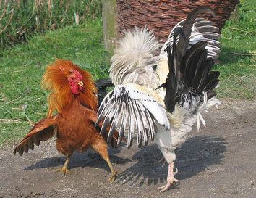
Dominance orders among animals
Dominance hierarchies:
  Observed across a number of species in the animal kingdom
  Including (most notably) among chickens
  You do not need a big brain to create a (complex) social network!
“Pure” dominance order:
  Directed
    A dominates B
  Anti-symmetric
    If A dominates B then B cannot dominate A

Slide 503
Dominance orders among animals
Dominance hierarchies:
  Observed across a number of species in the animal kingdom
  Including (most notably) among chickens
  You do not need a big brain to create a (complex) social network!
“Pure” dominance order:
  Complete (all ties present)
    Either A dominates B or B dominates A

Slide 504
Dominance orders among animals
Dominance hierarchies:
  Observed across a number of species in the animal kingdom
  Including (most notably) among chickens
  You do not need a big brain to create a (complex) social network!
“Pure” dominance order:
  Transitive (all ties present)
    If A dominates B, and B dominates C, then by necessity A dominates C

Slide 505
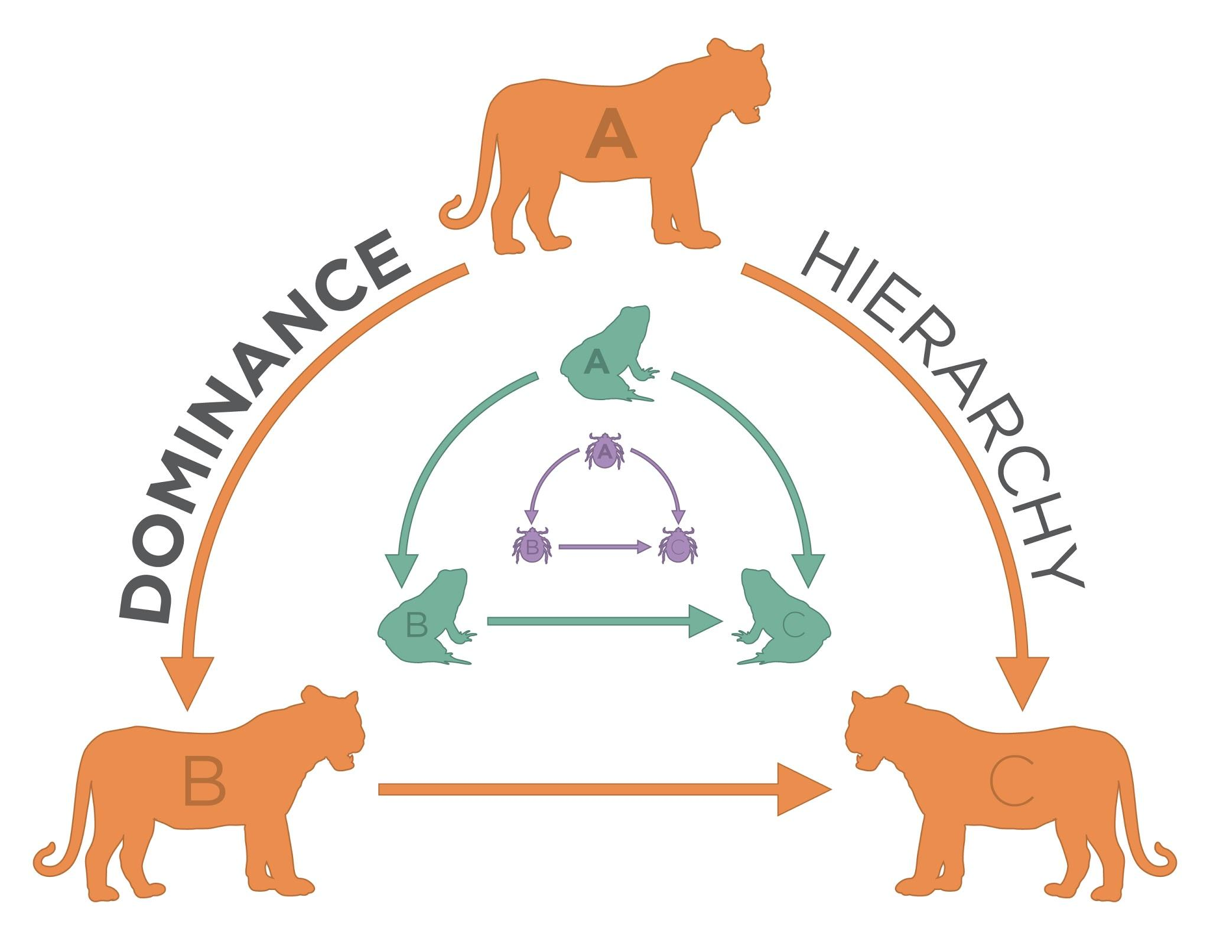
Algebraic Requirements for Dominance Order
A linear dominance order is transitive
Transitivity is a relation between node triples
  If a dominates b, and b dominates c
    Then a necessarily dominates c
a
b
c
This arc has to exist!
Transitive Triad

Slide 506
Algebraic Requirements for Dominance Order
A linear dominance order contains no cyclical triads
  Flashback: A cycle is a path that begins and ends with the same node
a
b
c
This would be weird!
Cyclical Triad

Slide 507
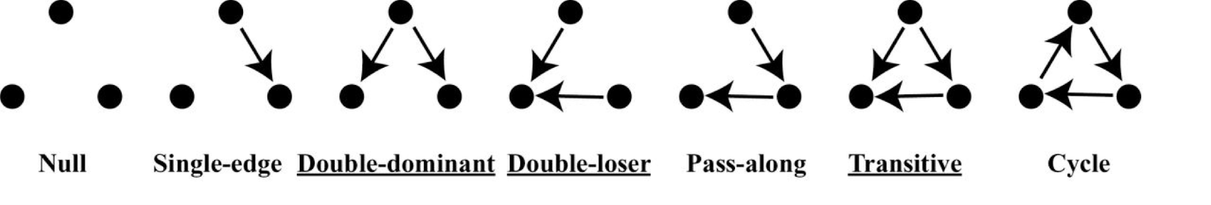
The emergence of dominance hierarchies
A dominance order can be represented as dominance network
  Nodes are animals (whether human or not)
  Directed, antisymmetric links indicate that animal i dominates animal j
Types of possible triads in dominance networks:

Slide 508
The emergence of dominance hierarchies
A dominance order can be represented as dominance network
  Nodes are animals (whether human or not)
  Directed, antisymmetric links indicate that animal i dominates animal j
Types of expected triads in dominance networks:

Slide 509
The emergence of dominance hierarchies
Chickens form perfectly linear hierarchies (breaks down at about 10)
How are these social structures formed?
  An attribute based-model says position in the hierarchy is a function of individual characteristics (size, age, strength, etc.)
How do we
go from:
This
To this?

Slide 510
The emergence of dominance hierarchies
Chickens form perfectly linear hierarchies (breaks down at about 10)
How are these social structures formed?
  A interaction-based model says the hierarchy emerges from local network processes partially independently from attributes
How do we
go from:
This
To this?

Slide 511
Agonistic Competition as Iterative and Social
Three possible mechanisms:
  Winner Effects
    Confidence, testosterone boost, experience
    Emergence of double-dominant triads
  Loser Effects
    Lowered confidence, injury
    Emergence of double-loser triads
  Bystander Effects
    Confidence vis-a-vis winner and loser changes
    From single-edge to either:
      Double-dominant triads
Winner Effects
Loser Effects
Bystander Effects
Time 1
Time 2

Slide 512
Agonistic Competition as Iterative and Social
Three possible mechanisms:
  Winner Effects
    Confidence, testosterone boost, experience
    Emergence of double-dominant triads
  Loser Effects
    Lowered confidence, injury
    Emergence of double-loser triads
  Bystander Effects
    Confidence vis-a-vis winner and loser changes
    From single-edge to either:
      Double-loser triads
Winner Effects
Loser Effects
Bystander Effects
Time 1
Time 2

Slide 513
Agonistic Competition as Iterative and Social
Three possible mechanisms:
  Winner Effects
    Confidence, testosterone boost, experience
    Emergence of double-dominant triads
  Loser Effects
    Lowered confidence, injury
    Emergence of double-loser triads
  Bystander Effects
    Bystanders almost never dominate initial dominant
Winner Effects
Loser Effects
Bystander Effects
Weird!
Time 1
Time 2

Slide 514
Agonistic Competition as Iterative and Social
Three possible mechanisms:
  Winner Effects
    Confidence, testosterone boost, experience
    Emergence of double-dominant triads
  Loser Effects
    Lowered confidence, injury
    Emergence of double-loser triads
  Bystander Effects
    Bystanders almost never dominate initial dominant
    Bystanders almost never get dominated by initial loser
Winner Effects
Loser Effects
Bystander Effects
Also
Weird!
Time 1
Time 2

Slide 515
Agonistic Competition as Iterative and Social
Three possible mechanisms:
  Winner Effects
    Confidence, testosterone boost, experience
    Emergence of double-dominant triads
  Loser Effects
    Lowered confidence, injury
    Emergence of double-loser triads
  Bystander Effects
    Bystanders almost never dominate initial dominant
    Bystanders almost never get dominated by initial loser
    This guarantees transitivity and linearity!
Winner Effects
Loser Effects
Bystander Effects
Time 1
Time 2

Slide 516
Affiliation Networks

Slide 517
Affiliation Networks
Typically a network consists of a set of units of the same kind linked via some kind of relationship
  Person to person friendship ties
  Organization to organization alliances
  Airport to airport plane routes

Slide 518
Affiliation Networks
Typically a network consists of a set of units of the same kind linked via some kind of relationship
  Person to person friendship ties
  Organization to organization alliances
  Airport to airport plane routes
Sometimes a network is composed of relationships between two types of entities:
  Persons and they groups they belong to
  Actors and the movies they appear in
  Scientists and papers they write

Slide 519
Affiliation Networks
Typically a network consists of a set of units of the same kind linked via some kind of relationship
  Person to person friendship ties
  Organization to organization alliances
  Airport to airport plane routes
Sometimes a network is composed of relationships between two types of entities:
  Persons and they groups they belong to
  Actors and the movies they appear in
  Scientists and papers they write
These are called Affiliation Networks

Slide 520
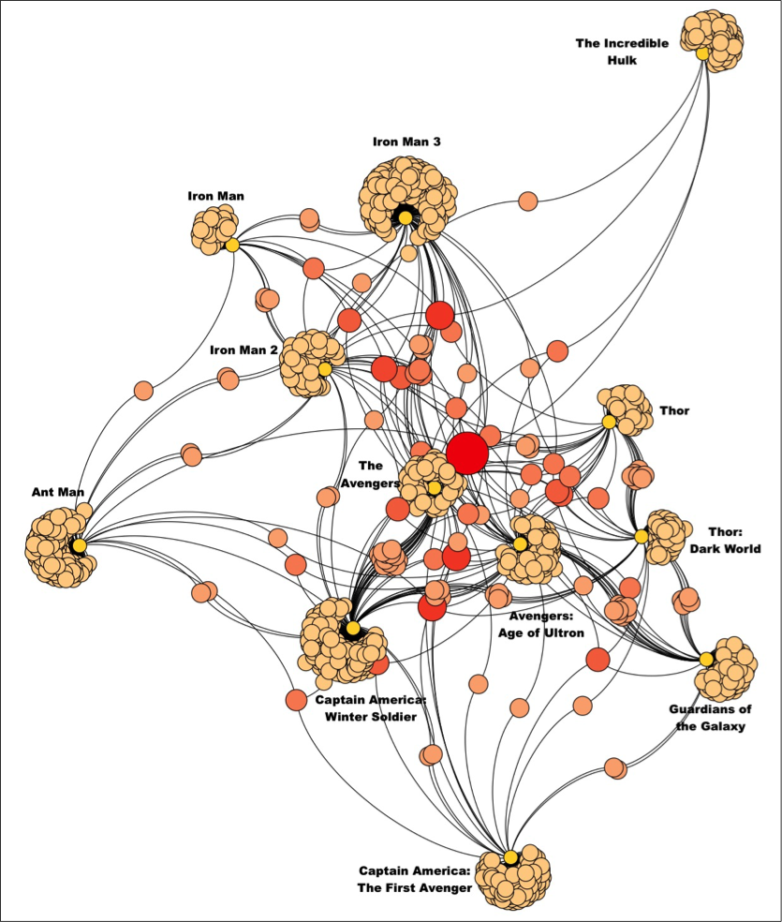
What is an affiliation network?
Types of affiliation networks that have been studied in the literature include:
  Hollywood actors and the movies that they make
  CEOs and the board of directors that they sit on
  Books and the people who buy them
  Scientists and the journal they publish in

Slide 521
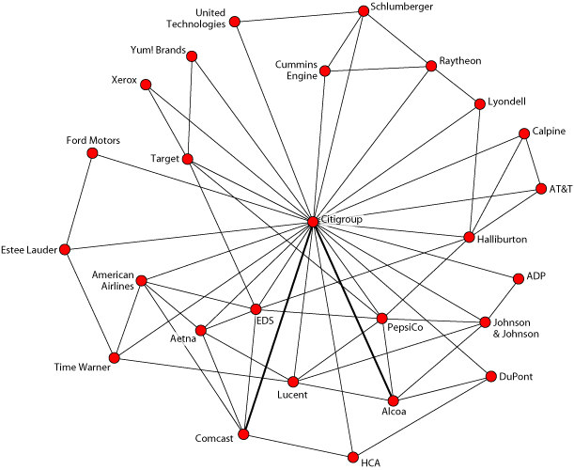
What is an affiliation network?
Types of affiliation networks that have been studied in the literature include:
  Hollywood actors and the movies that they make
  CEOs and the board of directors that they sit on
  Books and the people who buy them
  Scientists and the journal they publish in

Slide 522
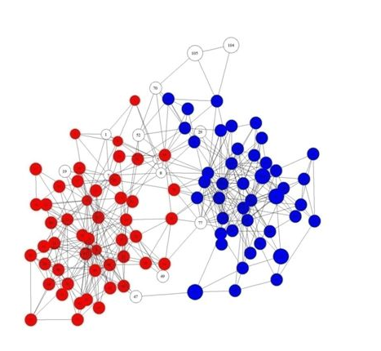
What is an affiliation network?
Types of affiliation networks that have been studied in the literature include:
  Hollywood actors and the movies that they make
  CEOs and the board of directors that they sit on
  Books and the people who buy them
  Scientists and the journal they publish in

Slide 523
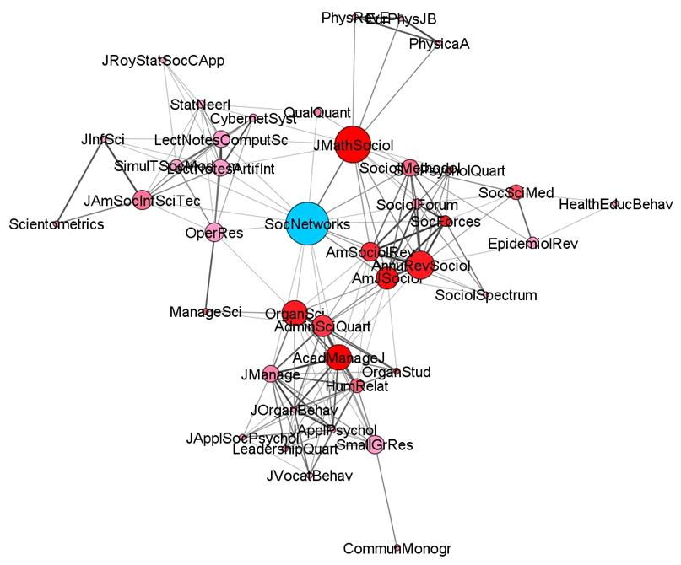
What is an affiliation network?
Types of affiliation networks that have been studied in the literature include:
  Hollywood actors and the movies that they make
  CEOs and the board of directors that they sit on
  Books and the people who buy them
  Scientists and the journal they publish in

Slide 524
Bipartite Graphs
U
V
In Affiliation Networks people are linked to other (usually larger) entities that are not people
  Actors and movies
  Scientists and papers
  Persons and events
Bipartite graphs can be used to represent the social network concepts of affiliation or membership
Gabriela
Super Smash Bros.
Parker
Cheese
Brandon
Nerdfighters
Marie
Magic
Rahul
Fashion
Minjoo

Slide 525
Bipartite Graphs
U
V
A bipartite graph is a special kind of graph featuring:
  Two disjoint sets of vertices, U, V
    Two sets are disjoint when they don’t share members
  One edge set (E)
    G = {U, V, E}
  Edges link vertices between sets but not within sets
  The two vertex sets can be of different cardinality (size)!
    |U| = 6, |V| = 5
Gabriela
Super Smash Bros.
Parker
Cheese
Brandon
Nerdfighters
Marie
Magic
Rahul
Fashion
Minjoo

Slide 526
Bipartite Graphs
U
V
A bipartite graph is a special kind of graph featuring:
  Two disjoint sets of vertices, U, V
    Two sets are disjoint when they don’t share members
  Edges link vertices between sets but not within sets
  Affiliation or membership relations are undirected
  The two sets can be of different cardinality (size)! (|U| = 6, |V| = 5)
Gabriela
Super Smash Bros.
Parker
Cheese
Brandon
Nerdfighters
Marie
Magic
Rahul
Fashion
Minjoo

Slide 527
Form bipartite graph to affiliation matrix
Gabriela
Super Smash Bros.
 | Super Smash Bros. | Cheese | Nerd- Fighters | Magic | Fashion
Gabriela
Parker
Brandon
Marie
Rahul
Minjoo
Parker
Cheese
Brandon
Nerdfighters
Marie
Magic
Rahul
Fashion
Minjoo
An affiliation matrix (A) has number of rows equals to the number of people and number of columns equal to the number of groups!

Slide 528
Form bipartite graph to affiliation matrix
Gabriela
Super Smash Bros.
 | Super Smash Bros. | Cheese | Nerd- Fighters | Magic | Fashion
Gabriela
Parker
Brandon
Marie
Rahul
Minjoo
Parker
Cheese
Brandon
Nerdfighters
Marie
Magic
Rahul
Fashion
Minjoo
Because the number of people does not have to be the same as the number of groups affiliation matrices are usually rectangular not square like adjacency matrices

Slide 529
Form bipartite graph to affiliation matrix
Gabriela
Super Smash Bros.
 | Super Smash Bros. | Cheese | Nerd- Fighters | Magic | Fashion
Gabriela
Parker
Brandon
Marie
Rahul
Minjoo
Parker
Cheese
Brandon
Nerdfighters
Marie
Magic
Rahul
Fashion
Minjoo
We fill out the affiliation matrix just like we did the adjacency matrix: Cell A_{ij} = 1 if person i is affiliated with group j. Otherwise A_{ij} = 0.

Slide 530
Form bipartite graph to affiliation matrix
Gabriela
Super Smash Bros.
 | Super Smash Bros. | Cheese | Nerd- Fighters | Magic | Fashion
Gabriela | 1 | 0 | 1 | 0 | 1
Parker
Brandon
Marie
Rahul
Minjoo
Parker
Cheese
Brandon
Nerdfighters
Marie
Magic
Rahul
Fashion
Minjoo
So Gabriela gets a one in the columns corresponding to the Super Smash Bros., Nerdfighters, and the Fashion Club

Slide 531
Form bipartite graph to affiliation matrix
Gabriela
Super Smash Bros.
 | Super Smash Bros. | Cheese | Nerd- Fighters | Magic | Fashion
Gabriela | 1 | 0 | 1 | 0 | 1
Parker | 0 | 1 | 0 | 1 | 0
Brandon | 0 | 1 | 0 | 0 | 0
Marie | 1 | 0 | 1 | 0 | 0
Rahul | 0 | 1 | 0 | 0 | 1
Minjoo | 0 | 1 | 0 | 1 | 1
Parker
Cheese
Brandon
Nerdfighters
Marie
Magic
Rahul
Fashion
Minjoo
This is the full affiliation matrix corresponding to the bipartite graph on the right

Slide 532
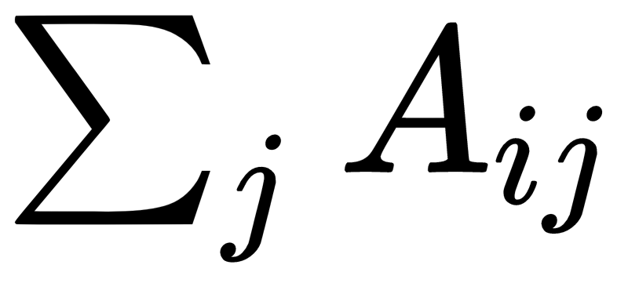
Degree centrality in affiliation networks
Gabriela
Super Smash Bros.
 | Super Smash Bros. | Cheese | Nerd- Fighters | Magic | Fashion
Gabriela | 1 | 0 | 1 | 0 | 1
Parker | 0 | 1 | 0 | 1 | 0
Brandon | 0 | 1 | 0 | 0 | 0
Marie | 1 | 0 | 1 | 0 | 0
Rahul | 0 | 1 | 0 | 0 | 1
Minjoo | 0 | 1 | 0 | 1 | 1
Parker
Cheese
3
2
1
2
2
3
Brandon
Nerdfighters
Marie
Magic
Rahul
Fashion
Minjoo
The row sums of the affiliation matrix gives us the number of each memberships each person has!

Slide 533
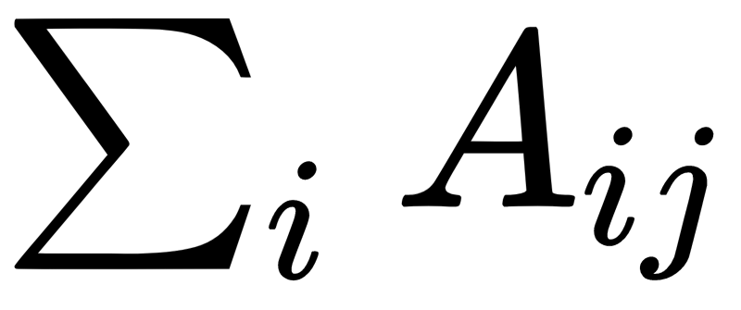
Degree centrality in affiliation networks
Gabriela
Super Smash Bros.
 | Super Smash Bros. | Cheese | Nerd- Fighters | Magic | Fashion
Gabriela | 1 | 0 | 1 | 0 | 1
Parker | 0 | 1 | 0 | 1 | 0
Brandon | 0 | 1 | 0 | 0 | 0
Marie | 1 | 0 | 1 | 0 | 0
Rahul | 0 | 1 | 0 | 0 | 1
Minjoo | 0 | 1 | 0 | 1 | 1
Parker
Cheese
Brandon
Nerdfighters
Marie
Magic
Rahul
Fashion
Minjoo
The column sums of the affiliation matrix gives us the size of each group!
2 | 4 | 2 | 2 | 3

Slide 534
Matrix Operations: The Transpose
The transpose (' or ^{T}) of a matrix reverses the row and column dimensions.
  A g x h matrix becomes a h x g matrix
  The number of rows of the transpose A^{T} is the number of columns of the original A
  The number of columns of the transpose A^{T} is the number of rows of the original A
A
A^{T}
a | b
c | d
e | f
a | c | e
b | d | f
2 X 3
3 X 2
A_{ij}^{T}= A_{ji}

Slide 535
A matrix (A) and its transpose (A^{T})
 | Super Smash Bros. | Cheese | Nerd- Fighters | Magic | Fashion
Gabriela | 1 | 0 | 1 | 0 | 1
Parker | 0 | 1 | 0 | 1 | 0
Brandon | 0 | 1 | 0 | 0 | 0
Marie | 1 | 0 | 1 | 0 | 0
Rahul | 0 | 1 | 0 | 0 | 1
Minjoo | 0 | 1 | 0 | 1 | 1
 | Gabriela | Parker | Brandon | Marie | Rahul | Minjoo
Super Smash | 1 | 0 | 0 | 1 | 0 | 0
Cheese | 0 | 1 | 1 | 0 | 1 | 1
Nerd- Fighters | 1 | 0 | 0 | 1 | 0 | 0
Magic | 0 | 1 | 0 | 0 | 0 | 1
Fashion | 1 | 0 | 0 | 0 | 1 | 1
A_{(6 x 5)}
A^{T}_{(5 x 6)}

Slide 536
A matrix (A) and its transpose (A^{T})
The transpose of a matrix is the same matrix with the rows and columns switched around!
 | Super Smash Bros. | Cheese | Nerd- Fighters | Magic | Fashion
Gabriela | 1 | 0 | 1 | 0 | 1
Parker | 0 | 1 | 0 | 1 | 0
Brandon | 0 | 1 | 0 | 0 | 0
Marie | 1 | 0 | 1 | 0 | 0
Rahul | 0 | 1 | 0 | 0 | 1
Minjoo | 0 | 1 | 0 | 1 | 1
 | Gabriela | Parker | Brandon | Marie | Rahul | Minjoo
Super Smash Bros. | 1 | 0 | 0 | 1 | 0 | 0
Cheese | 0 | 1 | 1 | 0 | 1 | 1
Nerd- Fighters | 1 | 0 | 0 | 1 | 0 | 0
Magic | 0 | 1 | 0 | 0 | 0 | 1
Fashion | 1 | 0 | 0 | 0 | 1 | 1
A_{(6 x 5)}
A’_{(5 x 6)}

Slide 537
Matrix Operations: Matrix Multiplication
A_{4 x 2} ✕ B_{2 x 3}
A_{4 x 3} ✕ B_{2 x 3}
Inner dimensions
Inner dimensions
Outer dimensions
.
Outer dimensions
.
B _{2 x 3}
B _{2 x 3}
A _{4 x 3}
A _{4 x 2}

Slide 538
Matrix Operations: Matrix Multiplication
A_{4 x 2} ✕ B_{2 x 3}
A_{4 x 3} ✕ B_{2 x 3}
Inner dimensions match! Matrices are conformable
Inner dimensions don’t match! Matrices are not conformable
Inner dimensions
Inner dimensions
Outer dimensions
.
Outer dimensions
.
B _{2 x 3}
B _{2 x 3}
A _{4 x 3}
A _{4 x 2}

Slide 539


Matrix Operations: Matrix Multiplication
A_{4 x 2} ✕ B_{2 x 3}
A_{4 x 3} ✕ B_{2 x 3}
Inner dimensions match! Matrices are conformable
Inner dimensions don’t match! Matrices are not conformable
Inner dimensions
Inner dimensions
Outer dimensions
.
Outer dimensions
.
B _{2 x 3}
B _{2 x 3}
A _{4 x 3}
A _{4 x 2}

Slide 540
Matrix Operations: Matrix Multiplication
A_{4 x 2} ✕ B_{2 x 3}
A_{4 x 3} ✕ B_{2 x 3}
Inner dimensions match! Matrices are conformable
Inner dimensions don’t match! Matrices are not conformable
Inner dimensions
Inner dimensions
Outer dimensions
.
Outer dimensions
.
B _{2 x 3}
B _{2 x 3}
A _{4 x 3}
A _{4 x 2}

Slide 541
Matrix Operations: Matrix Multiplication
A_{4 x 2} ✕ B_{2 x 3}
A_{4 x 3} ✕ B_{2 x 3}
Inner dimensions match! Matrices are conformable
Inner dimensions don’t match! Matrices are not conformable
Inner dimensions
Inner dimensions
Outer dimensions
.
Outer dimensions
.
In general you can multiply any A_{m x n} matrix ✕ any B _{q x p} matrix:
  So long as n = q
  It doesn’t matter what the values of the outer dimensions is

Slide 542
Matrix Operations: Matrix Multiplication
A_{3 x 2} ✕ B_{2 x 4} = C_{3 x 4}
A_{3 x 2} ✕ B_{3 x 4} = Not defined
Inner dimensions
Inner dimensions
Product matrix C is 3 X 4 same as the outer dimensions
Outer dimensions
.
Outer dimensions
.
The outer dimensions determine the dimensions of the resulting matrix such that A_{m x n} ✕ B _{q x p} = C _{m x p}

Slide 543
Matrix Operations: Matrix Multiplication
Turns out that the product of any matrix (A) times its transpose (A^{T}) is always defined!
So is the product of the transpose (A^{T}) times the original matrix (A)!
A_{3 x 2} x A^{T}_{2 x 3} = C_{3 x 3}
A^{T}_{2 x 3} x A_{3 x 2} = C_{2 x 2}
Inner dims. match!
Inner dims. match!
Outer dims.
Outer dims.

Slide 544
Affiliation matrix -> Co-membership matrix
 | Super Smash Bros. | Cheese | Nerd- Fighters | Magic | Fashion
Gabriela | 1 | 0 | 1 | 0 | 1
Parker | 0 | 1 | 0 | 1 | 0
Brandon | 0 | 1 | 0 | 0 | 0
Marie | 1 | 0 | 1 | 0 | 0
Rahul | 0 | 1 | 0 | 0 | 1
Minjoo | 0 | 1 | 0 | 1 | 1
 | Gabriela | Parker | Brandon | Marie | Rahul | Minjoo
Super Smash Bros. | 1 | 0 | 0 | 1 | 0 | 0
Cheese | 0 | 1 | 1 | 0 | 1 | 1
Nerd- Fighters | 1 | 0 | 0 | 1 | 0 | 0
Magic | 0 | 1 | 0 | 0 | 0 | 1
Fashion | 1 | 0 | 0 | 0 | 1 | 1
A^{T}
A
✕
 | Gabriela | Parker | Brandon | Marie | Rahul | Minjoo
Gabriela
Parker
Brandon
Marie
Rahul
Minjoo
=
C

Slide 545
Affiliation matrix -> Co-membership matrix
 | Super Smash Bros. | Cheese | Nerd- Fighters | Magic | Fashion
Gabriela | 1 | 0 | 1 | 0 | 1
Parker | 0 | 1 | 0 | 1 | 0
Brandon | 0 | 1 | 0 | 0 | 0
Marie | 1 | 0 | 1 | 0 | 0
Rahul | 0 | 1 | 0 | 0 | 1
Minjoo | 0 | 1 | 0 | 1 | 1
 | Gabriela | Parker | Brandon | Marie | Rahul | Minjoo
Super Smash Bros. | 1 | 0 | 0 | 1 | 0 | 0
Cheese | 0 | 1 | 1 | 0 | 1 | 1
Nerd- Fighters | 1 | 0 | 0 | 1 | 0 | 0
Magic | 0 | 1 | 0 | 0 | 0 | 1
Fashion | 1 | 0 | 0 | 0 | 1 | 1
A^{T}
A
✕
 | Gabriela | Parker | Brandon | Marie | Rahul | Minjoo
Gabriela |  | 0
Parker
Brandon
Marie
Rahul
Minjoo
= (1 * 0) + (0 * 1) + (1 * 0) + (0 * 1) + (1 * 0)
=
C

Slide 546
Affiliation matrix -> Co-membership matrix
 | Super Smash Bros. | Cheese | Nerd- Fighters | Magic | Fashion
Gabriela | 1 | 0 | 1 | 0 | 1
Parker | 0 | 1 | 0 | 1 | 0
Brandon | 0 | 1 | 0 | 0 | 0
Marie | 1 | 0 | 1 | 0 | 0
Rahul | 0 | 1 | 0 | 0 | 1
Minjoo | 0 | 1 | 0 | 1 | 1
 | Gabriela | Parker | Brandon | Marie | Rahul | Minjoo
Super Smash Bros. | 1 | 0 | 0 | 1 | 0 | 0
Cheese | 0 | 1 | 1 | 0 | 1 | 1
Nerd- Fighters | 1 | 0 | 0 | 1 | 0 | 0
Magic | 0 | 1 | 0 | 0 | 0 | 1
Fashion | 1 | 0 | 0 | 0 | 1 | 1
A^{T}
A
✕
 | Gabriela | Parker | Brandon | Marie | Rahul | Minjoo
Gabriela |  | 0
Parker | 0
Brandon
Marie
Rahul
Minjoo
= (0 * 1) + (1 * 0) + (0 * 1) + (1 * 0) + (0 * 1)
=
C

Slide 547
Affiliation matrix -> Co-membership matrix
 | Super Smash Bros. | Cheese | Nerd- Fighters | Magic | Fashion
Gabriela | 1 | 0 | 1 | 0 | 1
Parker | 0 | 1 | 0 | 1 | 0
Brandon | 0 | 1 | 0 | 0 | 0
Marie | 1 | 0 | 1 | 0 | 0
Rahul | 0 | 1 | 0 | 0 | 1
Minjoo | 0 | 1 | 0 | 1 | 1
 | Gabriela | Parker | Brandon | Marie | Rahul | Minjoo
Super Smash Bros. | 1 | 0 | 0 | 1 | 0 | 0
Cheese | 0 | 1 | 1 | 0 | 1 | 1
Nerd- Fighters | 1 | 0 | 0 | 1 | 0 | 0
Magic | 0 | 1 | 0 | 0 | 0 | 1
Fashion | 1 | 0 | 0 | 0 | 1 | 1
A^{T}
A
✕
 | Gabriela | Parker | Brandon | Marie | Rahul | Minjoo
Gabriela |  | 0 |  | 2
Parker | 0
Brandon
Marie | 2
Rahul
Minjoo
= (1 * 1) + (0 * 0) + (1 * 1) + (0 * 0) + (1 * 0)
=
C

Slide 548
Affiliation matrix -> Co-membership matrix
 | Super Smash Bros. | Cheese | Nerd- Fighters | Magic | Fashion
Gabriela | 1 | 0 | 1 | 0 | 1
Parker | 0 | 1 | 0 | 1 | 0
Brandon | 0 | 1 | 0 | 0 | 0
Marie | 1 | 0 | 1 | 0 | 0
Rahul | 0 | 1 | 0 | 0 | 1
Minjoo | 0 | 1 | 0 | 1 | 1
 | Gabriela | Parker | Brandon | Marie | Rahul | Minjoo
Super Smash Bros. | 1 | 0 | 0 | 1 | 0 | 0
Cheese | 0 | 1 | 1 | 0 | 1 | 1
Nerd- Fighters | 1 | 0 | 0 | 1 | 0 | 0
Magic | 0 | 1 | 0 | 0 | 0 | 1
Fashion | 1 | 0 | 0 | 0 | 1 | 1
A^{T}
A
✕
 | Gabriela | Parker | Brandon | Marie | Rahul | Minjoo
Gabriela | 3 | 0 |  | 2
Parker | 0
Brandon
Marie | 2
Rahul
Minjoo
= (1 * 1) + (0 * 0) + (1 * 1) + (0 * 0) + (1 * 1)
=
C

Slide 549
Affiliation matrix -> Co-membership matrix
 | Super Smash Bros. | Cheese | Nerd- Fighters | Magic | Fashion
Gabriela | 1 | 0 | 1 | 0 | 1
Parker | 0 | 1 | 0 | 1 | 0
Brandon | 0 | 1 | 0 | 0 | 0
Marie | 1 | 0 | 1 | 0 | 0
Rahul | 0 | 1 | 0 | 0 | 1
Minjoo | 0 | 1 | 0 | 1 | 1
 | Gabriela | Parker | Brandon | Marie | Rahul | Minjoo
Super Smash Bros. | 1 | 0 | 0 | 1 | 0 | 0
Cheese | 0 | 1 | 1 | 0 | 1 | 1
Nerd- Fighters | 1 | 0 | 0 | 1 | 0 | 0
Magic | 0 | 1 | 0 | 0 | 0 | 1
Fashion | 1 | 0 | 0 | 0 | 1 | 1
A^{T}
A
✕
 | Gabriela | Parker | Brandon | Marie | Rahul | Minjoo
Gabriela | 3 | 0 | 0 | 2 | 1 | 1
Parker | 0 | 2 | 1 | 0 | 1 | 2
Brandon | 0 | 1 | 1 | 0 | 1 | 1
Marie | 2 | 0 | 0 | 2 | 0 | 0
Rahul | 1 | 1 | 1 | 0 | 2 | 2
Minjoo | 1 | 2 | 1 | 0 | 2 | 3
=
C

Slide 550
Affiliation matrix -> Co-membership matrix
A X A^{T} returns the co-membership matrix (C)
  Each off-diagonal cell (C_{ij}) tell us the number of affiliations that person i has in common with person j
  Each diagonal cell (C_{ii}) tells us the number of total memberships person i has
  The matrix represents a weighted one-mode network
    Strength of tie between i and j = number of common memberships
    A “similarity” relation (thus symmetric)
 | Gabriela | Parker | Brandon | Marie | Rahul | Minjoo
Gabriela | 3 | 0 | 0 | 2 | 1 | 1
Parker | 0 | 2 | 1 | 0 | 1 | 2
Brandon | 0 | 1 | 1 | 0 | 1 | 1
Marie | 2 | 0 | 0 | 2 | 0 | 0
Rahul | 1 | 1 | 1 | 0 | 2 | 2
Minjoo | 1 | 2 | 1 | 0 | 2 | 3
C

Slide 551
Affiliation matrix -> Group Overlap matrix
 | Gabriela | Parker | Brandon | Marie | Rahul | Minjoo
Super Smash Bros. | 1 | 0 | 0 | 1 | 0 | 0
Cheese | 0 | 1 | 1 | 0 | 1 | 1
Nerd- Fighters | 1 | 0 | 0 | 1 | 0 | 0
Magic | 0 | 1 | 0 | 0 | 0 | 1
Fashion | 1 | 0 | 0 | 0 | 1 | 1
 | Super Smash Bros. | Cheese | Nerd- Fighters | Magic | Fashion
Gabriela | 1 | 0 | 1 | 0 | 1
Parker | 0 | 1 | 0 | 1 | 0
Brandon | 0 | 1 | 0 | 0 | 0
Marie | 1 | 0 | 1 | 0 | 0
Rahul | 0 | 1 | 0 | 0 | 1
Minjoo | 0 | 1 | 0 | 1 | 1
A^{T}
A
✕
 | Super Smash Bros. | Cheese | Nerd- Fighters | Magic | Fashion
Super Smash Bros. | 2 | 0 | 2 | 0 | 1
Cheese | 0 | 4 | 0 | 2 | 2
Nerd- Fighters | 2 | 0 | 2 | 0 | 1
Magic | 0 | 2 | 0 | 2 | 0
Fashion | 1 | 2 | 1 | 1 | 3
=
G

Slide 552
Affiliation matrix -> Group Overlap matrix
A^{T} X A returns the group overlap matrix (G)
  Each off-diagonal cell (G_{ij}) tell us the number of members groups i and j have in common
  Each diagonal cell (G_{ii}) tells us the number of total members in group i
  The matrix represents a weighted one-mode network
    Two groups are more strongly connected if they have lots of members in common
    A “similarity” relation (thus symmetric)
 | Super Smash Bros. | Cheese | Nerd- Fighters | Magic | Fashion
Super Smash Bros. | 2 | 0 | 2 | 0 | 1
Cheese | 0 | 4 | 0 | 2 | 2
Nerd- Fighters | 2 | 0 | 2 | 0 | 1
Magic | 0 | 2 | 0 | 2 | 0
Fashion | 1 | 2 | 1 | 1 | 3

Slide 553
From co-membership matrix back to graph
Parker
 | Gabriela | Parker | Brandon | Marie | Rahul | Minjoo
Gabriela | -- | 0 | 0 | 2 | 1 | 1
Parker | 0 | -- | 1 | 0 | 1 | 2
Brandon | 0 | 1 | -- | 0 | 1 | 1
Marie | 2 | 0 | 0 | -- | 0 | 0
Rahul | 1 | 1 | 1 | 0 | -- | 2
Minjoo | 1 | 2 | 1 | 0 | 2 | --
1
1
Gabriela
1
Rahul
1
2
2
2
Brandon
Minjoo
1
Co-Membership Matrix
Marie
One-Mode Person-to-Person Network

Slide 554
From group overlap matrix back to graph
Super Smash Bros.
 | Super Smash Bros. | Cheese | Nerd- Fighters | Magic | Fashion
Super Smash Bros. | -- | 0 | 2 | 0 | 1
Cheese | 0 | -- | 0 | 2 | 2
Nerd- Fighters | 2 | 0 | -- | 0 | 1
Magic | 0 | 2 | 0 | -- | 0
Fashion | 1 | 2 | 1 | 1 | --
2
1
Nerdfighters
1
Fashion
2
1
Group-Overlap Matrix
2
Cheese
Magic
One-Mode Group-to-Group Network

Slide 555
The duality between persons and groups
Connections between people are given by the groups they belong to
Connections between groups are given by the people that belong to them
  This is called the duality between persons and groups
Gabriela
Super Smash Bros.
Super Smash Bros.
Parker
Parker
1
Cheese
2
1
1
Gabriela
1
Rahul
Brandon
Nerdfighters
Nerdfighters
1
Fashion
2
1
2
Marie
Brandon
Minjoo
Magic
2
1
1
Rahul
Fashion
Cheese
2
Magic
Marie
Minjoo
One-Mode Person-to-Person Network
Original Two-Mode Network
One-Mode Group-to-Group Network

Slide 556
What is an affiliation network?
Types of affiliation networks that have been studied in the literature include:
  Hollywood actors and the movies that they make
  CEOs and the board of directors that they sit on
  Books and the people who buy them
  Scientists and the journal they publish in

Slide 557
What is an affiliation network?
Types of affiliation networks that have been studied in the literature include:
  Hollywood actors and the movies that they make
  CEOs and the board of directors that they sit on
  Books and the people who buy them
  Scientists and the journal they publish in

Slide 558
What is an affiliation network?
Types of affiliation networks that have been studied in the literature include:
  Hollywood actors and the movies that they make
  CEOs and the board of directors that they sit on
  Books and the people who buy them
  Scientists and the journal they publish in

Slide 559
What is an affiliation network?
Types of affiliation networks that have been studied in the literature include:
  Hollywood actors and the movies that they make
  CEOs and the board of directors that they sit on
  Books and the people who buy them
  Scientists and the journal they publish in

Slide 560
Glossary of Key Terms (Affiliation Networks)
Affiliation network: A social network in which two types of entities (e.g., people and the books they bought) are linked together
Bipartite Graph: A graph with two disjoint set of nodes in which nodes link only to nodes in the other set but not with nodes in their own set
  Bipartite graphs are useful for representing two-mode networks!
Affiliation Matrix: Matrix recording the adjacency relations between vertices in a bipartite graph representing a two-mode network

Slide 561
Glossary of Key Terms (Affiliation Networks)
Matrix Transpose: A matrix operation that produces a new matrix (the transpose) by switching around the number of rows and the number of columns of the original matrix
Co-membership Matrix: Matrix that results from multiplying an affiliation matrix times its transpose. The off-diagonal cells of the co-membership matrix records the number of shared memberships each pair of people have in an affiliation network.
Group Overlap Matrix: Matrix that results from multiplying the transpose of an affiliation matrix times the original. The off-diagonal cells of the group overlap matrix records the number of shared members each pair of groups have in an affiliation network.

Slide 562
Whole Network Level

Slide 563
Levels of Analysis in social networks
Individual
1
Dyads
2
Triads
3
Cliques, Communities
4
Whole Network
5
The first part of the course follows this organization!

Slide 564
Levels of Analysis in social networks
Individual
1
Dyads
2
Triads
3
Cliques, Communities
4
Whole Network
5
The first part of the course follows this organization!

Slide 565
Key properties of whole networks
We have already some important ones:
  Number of nodes (graph order): N
  Number of links (graph size): E
  Density: E / (N(N-1)/2)
  Max/min degree: d_{max} and d_{min}
  Average degree: d
But there are some other ones:
    Network Diameter: D
    Average shortest path: L
    Average clustering coefficient: C

Slide 566
Degree-based network properties
A
A
E
B
C
E
B
C
D
D

Slide 567
Degree-based network properties
A
A
E
B
C
E
B
C
D
D
A | B | C | D | E
4 | 3 | 2 | 1 | 2
A | B | C | D | E
3 | 4 | 3 | 3 | 3
Degree Set
Degree Set

Slide 568
Degree-based network properties
A
d = (4 + 3 + 2 + 1 + 2) / 5
A
d = (3 + 4 + 3 + 3 + 3) / 5
E
B
C
E
B
C
D
D
A | B | C | D | E
4 | 3 | 2 | 1 | 2
Max degree: 4
Min degree: 1
A | B | C | D | E
3 | 4 | 3 | 3 | 3
Max degree: 4
Min degree: 3
Degree Set
Degree Set

Slide 569
Degree-based network properties
A
d = (4 + 3 + 2 + 1 + 2) / 5
A
d = (3 + 4 + 3 + 3 + 3) / 5
E
B
C
E
B
C
D
D
A | B | C | D | E
4 | 3 | 2 | 1 | 2
Max degree: 4
Min degree: 1
d = 2.4
A | B | C | D | E
3 | 4 | 3 | 3 | 3
Max degree: 4
Min degree: 3
d = 3.2
Degree Set
Degree Set

Slide 570
Degree-based network properties
The degree distribution (p_{k}) is the probability of observing a node with degree k for each value of degree in the network!
A
A
E
B
C
E
B
C
D
D
1 | 2 | 3 | 4
1/5 | 2/5 | 1/5 | 1/5
0.2 | 0.4 | 0.2 | 0.2
Max degree: 4
Min degree: 1
d = 2.4
1 | 2 | 3 | 4
0/5 | 0/5 | 4/5 | 1/5
0 | 0 | 0.8 | 0.2
Max degree: 4
Min degree: 3
d = 3.2
Degree Distribution
Degree Distribution

Slide 571
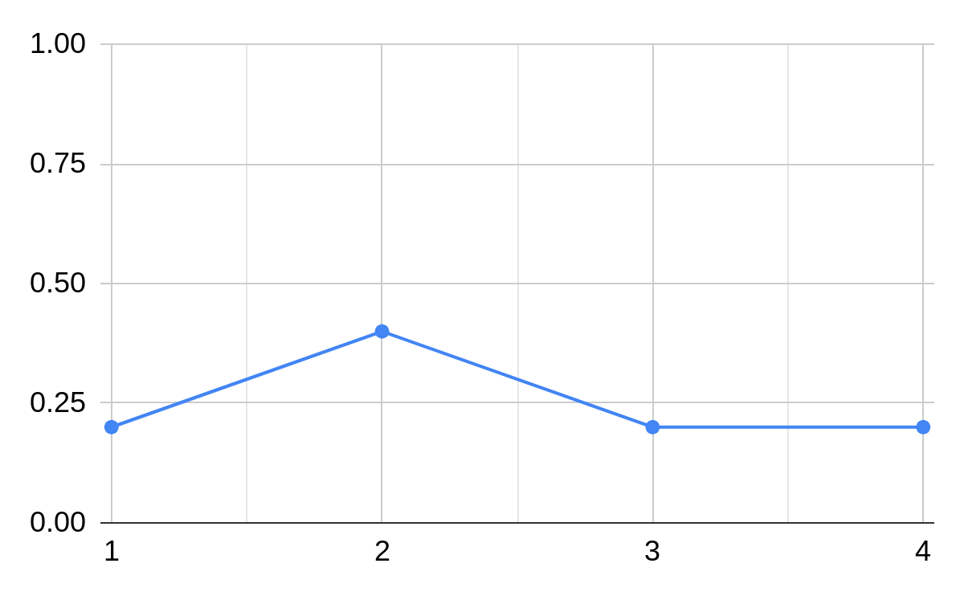
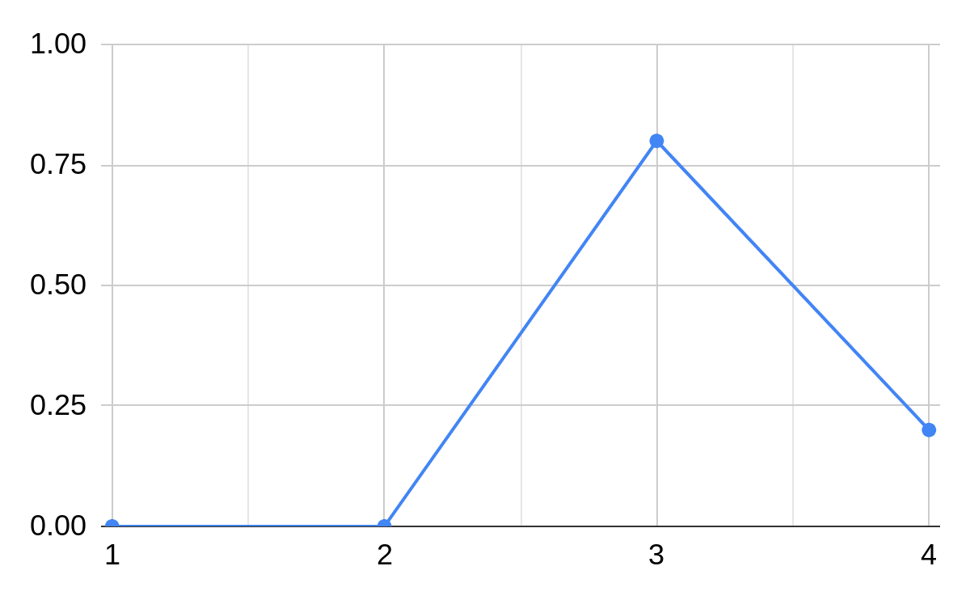
Degree-based network properties
1 | 2 | 3 | 4
1/5 | 2/5 | 1/5 | 1/5
0.2 | 0.4 | 0.2 | 0.2
Max degree: 4
Min degree: 1
d = 2.4
1 | 2 | 3 | 4
0/5 | 0/5 | 4/5 | 1/5
0 | 0 | 0.8 | 0.2
Max degree: 4
Min degree: 3
d = 3.2
Degree Distribution
Degree Distribution

Slide 572



Degree-based network properties
Facebook Users
Add Health Study (High School)
LiveJournal Users
N = 63,731
E = 817,035
Max degree: 1,098
d = 25.6
N = 2539
E = 12,969
Max degree: 36
d = 10.2
N = 4,847,571
E = 68,475,391
Max degree: 22,887
d = 28.5

Slide 573

Path-based network properties
The diameter (D) of a network is the length of the longest shortest path between two nodes

Slide 574
Path-based network properties
The diameter (D) of a network is the length of the longest shortest path between two nodes
We can also compute the average shortest path length (L) between all pairs of nodes in a network

Slide 575
Path-based network properties
The diameter (D) of a network is the length of the longest shortest path between two nodes
We can also compute the average shortest path length (L) between all pairs of nodes in a network
  Can only be computed for connected graphs or in the giant component of disconnected ones

Slide 576
Path-based network properties
Facebook Users
Add Health Study (High School)
LiveJournal
N = 63,731
E = 817,035
Max degree: 1,098
d = 25.6
D = 15
L = 4.3
N = 2539
E = 12,969
Max degree: 36
d = 10.2
D = 10
L = 4.5
N = 4,847,571
E = 68,475,391
Max degree: 22,887
d = 28.5
D = 20
L = 5.5

Slide 577
Path-based network properties
Facebook Users
Add Health Study (High School)
LiveJournal
N = 63,731
E = 817,035
Max degree: 1,098
d = 25.6
D = 15
L = 4.3
N = 2539
E = 12,969
Max degree: 36
d = 10.2
D = 10
L = 4.5
N = 4,847,571
E = 68,475,391
Max degree: 22,887
d = 28.5
D = 20
L = 5.5
L is small!

Slide 578
Small World Networks

Slide 579

The world as a network
Imagine that the entire world (or a big place like the U. S.) as a network
  What can we deduce to be true of the graph the represents this network?

Slide 580
The world as a network
Imagine that the entire world (or a big place like the U. S.) as a network
  What can we deduce to be true of the graph the represents this network?
Order (N) is large
  7.8 billion as of March 2021!

Slide 581

The world as a network
Imagine that the entire world (or a big place like the U. S.) as a network
  What can we deduce to be true of the graph the represents this network?
Order (N) is large
Sparse
  Density (d) is low:
  Number of connected pairs of people in the world (E) is small relative graph size:

Slide 582

The world as a network
Imagine that the entire world (or a big place like the U. S.) as a network
  What can we deduce to be true of the graph the represents this network?
Order (N) is large
Sparse
  Average degree (d) is small relative to graph order

Slide 583

The world as a network
Imagine that the entire world (or a big place like the U. S.) as a network
  What can we deduce to be true of the graph the represents this network?
Order (N) is large
Sparse
Decentralized
  Maximum degree (d^{MAX}) is small relative to graph order:

Slide 584
The world as a network
Imagine that the entire world (or a big place like the U. S.) as a network
  What can we deduce to be true of the graph the represents this network?
Order (N) is large
Sparse
Decentralized
Clustered
  Transitivity: Friends of friends tend to be friends
  Most ego-networks have clustering coefficients above zero
  Average clustering coefficient is larger than zero

Slide 585
The world as a network
Imagine that the entire world (or a big place like the U. S.) as a network
  What can we deduce to be true of the graph the represents this network?
Order (N) is large
Sparse
Decentralized
Clustered
Subgroup structure
  Most connections in densely connected subgraphs
  Only a few between
  Graph can be split into cohesive subgroups

Slide 586
The world as a network
Imagine that the entire world (or a big place like the U. S.) as a network
  What can we deduce to be true of the graph the represents this network?
Order (N) is large
Sparse
Decentralized
Clustered
Subgroup structure
Six degrees of separation
  Average shortest path length between people is (relatively) small

Slide 587
The world as a network
Imagine that the entire world (or a big place like the U. S.) as a network
  What can we deduce to be true of the graph the represents this network?
Order (N) is large
Sparse
Decentralized
Clustered
Subgroup structure
Six degrees of separation
This last thing is weird!

Slide 588
The world as a network
Imagine that the entire world (or a big place like the U. S.) as a network
  What can we deduce to be true of the graph the represents this network?
In a large, sparse, decentralized graph, with clustering and subgroup structure:
  Any two random individuals should (on average) be separated by a long shortest paths
But real world shows “six degrees of separation” effect
  Six is a small number
  It’s a small world!

Slide 589

The small world phenomenon
Classic study by Travers and Milgram (1969)
Target (Boston stockbroker)
  296 participants ("starting persons")
  196 from Nebraska
    100 Stockbrokers
    96 Random
  100 from Boston
  217 forwarded packet so get to target person
  453 Intermediaries enlisted by the participants

Slide 590

The small world phenomenon
Target (Boston stockbroker)
  296 participants ("starting persons")
  196 from Nebraska
    100 Stockbrokers
    96 Random
  100 from Boston
  217 forwarded packet so get to target person
  453 Intermediaries enlisted by the participants
64 completed chains (29%)
    Mean path length: 5.2

Slide 591

The small world phenomenon
Target (Boston stockbroker)
  296 participants ("starting persons")
  196 from Nebraska
    100 Stockbrokers
    96 Random
  100 from Boston
  217 forwarded packet so get to target person
  453 Intermediaries enlisted by the participants
232 incomplete chains (71%)
  Mean path length: 2.6

Slide 592
The small world phenomenon
Out of the 64 completed chains 26 people made the final link
16 (25%) reached the target via a single neighbor: "Mr. G."
  Another accounted for 10
  Another for 5
  The top three account for 48% of completions
86% of “starters” sent the letter to friends and acquaintances
  14% send it to relatives
  age, gender, SES homophily in Intermediary choice

Slide 593
The small world phenomenon
Dodds, Muhammad and Watts (2003) Replication of Milgram
  Internet based social experiment
    18 target persons from 13 countries randomly allocated
    98,847 participants registered, 25% initiated a chain
    61,168 total participants from 166 countries (including intermediaries)

Slide 594

The small world phenomenon
384 completed chains (out 24,163); Average (L): 4.05
Corrected for attrition the median chain length is between 5 and 7

Slide 595

The small world phenomenon
Dodds, Muhammad and Watts (2003) Replication of Milgram
  Internet based social experiment
    18 target persons from 13 countries randomly allocated
    98,847 participants registered, 25% initiated a chain
    61,168 total participants from 166 countries (including intermediaries)

Slide 596
The small world phenomenon
Dodds, Muhammad and Watts (2003) Replication of Milgram
  More than half from North America
    Middle Class
    Professional, College Educated
    Largely Christian

Slide 597
The small world phenomenon
Dodds, Muhammad and Watts (2003) Replication of Milgram
  Strong preference for:
    Friends as role relations (rather than kin or co-workers)
    Ties embedded in work and school affiliations
    Ties of Intermediate strength (closeness)
    Same-gender ties

Slide 598
The small world phenomenon
Dodds, Muhammad and Watts (2003) Replication of Milgram
  Most effective chains more likely to feature:
    Professional ties (in contrast to friend and kin) as role relations
    Work or higher education ties as foci
    Either causal or “not close” ties in terms of strength
      Why this pattern?

Slide 599

The small world phenomenon
Dodds, Muhammad and Watts (2003) Replication of Milgram
  Geographic proximity and similarity of occupation were the primary search heuristics
    Number of friends ("hub heuristic") almost never used
    Proximity declines and homophily increases in importance with chain length

Slide 600
The small world phenomenon
384 completed chains (out 24,163); Average (L): 4.05
Corrected for attrition the median chain length is between 5 and 7
The world is indeed small!

Slide 601
Diffusion: How Things Spread in Networks

Slide 602

Thompson, D. (2012) The 100-Year March of Technology in 1 Graph. http://www.theatlantic.com/technology/archive/2012/04/the-100-year-march-of-technology-in-1-graph/255573/ (last accessed October 9th 2014)

Slide 603
What is diffusion?
Spread of objects, ideas, information, concepts, fashions, tastes, practices etc. in a social network
The diffusion process has five elements:
  An Innovation: The object that diffuses
  Actors: Usually people but also groups that adopt (or fail to adopt) the innovation
  Flow : From source actor to an adopting actor
  Mechanism :Process linking sources and adopters
    (e.g., imitation, physical contact, proximity, influence, comparison)
  Outcome: The end state of the adopting actor
    (e.g., opinion change, conversion, participation, infection)
Innovation
Source
Adopter
Mechanism

Slide 604
How do things spread? The S curve
Typical S-shaped pattern of cumulative adoptions
  Initial slow uptake
  Rapid spread
  Final slow saturation
100%
S-shaped diffusion curve
Percentage of Adopters in Population
0%
Time

Slide 605
How do things spread? The S curve
Typical S-shaped pattern of cumulative adoptions
  Initial slow uptake
  Rapid spread
  Final slow saturation
100%
S-shaped diffusion curve
Percentage of Adopters in Population
0%
Time

Slide 606
How do things spread? The S curve
Typical S-shaped pattern of cumulative adoptions
  Initial slow uptake
  Rapid spread
  Final slow saturation
100%
S-shaped diffusion curve
Percentage of Adopters in Population
0%
Time

Slide 607
How do things spread? The S curve
Typical S-shaped pattern of cumulative adoptions
  Initial slow uptake
  Rapid spread
  Final slow saturation
100%
S-shaped diffusion curve
Percentage of Adopters in Population
0%
Time

Slide 608
How do things spread? The S curve
Typical S-shaped pattern of cumulative adoptions
  Initial slow uptake
  Rapid spread
  Final slow saturation
Number of adopters per unit of time peaks during the “take off” period
100%
S-shaped diffusion curve
Percentage of Adopters in Population
-
0%
Time

Slide 609

How do things spread? The S curve
Typical S-shaped pattern of cumulative adoptions
  Initial slow uptake
  Rapid spread
  Final slow saturation
Number of adopters per unit of time peaks during the “take off” period
Ryan, B. and N.C. Gross (1943) The Diffusion of Hybrid Seed Corn in Two Iowa Communities, Rural Sociology, 8: 15-24.

Slide 610
Thompson, D. (2012) The 100-Year March of Technology in 1 Graph. http://www.theatlantic.com/technology/archive/2012/04/the-100-year-march-of-technology-in-1-graph/255573/

Slide 611

Social network models of diffusion
Four types of social network models of diffusion:
  Direct Cohesion Models
    Focus on the connectivity of adopters to their sources via network ties
  Two-Step Models
    Focus on the the social distance between adopters and influential sources as well as characteristics of influentials
  Threshold Models
    Focus on susceptibility of adopters to the behavior of multiple sources
  Positional Equivalence Models
    Focus on indirect influence and comparison between sources and positionally equivalent adopters

Slide 612
Diffusion via Cohesion
Simplest model of diffusion
Innovations “travel” via social network links
  Focuses on how innovations spread within networks
  Focuses on how patterns of connectivity help (or hinder) diffusion
  Imitation or adoption via the similarity heuristic is the main mechanism
Similarity heuristic:
  I adopt the innovations that people like me adopt (homophily)
  Imitation mechanism
Adopter
Innovation
Source
Adopter
Adopter
Imitation
Imitation
Adopter

Slide 613
Diffusion via Cohesion
Simplest model of diffusion
Innovations “travel” via social network links
  Focuses on how innovations spread within networks
  Focuses on how patterns of connectivity help (or hinder) diffusion
  Imitation or adoption via the similarity heuristic is the main mechanism
Innovations diffuse like a “virus” (sometimes literally)
  Contagion mechanism
    Sharing a meme on social media (“going viral”)
Adopter
Innovation
Source
Adopter
Adopter
Contagion
Contagion
Adopter

Slide 614


Diffusion via Cohesion

Slide 615

Diffusion via Cohesion (Planet of the Apes!)

Slide 616

Diffusion via Cohesion

Slide 617
Two step models of diffusion
Basic claim:
  Innovations diffuse via opinion leaders (“influencers”)
  Potential sources look up to opinion leaders to see what innovations they should adopt
Who are opinion leaders?
  “[P]eople who influence the opinions, attitudes, beliefs, motivations, and behaviors of others” (Valente and Pumpuang 2007: 881)
Opinion leaders are “early” or first adopters
  This is why this is called “two-step” diffusion
Innovation
Innovation
Original
Source
Opinion
Leader
Adopter
Access
Influence

Slide 618
Two step models of diffusion
Characteristics of opinion leaders:
  People who are visible (e.g., celebrities, instagram influencers)
  People who occupy powerful positions (e.g., politicians, captains of industry)
  People who are well connected
    Degree centrality (Popular people)
    Eigenvector centrality (People who can influence popular people)
    Betweenness centrality (People who can intermediate between groups)
Innovation
Innovation
Original
Source
Opinion
Leader
Adopter
Access
Influence

Slide 619
Two step models of diffusion
We can combine the two-step and cohesion models
  Innovations begin at a source and are transferred to opinion leaders
  Opinion leaders then transfer the information to adopters
  Innovation spreads via cohesion among adopters in the second step
1
2
3
Adopter
Innovation
Innovation
Original
Source
Opinion
Leader
Adopter
Adopter
Access
Influence
Imitation
Adopter

Slide 620
Global threshold model
If your friend jumped off a bridge would you?
  Better question:
    How many other people would have to jump before you did?
  What is your q?
100%
S-shaped diffusion curve
Percentage of Adopters in Population
0%
Time

Slide 621
Global threshold model
If your friend adopts an innovation would you?
Better question:
  How many other people would have to adopt it before you did?
  What is your q?
Each actor (i) has a “threshold” for adoption q(i)
  q_{i} is between zero and one
    0 > q(i) < 1
  (i) adopts when the proportion of people who have adopted (p) is equal to q(i)
100%
S-shaped diffusion curve
Percentage of Adopters in Population
0%
Time

Slide 622
Global threshold models
People have different q values
  Some high
  Some Low
  Most in the Middle (a bell curve)
This can explain the S-shaped pattern
  Slow uptake when adoption is concentrated among a few low q people
  Faster as the majority of middle q people join in
  Slow again as the last few high q people finally adopt
Probability of Adoption
Proportion of people with this q value
-
Low q
Middle q
High q

Slide 623
Global threshold models
People have different q values
  Some high
  Some Low
  Most in the Middle (a bell curve)
This can explain the S-shaped pattern
  Slow uptake when adoption is concentrated among a few low q people
  Faster as the majority of middle q people join in
  Slow again as the last few high q people finally adopt
High-risk early adopters
Risk-averse late adopters
Probability of Adoption
Proportion of people with this q value
-
Low q
Middle q
High q

Slide 624
Global threshold models
Too many risk-averse late adopters
People have different q values
  Some high
  Some Low
  Most in the Middle (a bell curve)
The shape of the threshold distribution can determine whether you get full diffusion or not:
  If q distribution is skewed toward risk averse late adopters the diffusion is less likely
Two few high-risk early adopters
Probability of Adoption
Proportion of people with this q value
-
Low q
Middle q
High q

Slide 625
Global threshold models
Plenty of high risk early adopters
Not too many averse late adopters
People have different q values
  Some high
  Some Low
  Most in the Middle (a bell curve)
The shape of the threshold distribution can determine whether you get full diffusion or not:
  If q distribution is skewed toward high risk early adopters diffusion is more likely
Probability of Adoption
Proportion of people with this q value
-
Low q
Middle q
High q

Slide 626


How do things spread? The S curve
Typical S-shaped pattern of cumulative adoptions
  Initial slow uptake
  Rapid spread
  Final slow saturation
González-Bailón, S., Borge-Holthoefer, J., Rivero, A., & Moreno, Y. (2011). The dynamics of protest recruitment through an online network. Scientific Reports, 1, 197.

Slide 627
How do things spread? The S curve
Typical S-shaped pattern of cumulative adoptions
  Initial slow uptake
  Rapid spread
  Final slow saturation
<- Long uptake period! ->
González-Bailón, S., Borge-Holthoefer, J., Rivero, A., & Moreno, Y. (2011). The dynamics of protest recruitment through an online network. Scientific Reports, 1, 197.

Slide 628
How do things spread? The S curve
Big mobilization helps to recruit high threshold people leading to rapid spread
Typical S-shaped pattern of cumulative adoptions
  Initial slow uptake
  Rapid spread
  Final slow saturation
González-Bailón, S., Borge-Holthoefer, J., Rivero, A., & Moreno, Y. (2011). The dynamics of protest recruitment through an online network. Scientific Reports, 1, 197.

Slide 629

The Rogers Classification of Adopters
Proportion of adopters
Rogers, E.M.(1962) The Diffusion of Innovations, Free Press, New York.

Slide 630
The Rogers Classification of Adopters
Proportion of adopters
Rogers, E.M.(1962) The Diffusion of Innovations, Free Press, New York.

Slide 631
The Rogers Classification of Adopters
Tipping point
Proportion of adopters
Rogers, E.M.(1962) The Diffusion of Innovations, Free Press, New York.

Slide 632
The Rogers Classification of Adopters
Failed Innovations die before reaching the tipping point
Proportion of adopters
Rogers, E.M.(1962) The Diffusion of Innovations, Free Press, New York.

Slide 633

The Rogers Classification of Adopters
Area under the curve represents number of adopters
Kastelle, T (2012) Two Problems Caused by the Innovation Diffusion Curve
http://timkastelle.org/blog/2012/02/two-problems-caused-by-the-innovation-diffusion-curve/

Slide 634
The Rogers Classification
Innovators and Early adopters
  Individuals whose time-of-adoption is greater than one standard deviation earlier than the average time-of-adoption
Early and late majorities
  Individuals whose time-of-adoption is bounded by one standard deviation earlier and later than the average
Laggards
  Individuals who adopted later than one standard deviation from the average
Proportion of adopters

Slide 635

Complex versus simplex contagion
Innovations that entail risk, ostracism, potential loss of resources, may elicit higher thresholds from all actors in the network
  Persons require exposure to multiple sources to adopt
This is the difference between simplex and complex contagion
  Certain innovations only diffuse via complex contagion

Slide 636
Complex versus simplex contagion
Candidates for simplex contagion:
  Information, gossip, disease
Candidates for complex contagion:
  High risk social movement participation, religious conversion, migration, etc.

Slide 637
Complex versus simplex contagion
Weakness of long ties argument (Centola and Macy 2007):
  Long (weak) ties help to spread things in networks faster
    But only for things that spread via simplex contagion
  They are worse at spreading things that require complex contagion
    You are usually connected to one network bridge and access the tie infrequently

Slide 638
Complex versus simplex contagion
Information, gossip, disease:
  Can spread faster in a network via weak ties (bridges)
    Strength of Weak Ties (Granovetter 1973)
High risk social movement participation, religious conversion, migration:
  Can spread faster via cliques and strong ties

Slide 639
Network Threshold Models
Global threshold models are appropriate for adoptions of behaviors that are public and observable
  Not always the case
  Assumption that people know what everyone is doing is not always realistic
    People must know the actual proportion of population who has adopted
The network threshold model relaxes the assumption that persons have global information on all adoptions
  They only know what their direct contacts are doing
  Individuals adopt when some proportion of their contacts adopt
    More appropriate for the adoption of practices, behaviors and ideas that entails some sort of risk or uncertainty (complex contagion)

Slide 640
Valente’s Network Threshold Model
Each person (i) has some exposure e(i)
e(i) = proportion of i’s friends who adopted
When proportion of neighbors who adopt equals q(i), ego adopts
Person 1: q = 0.25
Person 2: q = 0.75
Time 1
Time 2
Time 3
Time 4
Time 5

Slide 641
Network Threshold Models
Just like before, everybody has a threshold q(i)
  When the proportion of neighbors who have adopted equals q(i), the person adopts
We can then redefine adopter categories (e.g. innovators) as either
  System Relative
    Whole network
  Network Relative
    Ego-network
For instance you can be an innovator in the grand scheme of things
  But be a relative laggard compared to your friends
  If all of your friends are innovators
You can be a laggard in the grand scheme of things
  But be an innovator among your friends
  Because you are surrounded by even bigger laggards!

Slide 642
Valente’s Network Threshold Model
Revisiting the Roger’s classification using Valente’s model:
Who's an “opinion leader”?
  Early adopters who convince those with high network thresholds (but similar system threshold) to adopt
Whole Network Threshold
Low High
Personal Network Threshold
Low
High
True innovators (influentials) | Isolates
Connected Bandwagon | Resistant rearguard

Slide 643
Valente’s Network Threshold Model
The network threshold model makes sense of a lot of classic findings
  For instance, early adopters adopt from media or weak ties, late adopters adopt from their friends/strong ties
    This seems to reflect a Local/Cosmopolitan split
Whole Network Threshold
Low High
Personal Network Threshold
Low
High
True innovators (influentials) | Isolates
Connected Bandwagon | Resistant rearguard

Slide 644
Valente’s Network Threshold Model
The network threshold model makes sense of a lot of classic findings
  For instance, early adopters adopt from media or weak ties, late adopters adopt from their friends/strong ties
    Cosmopolitan innovators tend to be early adopters relative to the system and have very low threshold relative to their network
Whole Network Threshold
Low High
Personal Network Threshold
Low
High
True innovators (influentials) | Isolates
Connected Bandwagon | Resistant rearguard

Slide 645
Complex versus simplex contagion
Differences in the propensity to adopt an innovation can be modeled as a threshold process
  However, thresholds may not be fixed for individuals regardless of what is being diffused
  Thresholds may depend on the characteristics of what is being diffused
    Low threshold -> Low risk
    High threshold -> High risk
Innovations that entail risk, ostracism, potential loss of resources, may elicit higher thresholds from all actors in the network
  Persons require exposure to multiple sources to adopt
Innovations (e.g. gossip) that carry little risk may in their turn elicit a very low threshold
  In the simplest case, the person adopts as soon as one of their neighbors adopts

Slide 646
Social Position in Networks

Slide 647
Social position in networks
In standard social science social position is measured either:
  As a rank on some kind of ordinal or continuous scale
    Wealth, income, education
  As membership in some kind of nominal category
    Gender, race, marital status
  Standard social science measures social position as attribute similarity
    Two actors occupy the same social position is they have the same rank on scale (e.g., college educated) or are members of the same nominal category (e.g., gender)

Slide 648
Social position in networks
In standard social science social position is measured either:
  As a rank on some kind of ordinal or continuous scale
    Wealth, income, education
  As membership in some kind of nominal category
    Gender, race, marital status
  Standard social science measures social position as attribute similarity
    Two actors occupy the same social position is they have the same rank on scale (e.g., college educated) or are members of the same nominal category (e.g., gender)
In social network analysis social position is measured by the pattern of relations each actor has with other actor in the network
  Social network analysis measures social position as relational similarity

Slide 649
Social position in networks
Positional analysis is the branch of social network analysis in charge of:
  Defining different notions of network position
    Using graph theory
  Developing techniques to measure them:
    Using matrix algebra
The position of actor b in the network is given by their pattern of relations to other actors
  How similar (or different) in terms of their connectivity pattern is b from other actors?
  Can we create groups or classes of actors based on their relational similarity?
Directed Graph
 | a | b | c | d | e
a | -- | 1 | 0 | 0 | 0
b | 1 | -- | 0 | 0 | 0
c | 0 | 1 | -- | 1 | 1
d | 0 | 0 | 0 | -- | 0
e | 0 | 0 | 1 | 1 | --

Slide 650

Differences between positional and clique analysis
Positional analysis is both similar and different than cohesive subgroup (clique) analysis:
  Both partition the original set of actors (nodes) into subsets (subgraphs). But
    In cohesive subgroup analysis the aim is to find clusters of actors that are strongly connected to one another
    In positional analysis the aim is to find cluster of actors who have the same pattern of connections to other actors

Slide 651
Differences between positional and clique analysis
Positional analysis is both similar and different than cohesive subgroup (clique) analysis:
  Both partition the original set of actors (nodes) into subsets (subgraphs). But
    Actors in the same position in a network don’t need to be directly connected to one another!
      Although they could
    Actors in the same subgroup need to be directly or indirectly connected to one another

Slide 652



Notions of Equivalence: Structural Equivalence
Structural equivalence is the simplest of the equivalence notions in positional analysis
  Two nodes u and v are structurally equivalent if they are connected to the same others
  If N(a) is the set of vertices vertex is connected to (a’s neighborhood)
  If N(b) is the set of vertices vertex b is connected to (b’s neighborhood)
    Then a and b are structurally equivalent if N(a) = N(b)
      Without counting a or b!

Slide 653
Notions of Equivalence: Structural Equivalence
Structurally equivalent actors:
  Have the same ego-networks (they are connected to the same set of others)
  Are part of the same cohesive subset (they are connected by at least a path of length 2)
  Have the same graph theoretic attributes (e.g., centrality, clustering coefficient, etc.)
    But not necessarily the reverse!
      Two actors can have the same graph theoretic attributes but not be connected to the same others

Slide 654
Notions of Equivalence: Structural Equivalence
Kin and hierarchical relations provide the basic model of structural equivalence
  Parents are structural equivalent (in relation to offspring)
  Siblings are structurally equivalent (in relation to parents)
  In work settings people at the same level of the hierarchy are structurally equivalent
Parent
Parent
Supervisor
Supervisor
Son
Daughter
Worker
Worker

Slide 655
Notions of Equivalence: Structural Equivalence
A positional analysis finds a set of positions P = {l, m, n…}
  Where each position (blocks) is a subset of the nodes in the original network that are seen as equivalent
    The symbol for equivalence is ≣
      X ≣ Y reads as “X is (structurally) equivalent to Y”
a
b
g
h
e
f
c
d
i
j
Borgatti and Everett’s
“Thinking Graph”

Slide 656
Notions of Equivalence: Structural Equivalence
A positional analysis finds a set of positions P = {l, m, n…}
  Where each position (blocks) is a subset of the nodes in the original network that are seen as equivalent
  In the case of positions defined as structural equivalence below:
    P = {a ≣ c}, {b ≣ d}, {e ≣ e}, {f ≣ f}, {g ≣ i}, {h ≣ j}
a
b
g
h
e
f
c
d
i
j
Borgatti and Everett’s
“Thinking Graph”
Borgatti and Everett’s
“Thinking Graph”

Slide 657
Notions of Equivalence: Structural Equivalence
A positional analysis finds a set of positions P = {l, m, n…}
  Where each position (blocks) is a subset of the nodes in the original network that are seen as equivalent
  In the case of positions defined as structural equivalence below:
    P = {a ≣ c}, {b ≣ d}, {e ≣ e}, {f ≣ f}, {g ≣ i}, {h ≣ j}
a
b
g
h
e
f
c
d
i
j
Borgatti and Everett’s
“Thinking Graph”
Borgatti and Everett’s
“Thinking Graph”

Slide 658
Notions of Equivalence: Structural Equivalence
Structurally equivalent actors:
  Have the same ego-networks (they are connected to the same set of others)
  Are part of the same cohesive subset (they are connected by at least a path of length 2)
  Have the same graph theoretic attributes (e.g., centrality, clustering coefficient, etc.)
a
b
g
h
e
f
c
d
i
j
Borgatti and Everett’s
“Thinking Graph”

Slide 659
Blockmodeling based on structural equivalence
Structural Equivalence Blocked Matrix
 | a | c | h | j | b | d | g | i | e | f
a | -- | 1 | 0 | 0 | 1 | 1 | 0 | 0 | 0 | 0
c | 1 | -- | 0 | 0 | 1 | 1 | 0 | 0 | 0 | 0
h | 0 | 0 | -- | 1 | 0 | 0 | 1 | 1 | 0 | 0
j | 0 | 0 | 1 | -- | 0 | 0 | 1 | 1 | 0 | 0
b | 1 | 1 | 0 | 0 | -- | 0 | 0 | 0 | 1 | 0
d | 1 | 1 | 0 | 0 | 0 | -- | 0 | 0 | 1 | 0
g | 0 | 0 | 1 | 1 | 0 | 0 | -- | 0 | 0 | 1
i | 0 | 0 | 1 | 1 | 0 | 0 | 0 | -- | 0 | 1
e | 0 | 0 | 0 | 0 | 1 | 1 | 0 | 0 | -- | 1
f | 0 | 0 | 0 | 0 | 0 | 0 | 1 | 1 | 1 | --
The off-block cells have the same values for each block!
a
b
g
h
e
f
c
d
i
j
People assigned to the same block are connected to the same others!

Slide 660

Notions of Equivalence: Regular Equivalence
Intuition:
  Two people are regularly equivalent if they are friends with the similar set of people
  Two papers are regularly equivalent if they cite a similar set of other papers
  Two species are regularly equivalent if they feed on similar set of prey
  Two clubs are regularly equivalent if they share similar set of members
  Two countries are regularly equivalent if they trade with a similar set of countries
Where similarity is graph theoretic similarity!

Slide 661
Notions of Equivalence: Regular Equivalence
Theoretically, the notion of role implies similar patterns of connectivity to similarly positioned actors not to literally the same actors
  Structural equivalence is the wrong measure in this case
    Need a more flexible notion of equivalence: Regular equivalence
a
b
g
h
e
f
c
d
i
j
Borgatti and Everett’s
“Thinking Graph”

Slide 662
Notions of Equivalence: Regular Equivalence
Theoretically, the notion of role implies similar patterns of connectivity to similarly positioned actors not to literally the same actors
  Structural equivalence is the wrong measure in this case
    Need a more flexible notion of equivalence: Regular equivalence
    P = {a ≣ b ≣ h ≣ j}, {b ≣ d ≣ g ≣ i}, {e ≣ f}
a
b
g
h
e
f
c
d
i
j
Borgatti and Everett’s
“Thinking Graph”

Slide 663
Notions of Equivalence: Regular Equivalence
Theoretically, the notion of role implies similar patterns of connectivity to similarly positioned actors not to literally the same actors
  Structural equivalence is the wrong measure in this case
    Two nodes are regularly equivalent if they are connected to equivalent others
    P = {a ≣ b ≣ h ≣ j}, {b ≣ d ≣ g ≣ i}, {e ≣ f}
a
b
g
h
e
f
c
d
i
j
Borgatti and Everett’s
“Thinking Graph”

Slide 664
Notions of Equivalence: Regular Equivalence
If two actors are regularly equivalent they have the same graph theoretic attributes, and vice versa:
  If two actors share all graph theoretic attributes they are regularly equivalent
  Regular equivalence is a non-local concept
a
b
g
h
e
f
c
d
i
j
Borgatti and Everett’s
“Thinking Graph”

Slide 665
Blockmodeling based on regular equivalence
Regular Equivalence Blocked Matrix
 | a | c | h | j | b | d | g | i | e | f
a | -- | 1 | 0 | 0 | 1 | 1 | 0 | 0 | 0 | 0
c | 1 | -- | 0 | 0 | 1 | 1 | 0 | 0 | 0 | 0
h | 0 | 0 | -- | 1 | 0 | 0 | 1 | 1 | 0 | 0
j | 0 | 0 | 1 | -- | 0 | 0 | 1 | 1 | 0 | 0
b | 1 | 1 | 0 | 0 | -- | 0 | 0 | 0 | 1 | 0
d | 1 | 1 | 0 | 0 | 0 | -- | 0 | 0 | 1 | 0
g | 0 | 0 | 1 | 1 | 0 | 0 | -- | 0 | 0 | 1
i | 0 | 0 | 1 | 1 | 0 | 0 | 0 | -- | 0 | 1
e | 0 | 0 | 0 | 0 | 1 | 1 | 0 | 0 | -- | 1
f | 0 | 0 | 0 | 0 | 0 | 0 | 1 | 1 | 1 | --
a
b
g
h
e
f
c
d
i
j

Slide 666

Positional equivalence model
Cohesion-based network models presume that diffusion only happens between connected actors (direct influence)
  However, the diffusion mechanism can sometimes operate among disconnected actors
This is diffusion via positional equivalence (indirect influence)
  Remember: Positionally equivalent actors don’t have to be necessarily connected to one another!

Slide 667
Positional equivalence model
Cohesion-based network models presume that diffusion only happens between connected actors (direct influence)
  However, the diffusion mechanism can sometimes operate among disconnected actors
This is diffusion via positional equivalence (indirect influence)
  Mechanism: Comparison to similarly positioned others
Innovation
Source
Adopter
Comparison
Alter
Alter
Alter
Alter
Alter
Alter

Slide 668
The social psychology of social networks

Slide 669
Cognition and social networks
Cognitive aspects of networks central to classical approaches such as balance theory
More recent work has rediscovered the cognitive psychological dimension of social networks
Main contemporary cognitive-psychological approaches:
  Freeman’s theory of schema-based network recall
  Krackhardt’s theory of Cognitive Social Structures (CSS)
  Research linking Personality and Social Network Outcomes

Slide 670

Remembering Social Structures
What kinds of networks are easy for people to remember?
  People store network information in a cognitive template called a schema

Slide 671
Remembering Social Structures
What kinds of networks are easy for people to remember?
  People store network information in a cognitive template called a schema
What are schemas?
  [C]ognitive structures consisting of a fuzzy set of interrelated associations that influence individuals’ perceptions of the world around them” (Brands 2013: S88)

Slide 672
Remembering Social Structures
What kinds of networks are easy for people to remember?
  People store network information in a cognitive template called a schema
Schemas influence memory
  We remember information consistent with stored schemas
  We forget information inconsistent with stored schemas
  We change schema inconsistent information into schema consistent forms

Slide 673

Remembering Social Structures
What kinds of networks are easy to remember?
  Networks with hierarchical structure are easier to remember
  Networks with reciprocity (if the relationship is friendship) are easier to remember
  Networks with transitivity are easier to remember
  Networks clustered into subgroups are easier to remember
  Networks featuring balance are easier to remember

Slide 674
Schema-based network recall
The balance schema:
  Friends of friends are friends
  Friends of enemies are enemies
People find it easier to remember social structures respecting the balance schema
  People recall signed networks as obeying the balance schema even if the original network violates the rules
  They impose “balance” to valenced social structures in their heads

Slide 675
Schema-based network recall
The transitivity schema:
  If a has a tie with b and a has a tie with c, b should have a tie with c
People find it easier to remember social structures respecting the transitivity shema
  Especially if these are hierarchical or dominance structures
  People recall networks as obeying the transitivity schema even if the original network violates the rules
    (e.g., has a lot of “open” triads)

Slide 676
Schema-based network recall
The reciprocity schema:
  If a likes b then b should like a
People find it easier to remember social structures respecting the reciprocity shema
  Especially if the network is a friendship or positive sentiments network
  The schema for friendship and liking is “reciprocal”
  People recall networks as obeying the reciprocity schema even if the original network violates the rules
    (e.g., has a lot of non-reciprocal dyads)

Slide 677
Schema-based network recall
Bernard, Kilworth and Sailer showed that people have poor memories of who talks with who in social networks
  People are bad at recalling specific interactions
  People are good at recalling broad communication patterns
    Who interacts frequently with whom
    Who is somebody’s top contact
Freeman proposed a theory of schema-based network recall to explain this discrepancy
  People tend to commit to memory not specific interactions but the broad previous history of interaction between themselves and others and between alters

Slide 678
Cognitive Social Structures
What are cognitive social structures?
  It is the network of connections between people (including yourself but also between others) as each person perceives it to be rather than as it “really” is
  We go from asking:
    Is person i connected to person j?
  To asking:
    Does person k think that person i is connected to person j?
  This means that in a network of size N:
    Each relationship in the network exists N times as recorded inside the head of each the people in the network!
  We go from a dyadic conception of relations (R_{ij}) to a triadic one:
    R_{ijk} (person is connected to person j according to person k)

Slide 679
Cognitive Social Structures (CSS)
CSS provides new ways of measuring social ties between two people
  Makes the standard approach (e.g., mutual nomination) a special case
CSS modifies standard theories of networks as social capital
  Adds a perceptual component:
    Connections can help but only if you see them!
CSS focuses on three main questions:
  Is there a link between people’s network position (e.g., centrality) and the way the perceive the network?
  Is there a link between how people perceive the network they are in and how successful they are?
  Are there patterned similarities and differences between the way different people perceive the network?

Slide 680
Cognitive Social Structures (CSS)
The CSS Roster Method
  Each person (i) is asked not just about their relations to other persons (j)
  But also about their perception of the existence of relations between each other pair of people in the system:
    The tie between j and k as perceived by i
      R_{ijk} = 1 if person i thinks that there is a link of type R between j and k
      R_{ijk} = 0 otherwise
  This yields N x R adjacency matrices of perceived relations between all people
    One for each informant and each type of relation
  So if we are studying 20 people and ask them about two relations (e.g., friendship, advice) we end up with:
    20 X 2 = 40 adjacency matrices!

Slide 681


Cognitive Social Structures

Slide 682

Cognitive Social Structures

Slide 683
Cognitive Social Structures (CSS)
Three ways of using the information contained in these matrices:
  Slices
  Locally aggregated structures
  Consensus structures
Slices
  The network as perceived by a given individual (k)
    The k^{th} adjacency matrix

Slide 684
Cognitive Social Structures (CSS)
Three ways of using the information contained in these matrices:
  Slices
  Locally aggregated structures
  Consensus structures
Locally Aggregated Structure:
  i and j have a tie only if the both agree that there is a tie from i to j
    A tie exists only if both parties agree it does!

Slide 685
Cognitive Social Structures (CSS)
Three ways of using the information contained in these matrices:
  Slices
  Locally aggregated structures
  Consensus structures
Consensus Structure:
  i and j have a tie only if some proportion of people (e.g., > 50%) agree that there is a tie from i to j
    A tie exists if the majority agrees it does!

Slide 686
Cognitive Social Structures (CSS)
Cognitive Accuracy:
  Correlation between the network as perceived by k and either a locally aggregated or a consensus structure
    +1 = Person has perfect representation of the network
    -1 = Person’s representation is the opposite of reality
    0 = No correlation between person perception and the network

Slide 687
Cognitive Social Structures (CSS)
Dyadic Cognitive Accuracy:
  Correlation between the network as perceived by k and the part of either a locally aggregated or a consensus structure featuring ties involving a particular node (i)
  Tells us how good you are at perceiving ties originating from a given person

Slide 688
Cognitive Social Structures
Who has the most “veridical” view of the social network?
  Key questions:
    Are people in powerful positions more or less likely to have accurate representations of the social structure?
    Are people in certain network positions (e.g., central) more likely to have accurate representations of the social structure?
      Does this depend on the type of network?
        E.g., friendship, advice, etc.
    Are people with certain personality characteristics more likely to have an accurate representation of the social structure?

Slide 689
Cognitive Social Structures
Are people in powerful positions more or less likely to have accurate representations of the social structure?
  Surprisingly, no!
    Organizational rank and formal position in organizations tends to have either no correlation or even be negatively correlated with accuracy
  Why do you think this is?

Slide 690
Cognitive Social Structures
Are people in powerful positions more or less likely to have accurate representations of the social structure?
  Surprisingly, no!
    Organizational rank and formal position in organizations tends to have either no correlation or even be negatively correlated with accuracy
  Why do you think this is?
    Those in formal power are removed from the everyday informal interactions of others
    However, when managers do have accurate representations of the social networks of their subordinates they are rated as better and more effective

Slide 691
Cognitive Social Structures
Are people in certain network positions (e.g., central) more likely to have accurate representations of the social structure?
  In general, yes!
  Centrality, in particular in-degree centrality, has been shown to be positively correlated with accuracy in the informal advice and friendship networks in organizations
Predictors of dyadic accuracy:
  Central people are more accurate at reporting ties originating from other central people!
  You are more accurate in reporting ties originating from people you are “close to” (in the graph theoretic sense)

Slide 692
Cognitive Social Structures
Are people in certain network positions (e.g., central) more likely to have accurate representations of the social structure?
  In general, yes!
  Centrality, in particular in-degree centrality, has been shown to be positively correlated with accuracy in the informal advice and friendship networks in organizations
Consequences of accuracy:
  The accuracy principle:
    People who have more accurate network perceptions are perceived as more powerful and influential than people who have inaccurate perceptions

Slide 693
Cognitive Social Structures
Who has the most “veridical” view of the social network?
  Sources of accuracy:
    The centrality principle:
      More central people have a more accurate view of the social structure in terms of reporting “correctly” who is tied to whom
        Correct = agrees with the respective alters
    The clique principle:
      People who are members of well connected cliques are more likely to have accurate perceptions of the social network than isolated or peripheral people
    The role principle:
      People with similar positions in the social network (e.g., structurally equivalent) will have similar perceptions of the overall network structure

Slide 694

Personality traits and social networks
Big five (aka five factor model)
  Most well-established personality inventory
    Extraversion/Introversion
      Gets a high from interaction
    Openness/Cautiousness
      Like experiencing new things
    Neuroticism/Stability
      Experiences negative emotions
    Agreeableness/Detachment
      Niceness, resolves conflicts
    Conscientiousness/Carefreeness
      Organization, reliability

Slide 695
Personality traits and social networks
Neither end is necessarily “good” or “bad”
Big five (aka five factor model)
  Most well-established personality inventory
    Extraversion/Introversion
      Gets a high from interaction
    Openness/Cautiousness
      Likes experiencing new things
    Neuroticism/Stability
      Experiences negative emotions
    Agreeableness/Detachment
      Niceness, resolves conflicts
    Conscientiousness/Carefreeness
      Organization, reliability
Factors are bipolar (both ends are actual traits) not unidimensional!

Slide 696
Personality traits and social networks
Neither end is necessarily “good” or “bad”
Big five (aka five factor model)
  Most well-established personality inventory
    Extraversion/Introversion
      Prefers self-reflection
    Openness/Cautiousness
      Likes consistency and predictability
    Neuroticism/Stability
      Is more emotionally “balanced”
    Agreeableness/Detachment
      Distant/Emotionally neutral
    Conscientiousness/Carefreeness
      Spontaneous/disorganized
Factors are bipolar (both ends are actual traits) not unidimensional!

Slide 697
Ego Networks: Dunbar Circles
Support clique (~ 4 - 5)
  Your most intimate kin and best friends you can rely on them for crises and emergencies
Sympathy group (~12 - 15)
  Kin and good friends that can provide some services and that you interact with often
Affinity group (~ 45 - 50)
  More casual but still close friends, extended family
Active Network (~120 - 150)
  Total number people that you know by face/name and interact with at least once a year
Active Network(120-150)
Affinity Group (45-50
Ego
Sympathy Group (12-15)
Support Clique (4-5)
Ego
Tie Strength

Slide 698
How do you measure tie strength?
Predictors
Best approach:
  Marsden and Campbell’s (1984) Indicator/Predictor Model
Predictors tell us that a strong tie is more or less likely to form
  E.g., people who are similar are more likely to form strong ties
Indicators tell us that an existing tie is more or less strong
  The more indicators the stronger
    Closeness + Interaction + Support
Role Relations
Similarities
Tie Strength
Sentiment
Interaction
Exchange
Indicators

Slide 699
Personality traits and social networks
People high in trait extraversion:
  Have larger networks at all layers
  Tend to be part of strong tie triads
  More likely to introduce friends of friends
  Add new contacts at a faster rate
  Have higher indegree and outdegree centrality
People high in trait neuroticism:
  Have smaller ego-networks
  Tend to be part of weak tie triads
  Are less like to introduce friends of friends
Active Network(120-150)
Affinity Group (45-50
Ego
Sympathy Group (12-15)
Support Clique (4-5)
Ego
Tie Strength

Slide 700
Personality traits and social networks
People high in trait extraversion:
  Have larger networks at all layers
  Tend to be part of strong tie triads
  More likely to introduce friends of friends
  Add new contacts at a faster rate
  Have higher indegree and outdegree centrality
People high in trait agreeableness:
  Have higher indegree
  Add new contacts at a faster rate
Active Network(120-150)
Affinity Group (45-50
Ego
Sympathy Group (12-15)
Support Clique (4-5)
Ego
Tie Strength

Slide 701

Personality traits and social networks
Self monitoring:
  Are you a “social chameleon” who changes depending on who you are interacting with and the social context or are you the same person regardless?
  “[I]ndividuals high in self-monitoring...regulate their expressive self-presentation for the sake of desired public appearance…[they are] highly responsive to cues of social and interpersonally-appropriate performances
    (Snyder and Gangestad, 1986, p. 128)

Slide 702
Personality traits and social networks
Self monitoring:
  Are you a “social chameleon” who changes depending on who you are interacting with and the social context or are you the same person regardless?
  Individuals low in self-monitoring...lack...the motivation to...reflect [on] their own enduring and momentary inner states, including their attitudes, traits and beliefs”
    (Snyder and Gangestad, 1986, p. 128)

Slide 703
Personality traits and social networks
Self monitoring:
  Are you a “social chameleon” who changes depending on who you are interacting with and the social context or are you the same person regardless?
Self-monitoring is a type of social skill:
  Use of humor in interaction
  Appropriate pace in conversation
  Less likely to do “self-talk”
  More likely to do “other talk”
  Likely to collaborate and compromise

Slide 704
Personality traits and social networks
Self monitoring:
  Are you a “social chameleon” who changes depending on who you are interacting with and the social context or are you the same person regardless?
Self-monitors:
  Have higher indegree
    In both sentiment (e.g., friendship) and exchange (e.g., advice) networks
  More likely to bridge structural holes
    Betweenness centrality
    But only in sentiment networks

Slide 705
The End!

Slide 706
Personality traits and cognitive accuracy
Some personality traits are linked to cognitive accuracy
  Need for achievement
    Extent to which instrumental success is a valued goal
      More accuracy in sentiment and exchange networks
  Need for attachment
    Extent to which being liked by others is an important goal
      More accuracy in sentiment but not exchange networks
  Need for closure
    Extent to which order and lack of ambiguity are important
      Less accurate perceptions of whether friends of friends are tied (overestimate)
      Less accurate perceptions of homophily (overestimate)

